Slide 1

Coloplast® Professional
Writing for presentation and publication
Notes:
Welcome to a masterclass on the challenges that living with an outward body profile poses – and a discussion on how to help solve some of these.

Slide 2


What’s today all about?
Empowering you to confidently share what
you & your service does
Being proud
Speaking up with confidence
Raising the profile of stoma care nursing
Busting myths
Developing new skills
‘its good for you, your service and our profession’

Slide 3

Today’s Agenda
Part 1: Abstract writing
Developing a presentation
Part 2: Writing for Publication
Top Tips for success

Slide 4

Aims of today
Be confident in the key objectives and skills in writing an abstract
Be able to write a presentation with the ‘less is more’ focus
Understand the clear steps required to write for publication
Be confident to raise the profile of your specialist service and the value to patients and the Trust

Slide 5
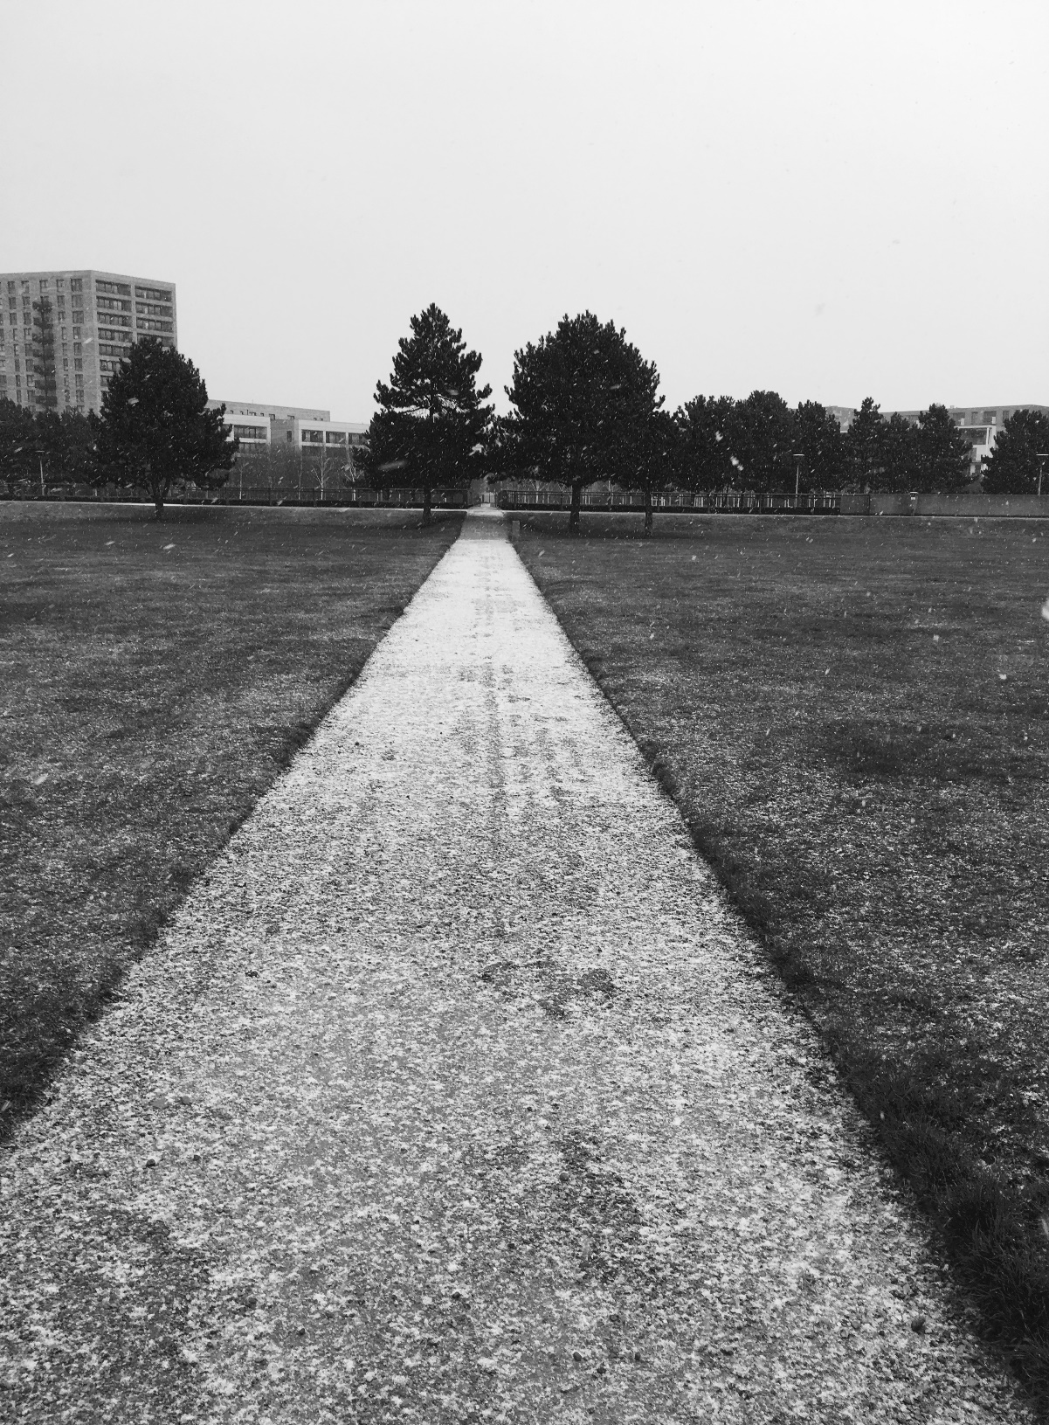
Where are we on our publication journey?
Team ice breaker
Favourite sandwich
Have you presented at a conference before?
Favourite film
If you had to get stuck in a lift with someone who would it be?
What causes you the most anxiety when you are presenting to an audience?
Have you had worked published?

Slide 6

Where are we on our publication journey?
Team ice breaker
Favourite sandwich
Have you presented at a conference before?
Favourite film
If you had to get stuck in a lift with someone who would it be?
What causes you the most anxiety when you are presenting to an audience?
Have you had worked published?

Slide 7
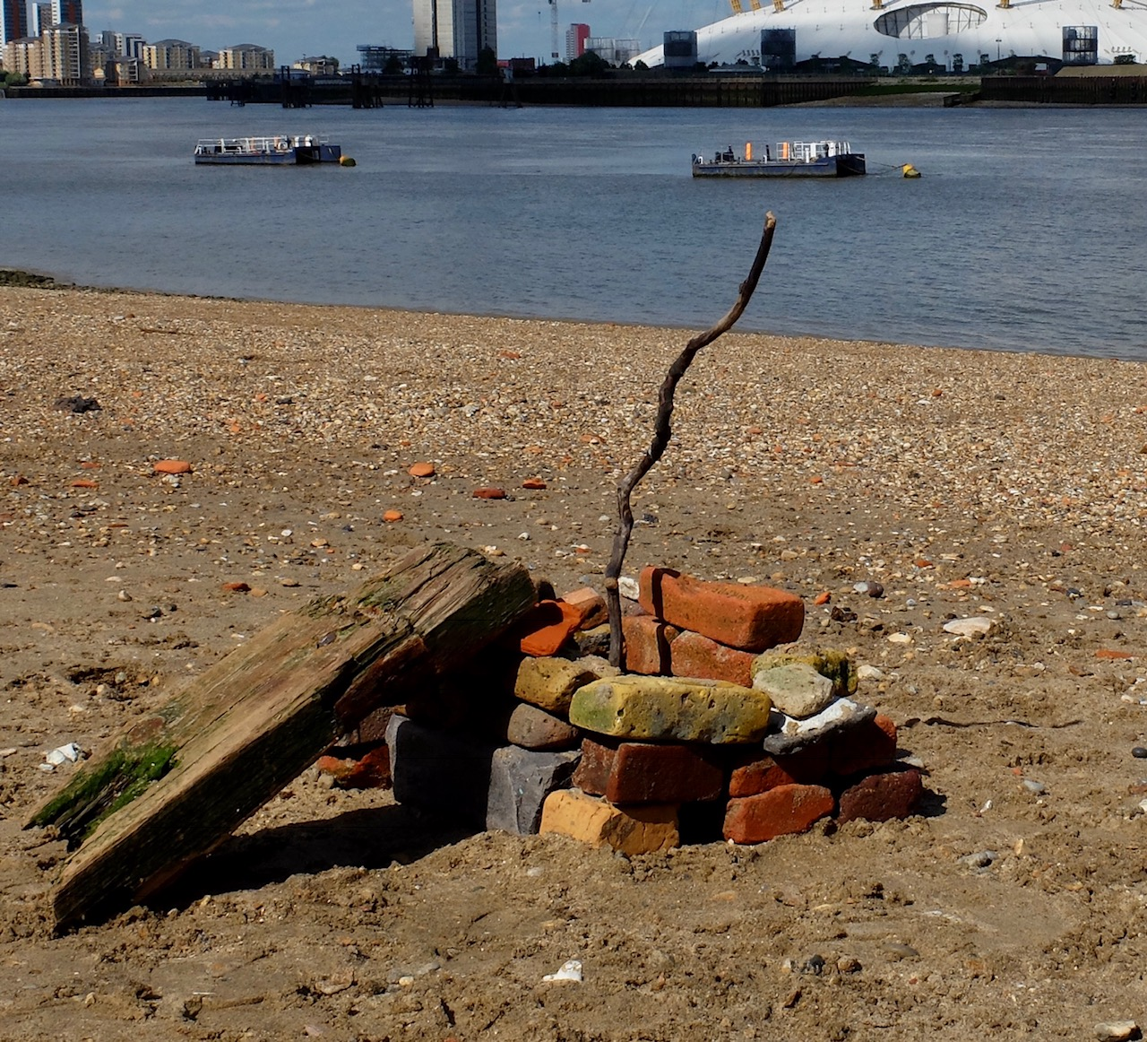
Coloplast® Professional
How to write an abstract
Notes:
Welcome to a masterclass on the challenges that living with an outward body profile poses – and a discussion on how to help solve some of these.

Slide 8
Writing an abstract
Writing a good abstract is a sophisticated skill
Writing an effective abstract will improve
  the chances of your manuscript being accepted
  encourage people to read it
  and increase its impact

Slide 9
There’s more to abstract writing than meets the eye!
What is an abstract?
What isn't it?
Abstract submission form
How long?
What should it include?
Writing style
Why
How
What you found
Conclusion
Check sheet for success

Slide 10
What should it contain?
A concise and clear summary of:
What you set out to do and why
How you did it
What you found or think
Recommendations
Be capable of being read or understood independently of your paper or presentation

Slide 11
What it isn't!
It is NOT:
An introduction – its purpose is to summarise not introduce
A plan to which your report or presentation is written – it is written last to summarise what your report or presentation contains
Extracts from your main presentation or paper

Slide 12
Abstract submission form
1. Submitter Information
Name
Institution
Address
Phone # Email
2. Abstract Submission Details
Title of Abstract
Authors & Affiliations (Surname + Initial)
Oral/Poster
3. Abstract (max. 300 words)
300 words will be adequate provided you write concisely & are summarising, not re-writing the contents of your presentation
Electronic databases automatically truncate abstracts beyond a certain length so keywords associated with your results, conclusions or recommendations may be omitted. (e.g. MEDLINE truncates everything beyond 400 words.)

Slide 13
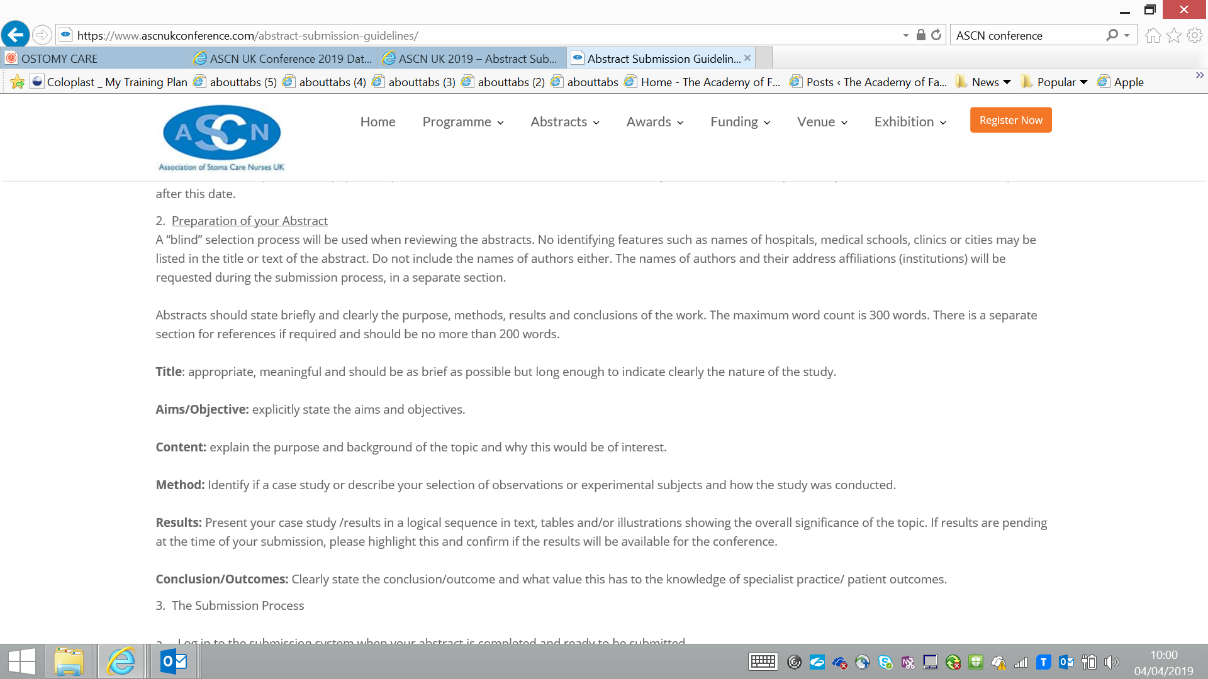
ASCN submission process

Slide 14

WCET/ASCN Abstract guidelines
The abstract length must be a minimum of 200 words and a maximum of 300 words, anything more than 300 words will not be reviewed.
Abstract titles should be short, but informative, indicating key points. Supplemental materials (photos, articles or reports) are prohibited.
During submission you will be asked to indicate your preference of presentation (oral/poster), if the work has been presented before, and any conflict of interest must be given.
The primary/submitting author will receive an email message confirming receipt of the abstract, and must keep co-authors informed and updated.

Slide 15
What should it include?
Title – The title is important, short attention catching titles are the most effective.
But the title describes the subject you are writing about. You should limit the length of the title to no more than 12 words
Purpose – Why
Methodology – How
Results and conclusions – What you found
Avoid the use of the personal pronouns "I" & "We“
An abstract should not normally contain references
Use the present tense to describe results & conclusions

Slide 16
Why
How
What
Why did you undertake the case study/audit?
Big picture problem or topic widely debated in your field
Gap in the literature on this topic
Lack of consistency in patient management
Your project fills this gap “My paper addresses the issue of xx with special attention to xxx”
What did you do?
Audit
Case history
Review of the literature
Research study
What did you find?
State specific outcomes & draw conclusions
Strong Conclusion! (“In conclusion, this project, by closely examining xxxxx, sheds new light on the rarely acknowledged issue of xxxxx”)

Slide 17
Group discussion
What ideas come to mind?
Pick 1 idea & outline an abstract together

Slide 18

Writing a presentation
Key points in preparing a presentation
Managing presentation nerves
What's the purpose of the presentation?
What is the structure of the presentation?
Who is the audience?
How can I deliver my talk confidently?
What strategies can help me handle questions?

Slide 19
What is the purpose of the presentation?
Clear
Focussed
Is your presentation to inform, persuade, entertain, demonstrate?
What should the presentation include & omit?
You can’t cram everything in!
Introduction –tell them what you are going
to tell them
Main body –tell them
Conclusion –tell them why what you
told them is important to them

Slide 20
Less is more

Slide 21
Introduction
Tell them who you are and why you are giving the presentation
Tell them what the presentation is about
Tell them what your objectives are
Tell them what the background to the presentation is
Tell them what they will gain from listening to you!

Slide 22
Main body
Give the details of your project in a logical and smooth order
Use anecdotes and real examples to illustrate your points
Tell the audience how this information applies to them
Back up the claims you made at the start

Slide 23
Conclusion
Summarise your key points
Remind the audience of how this can help/support their practice
Give them your contact details in case they require further information
Invite questions
Say thank you

Slide 24
Handling questions
Difficult –not a mind reader!
But you can prepare
Look through your presentation and identify the key messages and think of questions that could be asked on each point
Never bluff, if you don’t know say
‘that’s an interesting question, unfortunately I can’t answer it but perhaps a member of the audience might be able to contribute’

Slide 25
Body language
DO:
Stand up straight & face the audience
Hold your head high, chin up
Use your hands to reinforce & emphasise a point
Vary your gestures
Nod you head & smile to emphasise your point
Make eye contact
Don’t:
Shuffle your feet & sway
Constantly rub an eye, nose or ear
Keep clearing your throat
Clench your hands or point
Cross your arms
Continuous eye contact or stare

Slide 26
Writing for publication
How do we get an idea, a case study, an audit, a service development on paper and in front of the right audience?
What's the purpose of the paper?
What is the structure of the paper?
Who is the audience?
How can I make sure my message is clear and impactful ?
Understanding the submission process

Slide 27
Why publish?
Get your voice heard
Advance your career
Share your expertise/perspective
Professional responsibility to enhance the knowledge base of our speciality
Barriers to publishing
Lack of confidence
Inexperience
Lack of support
Not understanding the process
Fear of criticism /rejection

Slide 28
What can I publish?
Original research
Written in classic research style:
Abstract
Introduction
Literature review
Aims
Method Results/findings
Discussion
Conclusion
Description of practice
An article that describes logically & informatively a:
particular nursing procedure
the work of a ward or unit
the role and function of a nursing post or specialty.
The relevance of this work to other nurses should be discussed
      Literature review
This is a thorough & comprehensive review of current writing on a particular aspect of nursing.
Up-to-date referencing is essential
A strong conclusion is essential to bring the subject together
Implications for practice need to be explicitly stated – that is, how is this relevant to readers?
Case study
Case studies are a form of evidence on their own
Or can be used to introduce or illustrate specific points in an article
You will anonymise the case study but you should get permission from the subject for publication

Slide 29
Demystifying the writing process
Preparation
Nail your topic
Who is your audience?
What journals do they read?
A great way to understand how to write for publication is to read a selection of articles published in the journal
Read the submission guidance for authors
It’s a straight forward task when approached in an organised manner
It’s a skill which can be learnt

Slide 30
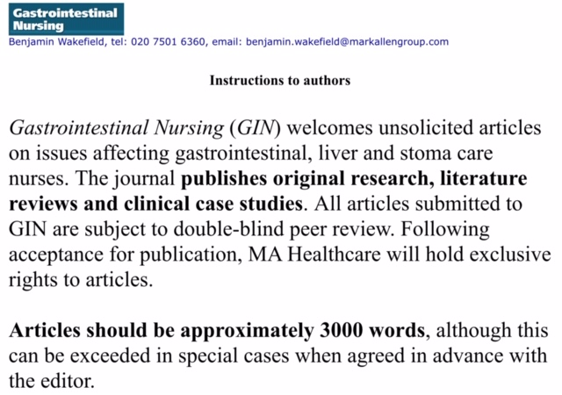
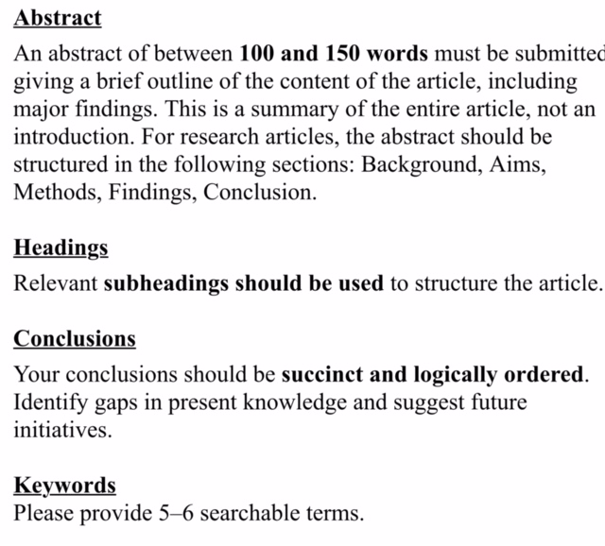

Slide 31
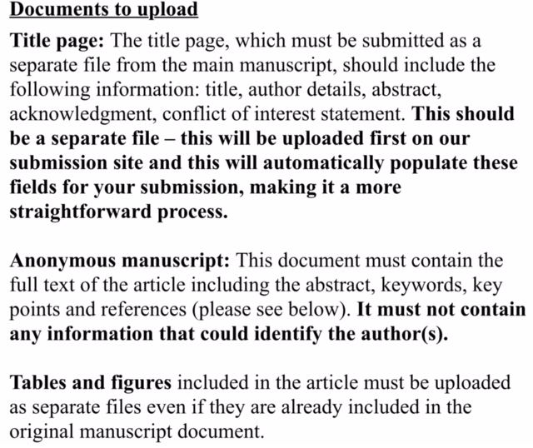
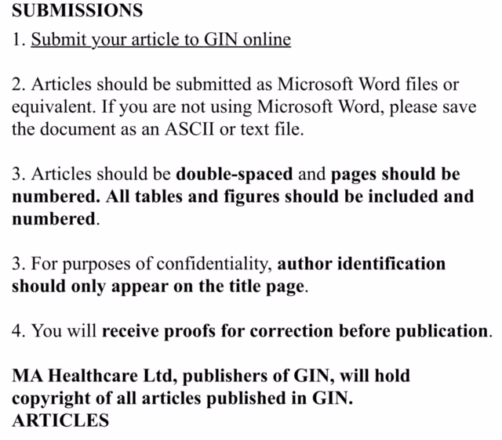

Slide 32
Demystifying the writing process
Planning the outline
Do your headings
Get the logical flow right
Background
Main body of work
Can be subdivided
Findings/outcomes/learning
Conclusion
Writing phase
Do one section at a time
Write the abstract at the end
Ask a non nurse friend to read it
Ask nurse colleagues to read it
Don’t over format the article

Slide 33
Abstract Writing -Check sheet for success
Does the abstract say how the research was/is being undertaken?
Does the abstract indicate the value of the findings & to whom will they be of use?
Does the abstract describe the work to be discussed in the paper?
Does the abstract give a concise summary of the findings?
Does the abstract conform to the word limit of 300 words?

Slide 34
Terri's top tips for a polished presentation
Voice –how you say it is as important as what you say
Body language –positive, pleased to be there, enthusiastic
Appearance- dress appropriately but in an outfit you feel confident in
Never read from a script
Keep to time
Speak clearly & don’t rush, deliberately pause at key points
Don’t wave your hands about too much
Look at the audience as much as possible
Enjoy yourself
Always say thanks you’ve been a great audience
gbtpo@coloplast.com

Slide 35
6 steps to conquering your nerves
Structure your presentation –don’t try and memorise word for word, so it gives you a clue as to what is coming next!
Have a set of key phrases listed on a cue card
Prepare, prepare, prepare –decide what you are going to wear, be early, have a backup, prepare responses to potential questions
Know your audience – do they want to hear what you have to say? Do you know what their key concerns are? Consult with your peers
Know your material –don’t cram everything in, key pertinent points!
Practice, practice, practice –not to memorise but to be comfortable in your delivery

Slide 36
Group comments/thoughts/feedback

