Slide 1
A randomised controlled trial of transanal irrigation versus conservative bowel management in spinal-cord injured patients
Christensen P, et al. Gastroenterology 2006;131:738–747

Slide 2
A randomised, controlled trial of TAI versus conservative bowel management in SCI patients
Intervention:
TAI with Peristeen vs. conservative bowel management (best supportive care without irrigation)
This is the largest randomised controlled trial ever conducted for TAI, providing some of the most robust data supporting the benefits of Peristeen over conservative bowel management in patients with SCI
Christensen P, et al. Gastroenterology 2006;131:738–747
Notes:
This study was a prospective, multicentre, randomised controlled trial lasting 10 weeks that compared transanal irrigation (TAI) using Peristeen with conservative bowel management (defined as best supportive care without irrigation)

Slide 3
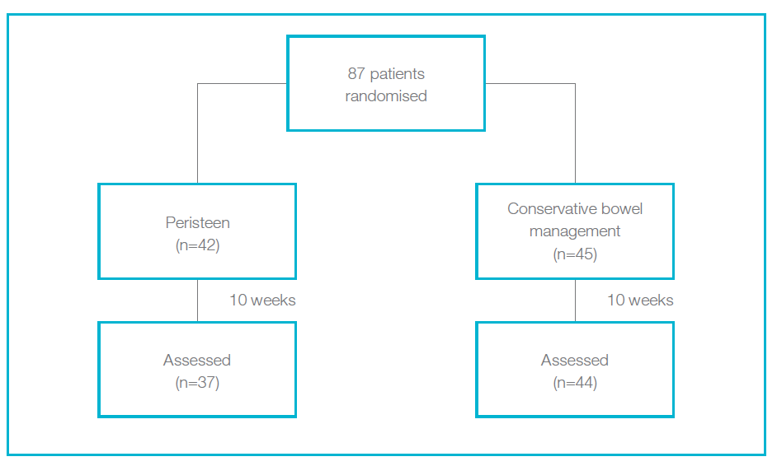
Study design
    Large prospective, multicentre, randomised controlled trial
  Patients
  87 SCI adults
  Lesion complete (n=48); or incomplete (n=39)
  74% T9 or above injury
  Predominant symptom: constipation (n=66); faecal incontinence (n=17); or other (n=4)
Christensen P, et al. Gastroenterology 2006;131:738–747
Notes:
The study enrolled 87 adult with spinal cord injury (SCI), including two individuals with spina bifida, 48 of these individuals had complete lesions and 39 had incomplete lesions. The predominant symptom was constipation (n=66). Seventeen individuals experienced faecal incontinence and four reported other symptoms

Slide 4
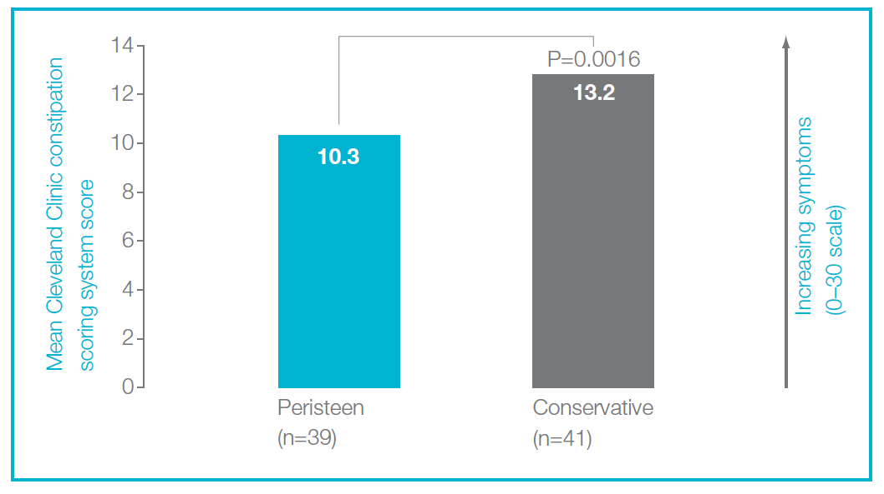
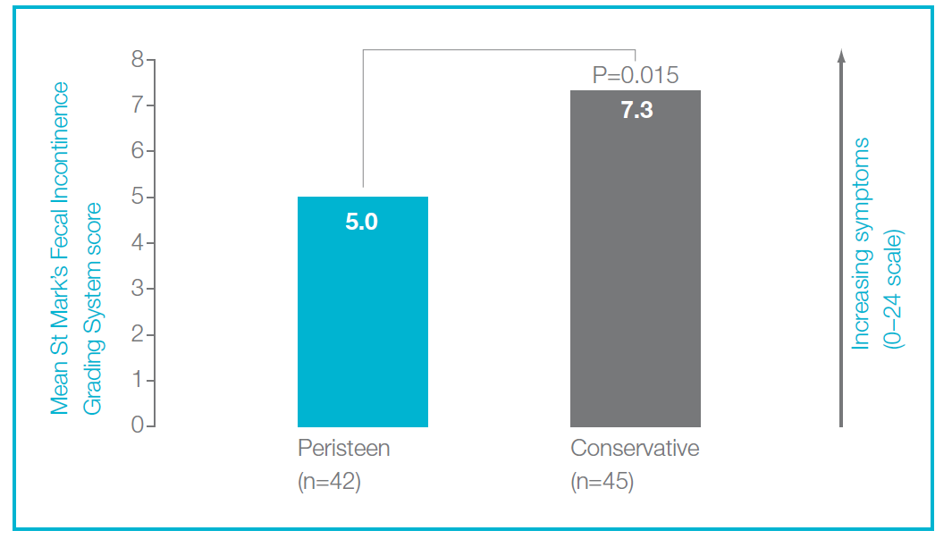
Peristeen® significantly reduced symptoms of constipation and faecal incontinence vs. conservative bowel management
Christensen P, et al. Gastroenterology 2006;131:738–747

Slide 5
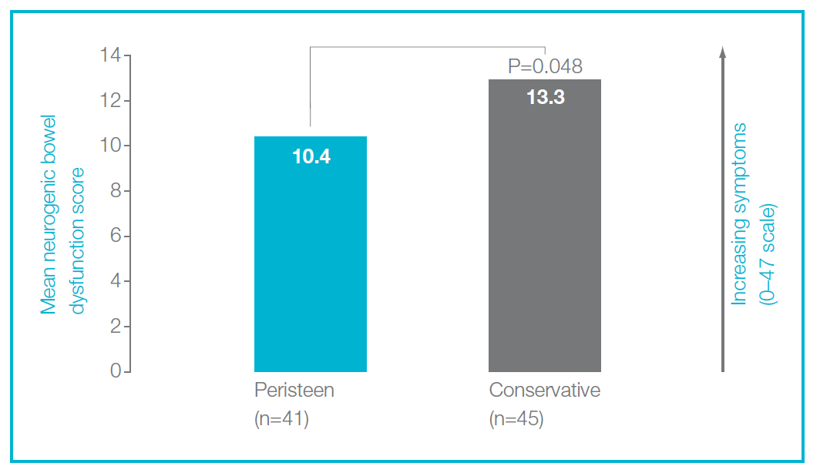
Peristeen® significantly reduced symptoms of NBD vs. conservative bowel management
Note: for more information about NBD score refer to the NBD score brochure
Christensen P, et al. Gastroenterology 2006;131:738–747
Notes:
The benefits of Peristeen over conservative bowel management included significantly reduced symptoms of NBD (P=0.048), including constipation (P=0.0016) and faecal incontinence (P=0.015)

Slide 6
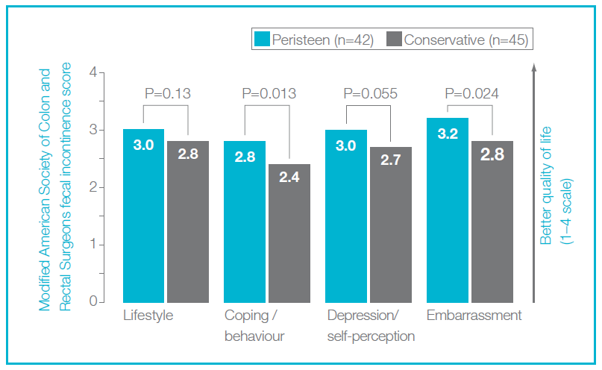
Peristeen® improved symptom-related QoL vs. conservative bowel management
Christensen P, et al. Gastroenterology 2006;131:738–747

Slide 7
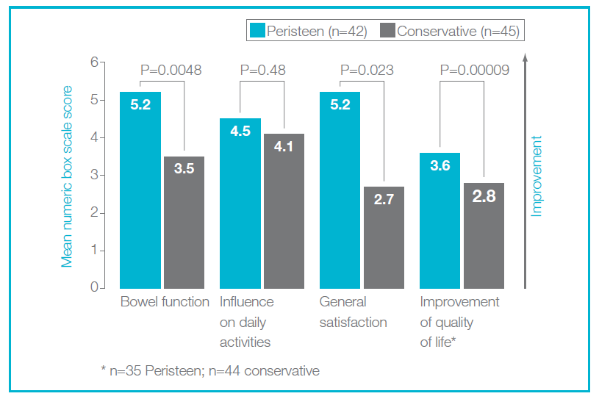
Peristeen® improved bowel function, general satisfaction and QoL vs. conservative bowel management
Christensen P, et al. Gastroenterology 2006;131:738–747
Notes:
Peristeen was associated with improved bowel function (P=0.0048), general satisfaction (P=0.023) and improved quality of life (P=0.00009) compared with conservative bowel management

Slide 8
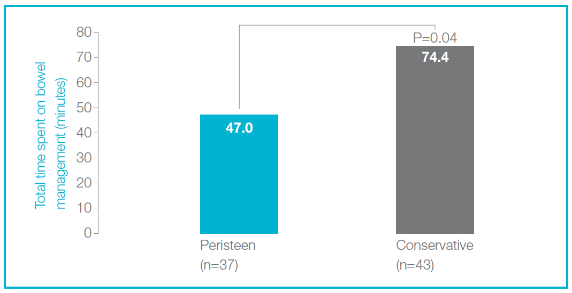
Peristeen® reduced daily time spent on bowel management vs. conservative bowel management
Improvement
Christensen P, et al. Gastroenterology 2006;131:738–747

Slide 9
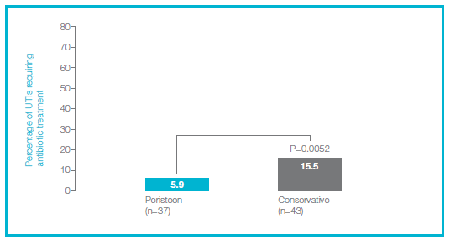
Peristeen® has a good safety profile
Subjects using Peristeen experienced:
  Fewer UTIs requiring antibiotic treatment than patients using conservative
  bowel management
  Few and only mild side effects
  Less frequent symptoms of autonomic dysreflexia than with conservative
  bowel management (17.3 vs.30.0%, P=0.099)
Improvement
Christensen P, et al. Gastroenterology 2006;131:738–747
Notes:
Peristeen has a good safety profile; subjects using Peristeen experienced:
Fewer UTIs requiring antibiotic treatment than patients using conservative bowel management (5.9% vs. 15.5%, respectively; P=0.0052)
Few and only mild side effects: only four patients reported adverse effects using Peristeen, none was considered serious or related to irrigation
Less frequent symptoms of autonomic dysreflexia (sweating, headache, flushing, or pronounced general discomfort) than with conservative bowel management (17.3% vs. 30.0%, respectively; P=0.099); with no serious episodes of autonomic dysreflexia reported

Slide 10
Summary: Peristeen’s significant benefits over conservative bowel management
Data from the largest trial of TAI to date support the benefits of Peristeen over conservative bowel management, both in terms of efficacy and safety
Evidence from this study suggests a positive benefit for subjects using Peristeen in terms of significant time saved on bowel management,
freeing-up nearly 30 minutes a day, and improved QoL
Return to index
Christensen P, et al. Gastroenterology 2006;131:738–747

