Slide 1
Anatomy of the Urinary System

Slide 2
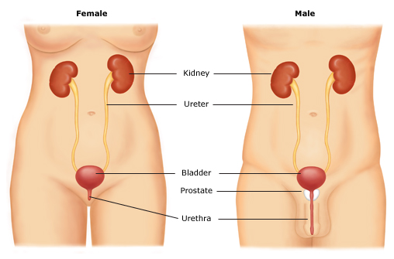
The Urinary System
Notes:
The main function of the urinary system is to make, store and remove urine from the body. The urinary system comprises the kidneys, ureters, bladder, urethra and urethral sphincter muscles.
Urine is produced in the kidneys, and flows from the kidneys into the bladder via the ureters. The bladder stores urine until the urethra carries it out of the body. This flow, from the bladder to the urethra, is controlled by the urethral sphincters, which open and close the bladder outlet. The sphincters, in turn, are controlled by the pelvic floor muscles. The healthy bladder expels urine in a controlled, usually voluntary fashion, and the average person urinates 4-8 times a day

Slide 3
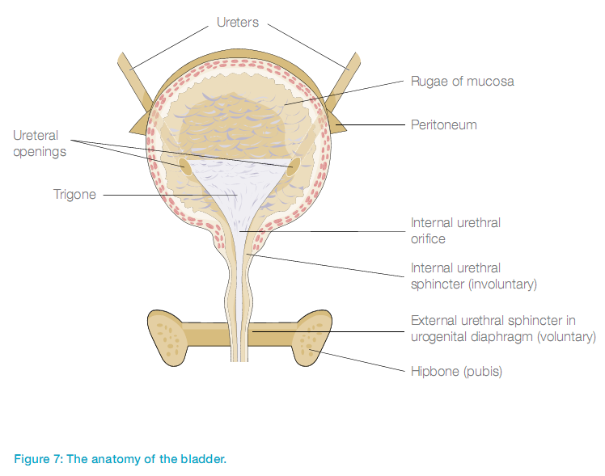
Bladder and Urethra
Intro to the Urinary System
Notes:
The bladder is a hollow muscular sack that can hold up to 700–800ml of urine that is produced by the kidneys prior to disposal by urination via the urethra. The internal and external urethral sphincter muscles control the retention and release of urine from the bladder. The internal sphincter is part of the muscular bladder wall and prevents urine from entering the urethra. This sphincter cannot be controlled voluntarily by the brain. The external sphincter is a layer of muscle that provides a second means of preventing the release of urine, and is under voluntary control.
Bladder activity is regulated by the central and peripheral nervous systems. You feel the need to urinate when the stretch receptors in the bladder tell the brain that the bladder is full. However, with bladder dysfunction, you may not be able to inhibit the urge to pass urine. Problems with the bladder may result in urinary incontinence or urine retention.

Slide 4
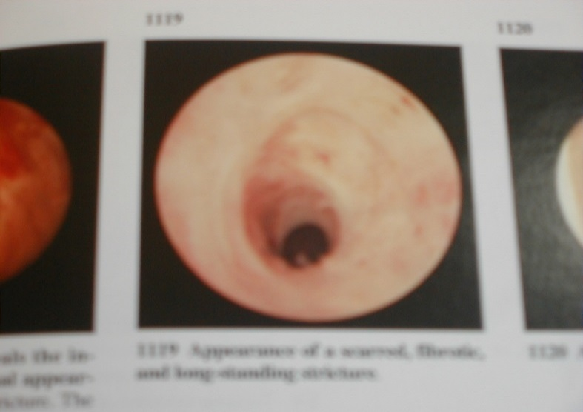
Male Urethra
Approx 17 – 20cms long
Lined with blood vessels which can bleed with trauma
Can scar with trauma
Prostate sits below bladder entrance and may cause some difficulty in catheterisation if enlarged due to age of patient.

Slide 5
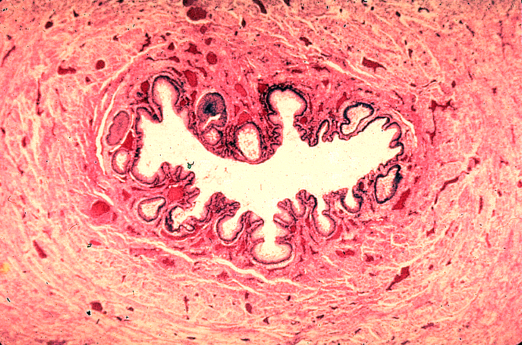
Female Urethra
Between 3 – 5 cms long
Folded internal surface which provides an environment for bacterial growth
Close proximity to the rectum causes increased risk of contamination
Becomes dry post – menopause therefore needs lubricating during catheterisation.

Slide 6
Normal Function of the Lower Urinary Tract
  To collect urine produced by the kidneys
  To store it under safe conditions; low pressure
  To empty when it is appropriate

Slide 7
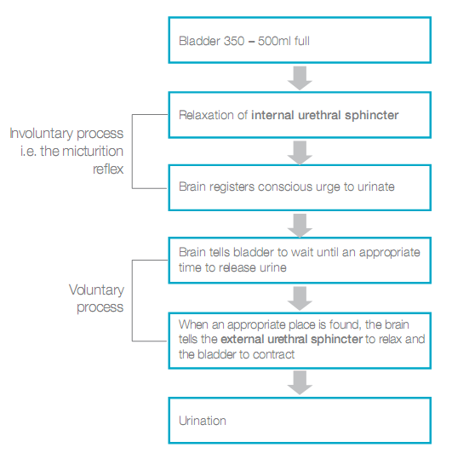
The Process of Urination
Notes:
The ‘micturition reflex’ is activated when the urinary bladder wall is stretched. When the bladder contains 350–500 ml of fluid, the internal pressure within the bladder becomes strong enough to activate stretch receptors in the bladder wall. Sensory signals are sent from the bladder to the sacral region of the spinal cord, and back to the bladder, resulting in an involuntary relaxation of the internal urethral sphincter. Sensory signals are also sent via the spinal cord to the brain, informing that the bladder is ready to be emptied. This results in a conscious feeling of needing to urinate. Under normal circumstances, the brain sends a signal back to the bladder, via the spinal cord, preventing urination until a convenient time, e.g. a toilet has been reached. Urination occurs when the conscious urge to urinate is followed by voluntary relaxation of the external urethral sphincter in conjunction with contraction of the bladder.

Slide 8
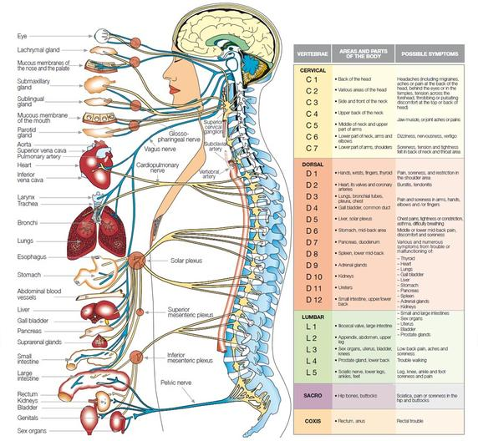
The Spinal Cord and Micturition
Intro to the Urinary System
Notes:
The spinal cord is a circular bundle of nerves about the thickness of a finger, which runs through the centre of the spinal column that comprises the stack of 26 bony vertebrae. The spinal cord consists of millions of nerve fibres that transmit electrical information to and from the limbs and organs of the body, back to and from the brain.
The spinal cord and vertebrae are grouped into five regions (cervical, thoracic, lumbar, sacral and coccyx). Spinal nerves (also called nerve roots) exit at different levels of the spinal cord, by passing out through a hole in each of the vertebrae, and control specific areas of the body (see image on the right-hand side of slide). The cervical region* of the spinal cord (C1–8) supplies the arms, neck and upper body; the thoracic region supplies the chest and abdomen; the lumbar region supplies the lower limbs, bladder and bowel; and the sacral region also supplies the bowel and bladder, as well as the sexual organs. The coccyx region has no major nervous function in humans.
*Note: there are seven cervical vertebrae but eight cervical nerves.

Slide 9
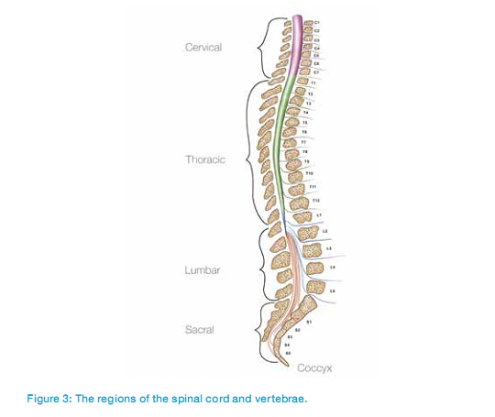
The Role of Spinal Nerves
Increase the storage capacity of the bladder
    Thoracic and lumbar levels (T11–L2)
Relaxation of the internal urethral sphincter and contraction of the bladder wall
    Sacral level (S2–4)
Voluntary control of external urethral sphincter
    Sacral level, specifically the pudendal nerve
Notes:
The nerves responsible for increasing the storage capacity of the bladder originate at the thoracic and lumbar (T11–L2) regions. The nerves responsible for causing relaxation of the internal urethral sphincter and contraction of the muscular bladder wall originate from the sacral (S2–4) region. The spinal nerve responsible for the voluntary (i.e. conscious) control of the external urethral sphincter is called the pudendal nerve and originates from the sacral region. Damage to the spinal cord prevents the brain receiving vital sensory information – resulting in problems with urinary continence. Module 2 provides more information on the role of SCI and bladder dysfunction.
Key message: as most of the nerves controlling the function of the bladder is placed at the sacral level most people with SCI will expirience bladder problems

