Slide 1
Bowel assessment

Slide 2
Bowel Assessment : What is required?
Hospital: Colorectal nurse / Continence Nurse or physio / Stoma care Nurse
Colorectal surgeon or gastroenterologist
Bowel assessment tool
Community: Continence Advisor / GP / District Nurse
GP to prescribe
Bowel assessment tool

Slide 3
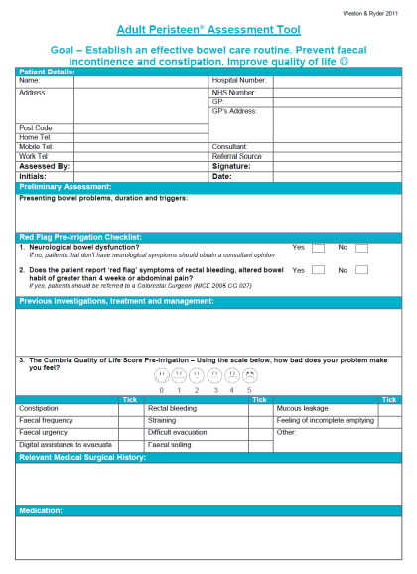
Peristeen Assessment tool
For all new patients starting on Peristeen
Can be used in clinic or the community
Stored in patients notes
Clinical record of training and follow up

