Slide 1
Consensus review of best practice of transanal irrigation in adults
Emmanuel A et al, Spinal Cord 2013
Notes:
After 10 years of practice and clinical papers delivered, in 2013…
More than 20 studies were included

Slide 2
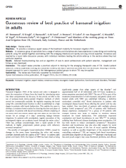
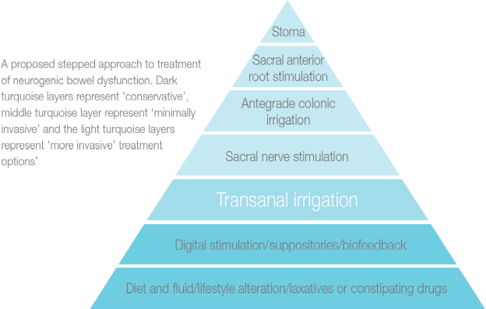
Best practice: 2013 Expert consensus review
Objective A consensus expert review of the treatment modality of transanal irrigation (TAI).
Methodology Collaborative effort of 12 specialists with TAI experience, to assimilate clinical expertise and literature.
Result TAI is the next recommended treatment following conservative treatment of NBD patients. Patient selection should take clinical history and indications/contraindications into account . Supervised training by experienced HCP and follow-up are key to optimizing outcome.
Spinal Cord 2013; 51(10)
[OPEN ACCESS PAPER]
The NBD step-wise
bowel approach
Symptoms that trigger consideration of onward referral
Indications to TAI met
‘More
invasive’
.
.
No contraindications to TAI
Clinical examination & preparation
.
‘Minimally
invasive’
Patient training for TAI
1st follow-up
‘Conservative’
Subsequent follow-ups
Successful treatment
= continue
Unsatisfactory response
= consider alternatives
Notes:
Hand out copy of consensus review
Briefly summarize the consensus paper results and the pyramid. This is a validation of the TAI method, and a recommendation that TAI should be considered at an early time when conservative treatment fails.

Slide 3
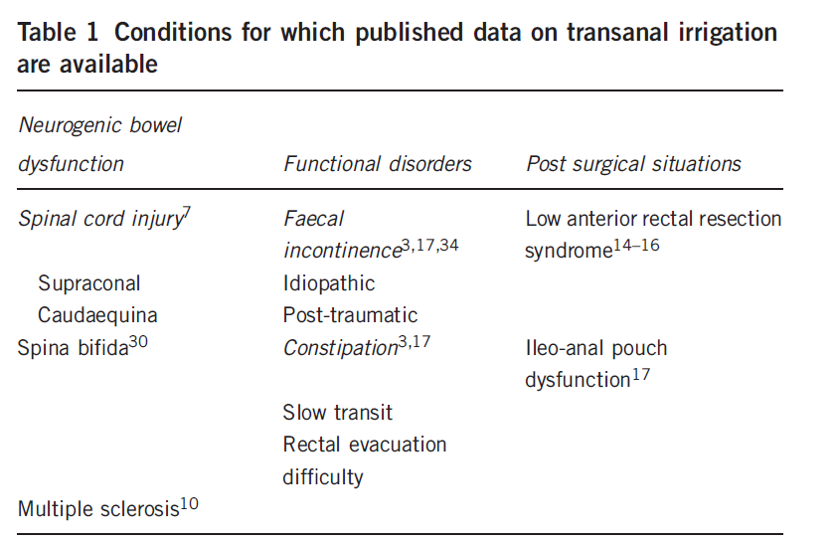
Summarises the situations in which TAI has been shown to improve bowel function in published studies
Notes:
Wider panorama respect the usual use of Peristeen, not only Neurological but also Functional and Post surgery patients

Slide 4
Patient selection and training
Training of the patient is central to a safe and efficient long-term use of TAI
“The hands-on training process should be supported by written information, and may be supplemented by online information provided by the manufacturer…”
“Information should include explanation of risks as well as patient benefits. Informed verbal consent to commence TAI should be documented in the medical chart before hands-on use of the irrigation system…”
“Some patients may require support and training during several episodes of TAI before they are confident to continue alone…”
Notes:
Dati interni confermano che i pz non addestrati hanno un tasso d’abbandono del 50% mentre per coloro che effettuano un corretto addestramento la compliance è quasi del 90% . Addestramento fondamentale per aumentare la retention! E questo è confermato anche dallo studio, dal quale per la prima volta emergono dei dati che riguardano anche l’aspetto pratico di Peristeen,per quanto riguarda il primo colloquio con il paziente, il momento del primo incontro con il paziente, emerge infatti la necessità di effettuare l’ addestramento a PAI con un professionista sanitario esperto e, per la prima volta, finalmente si parla di preparazione intestinale!lo studio infatti dice di escludere la presenza di una massa fecale eccessiva nell’intestino effettuando una preparazione intestinale adeguata. Per noi questo ha un grandissimo valore perché rappresenta la prima base scientifica in merito alla necessità della preparazione intestinale prima di Peristeen.

Slide 5

Follow up: the key for the success
Primary education and training is central to long-term adherence with TAI, this needs to be supplemented by ongoing support. To maintain a safe long-term use of TAI, it is essential that a designated health-care professional provides structured follow-up of the patient
…may be by telephone, e-mail, postal questionnaires or in person, according to local services. Follow-up needs to be frequently scheduled after treatment onset, and can be gradually reduced thereafter

Slide 6
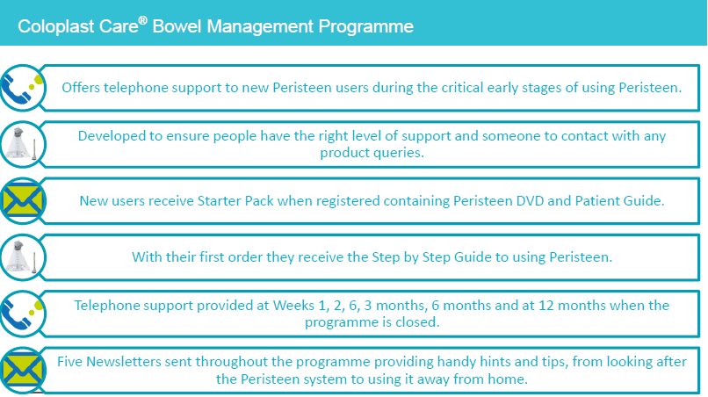
Peristeen Package includes the Bowel Management Programme

Slide 7
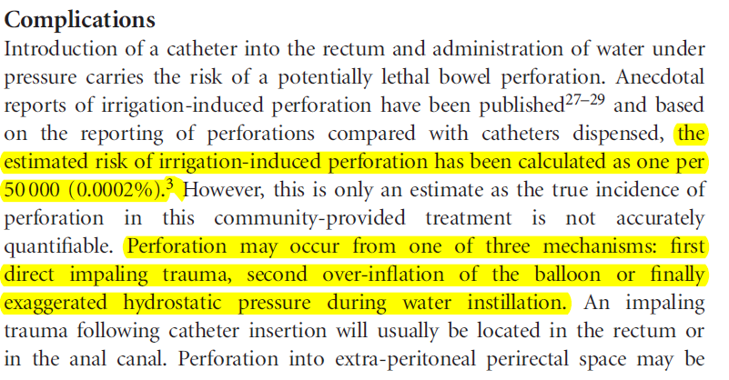

TAI and perforation rate
Previously reported estimated risk of perforation was 1: 50.000 (0,0002%)

Slide 8
TAI and diagnostic
According to general recommendations, patients with any alarm symptoms (blood in faeces, weight loss, abdominal pain, or recent and persistent changes in bowel habits), familial history of colorectal cancer or inflammatory bowel disease, should have a flexible sigmoidoscopy or colonoscopy as part of their health screening. It is controversial whether patient should have endoscopic evaluation before irrigation treatment.
Perforation rate
Colonoscopy: 1: 1000
Flexible Sigmoscopy: 1:40.000

