Slide 1
Continence Management Solutions

Slide 2
Management Solutions IC
Management Solutions
Some conditions can cause urinary retention or may completely prevent the bladder from emptying and require catheterization.
Some conditions can cause urinary incontinence in which case a collecting device (urisheath and bag) offers a comfortable solution for men.

Slide 3
Bladder management methods
Management Solutions
Reflex/manual stimulation
Indwelling
Suprapubic
Catheter
Indwelling
Urethral Catheter
ISC
Collecting Devices

Slide 4
Reflex Voiding
Reflex voiding is a bladder management option that works through stimulation
Crede maneuver: Compression of suprapubic area downward using both hands in order to press bladder body. This maneuver obviously requires adequate hand control.

Slide 5

Reflex Voiding /Crede Manoeuver
Rationale for use
Non-invasive treatment
It’s a way of avoiding having to put a catheter in the bladder which has a higher potential for infection.
Rationale for not use
Not supported by guidelines
Requires a urodynamic evaluation to determine if bladder and sphincter are working well enough to use
Make sure that bladder can be emptied sufficiently
Risk of sending urine back to the Kidneys (Kidney failure)
The high pressures cause reflux into the upper urinary tract with all known complications (Crede) http://ngbladder.org/treatments/2-A.asp
Requires use of an external condom - Male only
Needs to be monitored closely

Slide 6
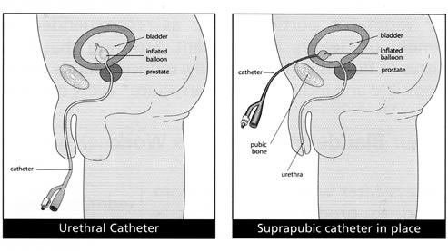
Indwelling Catheterisation
Management Solutions
Any catheter which is inserted into the bladder and allowed to remain in the bladder is called an “indwelling” catheter
A) The urethral catheter is inserted through the urethra.
B) Suprapubic catheter (tube) drains urine from your bladder. It is inserted into your bladder through a small hole in the abdomen.

Slide 7
Indwelling Catheterisation
Rationale for
Alternative when ISC is not working (short term only)
Indwelling catheterization is used in any individual with acute central nervous system trauma because it allows precise monitoring of urinary output
Successful indwelling catheterization does not require bladder contractions, nor does it require coordinated action of the sphincter mechanism
Drains the bladder

Slide 8
Indwelling Catheterisation
Rationale against
Not supported by guidelines
Indwelling transurethral catheterisation and, to a lesser extent, suprapubic cystostomy are significant and early risk factors for UTI and other complications
Invasive – surgery is needed (Suprapubic)
Complications - should be used only exceptionally, under close control and in line with best practice guidance

Slide 9
How-to Guide:
Prevent Catheter-Associated Urinary Tract Infections
‘the duration of catheterization is directly related to risk for developing a urinary tract infection.’
‘With a catheter in place, the daily risk of developing a urinary tract infection ranges from 3% to 7%. ‘
‘When a catheter remains in place for up to a week, bacteriuria risk increases to 25%; at one month, this risk is nearly 100%.’
‘Among those with bacteriuria, 10% will develop symptoms of UTI(fever, dysuria, urgency, frequency, suprapubic tenderness) and up to 3% will further develop bacteremia.’
7 Saint S. Clinical and economic consequences of nosocomial catheter-related bacteremia. Am J Infect Control. 2000;28:68-75.
8 Tambyah PA, Maki DG. Catheter-associated urinary tract infection is rarely symptomatic: a prospective study of 1,497
catheterized patients. Arch Intern Med. 2000 Mar 13;160(5):678-682.
9 Saint S, Lipsky BA. Arch Intern Med. 1999.

Slide 10

ISC - Intermittent Self Catheterisation
Rationale for use
Endorsed by medical guidelines as gold standard
Long-term need of bladder management
Drains the bladder effectively
Less invasive compared to Indwelling
Less risk of complications/UTIs
Quality of life
Rationale for not use
Price/lack of knowledge

Slide 11

Guidelines
4.3 Minimal invasive treatment
4.3.1 Catheterisation
Intermittent self- or third-party catheterisation is the gold standard for the management of NLUTD Indwelling transurethral catheterisation and, to a lesser extent, suprapubic cystostomy are significant and early risk factors for UTI and other complications
Rationale: Intermittent catheterisation provides a method of emptying the neurogenic bladder without leaving an indwelling catheter and lessens the frequency of long-term complications

Slide 12
ISC – Intermitant Self Catheterisation
Management Solutions
The average frequency of catheterisations per day is 4-6 times and the catheter size should be 12-14 Fr.
Less frequent catheterisation results in higher catheterisation volumes and a higher risk of UTI
More frequent catheterisation increases the risk of cross-infections and other complications (1,100-103).
Bladder volume at catheterisation should be lower than 400 mL.
Indwelling transurethral catheterisation and, to a lesser extent, suprapubic cystostomy are significant
and early risk factors for UTI and other complications.
Notes:
Incomplete bladder emptying can lead to bladder infection – high intravesicle pressure can cause damage to the upper urinary tract as a result of reflux (Winder 1992)
The frequency of catheterization needed can depend on many factors such as bladder volume, fluid intake, post-void residual and urodynamic parameters (bladder compliance, detrusor pressure). Usually it is recommended to catheterize 4 ± 6 times a day during the acute phase after spinal cord lesion. Some will need to keep this frequency if IC is the only way of bladder emptying. (JJ Wyndaele 2002)

Slide 13
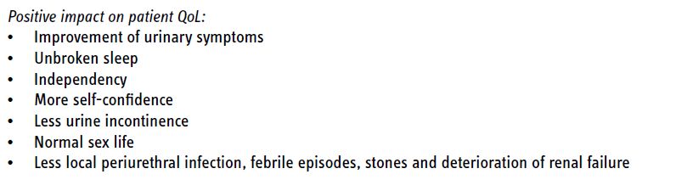
Intermittent Catherisation and impact on QoL
Management Solutions
Notes:
The last new section it the impact of quality of life. It its documentet that IC compared to alternative bladder management methods has a huge physical, psychological and emotional impact on patients and in many instances their partners, caregivers and the whole family. It is clear that patient quality of life is positively affected with IC – Qol consists of many aspects this slide highlights where patients see an improvement

Slide 14




Who may benefit from collecting devices?
Management Solutions
Neurological disorder
Urological disorder
Spina bifida (SB)
Spinal cord injury (SCI)
Multiple sclerosis (MS)
Bladder disease
Prostate disease
Enlarged prostate
(post surgery)
Notes:
Collecting devices are aimed at men with lower urinary tract disorders / urinary incontinence.

Slide 15
Male Bladder Management - Collecting Devices
Urinary Incontinence : Uncontrolled flow of urine
+90% of incontinent people have Stress and/or Urge Incontinence
Main causes are aging, birth , enlarged prostate, prostate and bladder cancer, and neurological disorders
Stress Incontinence is also a major market for Surgical Urology
Urinary Retention : Cannot empty bladder
Mainly SCI, Spina Bifida, and MS *
Main products are Intermittent Catheters & indwelling Catheters & Urine Bags depending on the development of the IC market
X
*

Slide 16
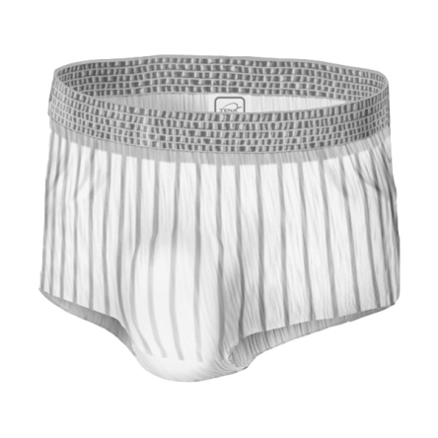
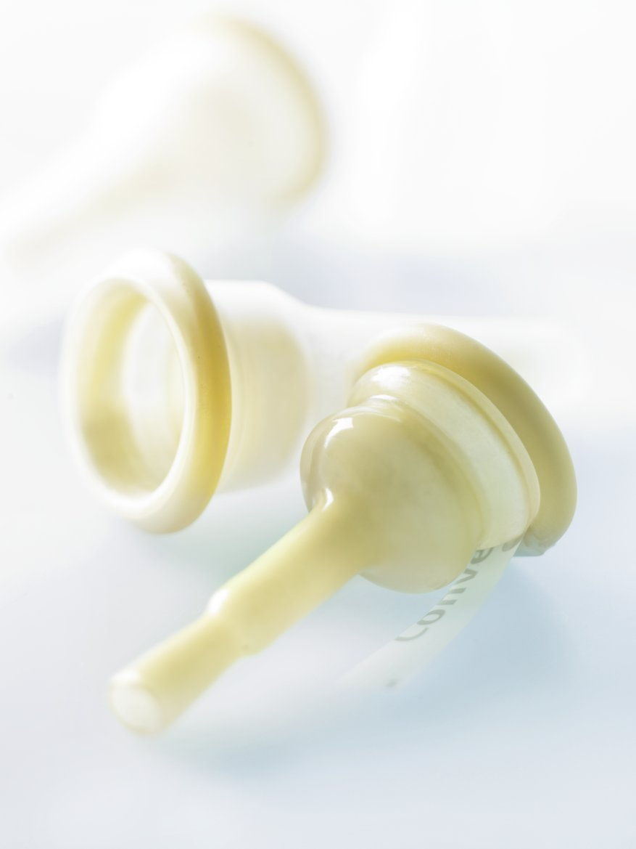
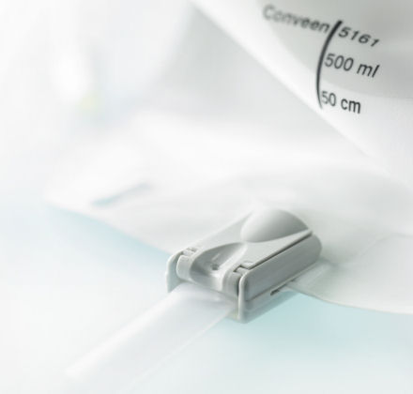

Solutions for management of chronic incontinence in men
Urisheaths & bags
Absorbing products (diapers / pads / protective underwear)
Source: Chartier-Kastler E et al.: Randomized, crossover study evaluating patient preference and the impact on quality of life of urisheaths vs. absorbent products in incontinent men, BJU Int. 2011 Jul; 08(
2):241-7.
Notes:
Use this slide to talk about absorbent products having a place in the management of incontinence but stress the need to be offered a choice and in a number of studies men have reported preferring to use a sheath.

Slide 17
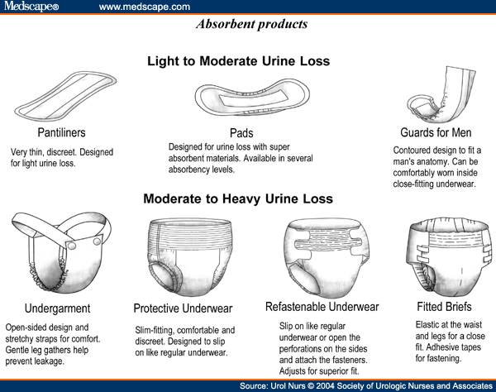
Managing male urinary incontinence with absorbent products
Management Solutions
Typically first choice of management of urinary incontinence:
  Self symptom management
  Post urological surgery
  urinary incontinence management.

Slide 18
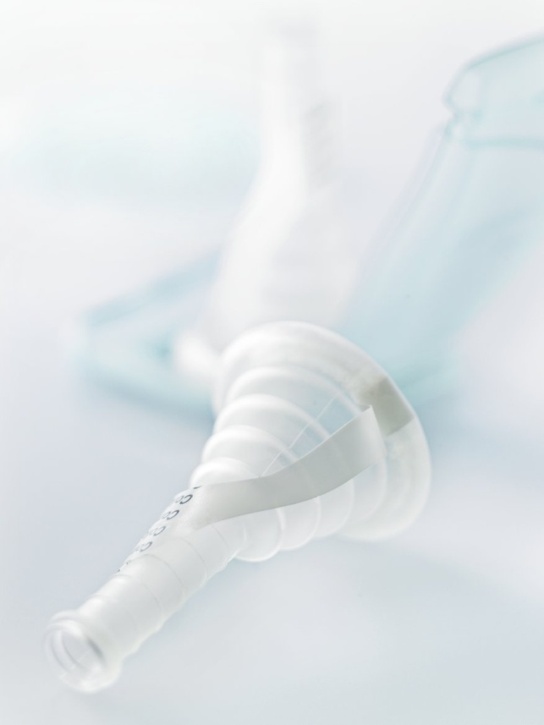
Managing male urinary incontinence with collecting devices
Management Solutions
External urine collection devices are a type of medical product used by men, to manage urinary incontinence. These devices attached to the outside of the male anatomy and direct urine into a separate collection chamber such as a leg or bedside bag.
  EAU guidelines recommends collecting device over absorbent products in men with urinary incontinence (2013)
Notes:
Chartier-Kastler E et al.: Randomized, crossover study evaluating patient preference and the impact on quality of life of urisheaths vs. absorbent products in incontinent men, BJU Int. 2011 Jul; 08(2):241-7.
61 outpatients with stable, moderate to severe urinary incontinence in a randomized control trial (RCT) study tested Conveen Optima urisheaths with bags and their usual absorbent product for two weeks. The two solutions’ impact on QoL was measured and each patient’s preference was recorded.
Main outcome:
Conveen Optima urisheaths showed a positive impact on QoL in moderate to severe incontinent men, who were long-term users of absorbent products, and participants largely preferred urisheaths.
Conveen Optima urisheaths should be recommended to incontinent men in preference to absorbent products.

Slide 19
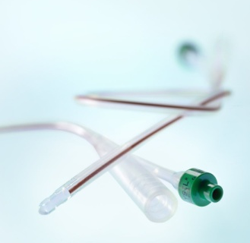
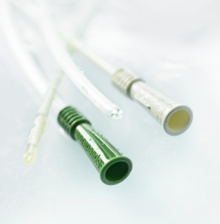
An SCI patient may benefit from different systems
Urisheath + urine bag
Indwelling catheter + urine bag
Intermittent catheter + urine bag

Slide 20

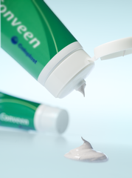
Coloplast offers a full collecting devices portfolio
Urisheaths
Leg bags
Bedside drainage bags (night bags)
Accessories

