Slide 1
ISC Onboarding: Coloplast products and technology
Internal presentation
Notes:
Welcome the group…

Slide 2

The Coloplast Portfolio
The Coloplast portfolio within intermittent catheters help making life easier for people with intimate healthcare needs. We have a full assortment – there is something for all needs (types, sizes, tips)
IC Coated
IC Uncoated
Notes:
[SPEAK]
Introduce the Coloplast Portfolio and the different category of products.
ISC Compact products have the highest level of technology

Slide 3
The SpeediCath® range – Setting the standard
Instantly ready to use hydrophilic coated catheters
Polished and hydrophilic coated eyelets
Superiority of SpeediCath is clinically proven
Preferred by users ⁽¹⁾
Made with PU (Polyurethane) without PVC (Polyvinyl chloride) and Phthalates
Pascoe G et al. Br J. Nus 2001;10:325-329
Notes:
[SPEAK]
Additional product characteristics you can mention about Easicath products
Can be rolled up for up to 3 hours
Shelf life 2 years
Can be connected to any bag
Pascoe study show preference of SpeediCath in terms of Convenience, discretion and speed of use.
Coloplast sales data (GERS, IMS, Assobiomedica, nefemed, PCA 2012/13), also show it is the most preferred catheter in Europe.
Phthalates are a family of chemicals used in plastics and many other products. Phthalates are a group of chemicals used to soften and increase the flexibility of plastic and vinyl. Polyvinyl chloride is made softer and more flexible by the addition of phthalates. Phthalates are used in hundreds of consumer products

Slide 4
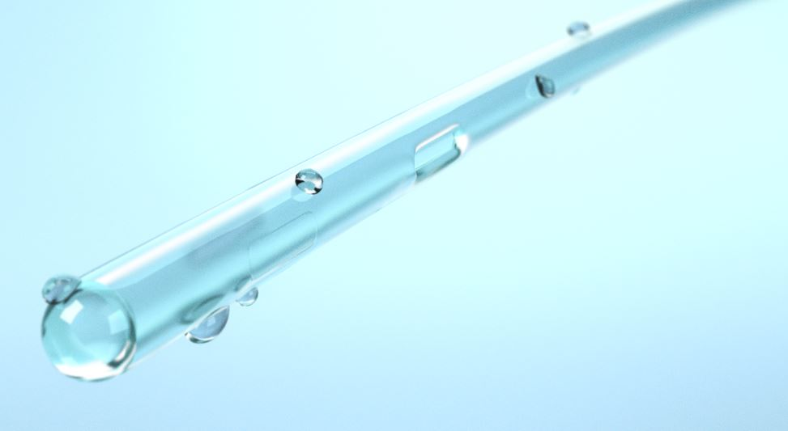
SpeediCath® - Unique Hydrophilic coating
High quality hydrophilic coating with PVP*
Immersed in a sterile saline solution (0,9% NaCl + PVP)
Sterilised by irradiation
Smooth and uniform coating for minimal friction during insertion and withdrawal*
*Stensballe J. et al. European Urology 2005;48:978-983
Notes:
[SPEAK]
PVP= Polyvinylpyrrolidone
PVP is a water absorbent polymer which is able to absorb up to 10 times its own weight. When exposed to water the coating becomes wet and slippery, reducing friction between the catheter surface and the urethral mucosa during insertion.

Slide 5


SpeediCath^{® -} Unique Hydrophilic coating
Minimize risk of urethral damage
Speedicath hydrophilic coating
Competitor hydrophilic coating
Microscopic view
Notes:
[SPEAK]
We can see on this microscopic view how the SpeediCath Coating is uniform compare to other competitor hydrophilic coating.

Slide 6


SpeediCath^{® -} Polished and hydrophilic coated eyelets
Safe and comfortable insertion
SpeediCath® Polished eyelet
Unpolished eyelet
Notes:
[SPEAK]

Slide 7

SpeediCath ^{® -} Clinically well documented
Less urethral trauma and friction
Withdrawal force in Newton, Stensballe et al., (2005)
!
Competitor
hydrophilic coated
0.28
P<0,0001
SpeediCath
0.14
SpeediCath, 2x less friction force compare with a competitor hydrophilic coated catheter
Notes:
[SPEAK]
Objective of the Stensballe Study was to evaluate withdraw friction forces and urethral trauma with SpeediCath vs 2 other competitors products (Lofric and Incare Advance Plus)
It was a Prospective, randomised, participant-blinded, cross over study made in 2006.

Slide 8

SpeediCath ^{® -} Clinically well documented
Reduced incidence of UTIs
% of patients with zero UTIs over 12 months on either uncoated PVC or SpeediCath
!
PVC
gel-coated
18%
SpeediCath
36%
Twice as many patients UTI-free over 12 months on SpeediCath
*De Ridder DJ et al. Eur Urol 2005; 48:991-995
Notes:
[SPEAK]
Objective of De Ridder Study was to evaluate the performance of Speedicath vs Uncotaed catheter for Male SCI.
It was a Prospective, randomised, parallel comparative trial made in 2005.
122 patients included in the study.

Slide 9

SpeediCath ^{® -} Clinically well documented
Reduced number of UTIs during institutional period
Number of UTI/month Cardenas et al.PM R 2011; 3:408-417
!
Uncoatedcatheter
P=0,038
SpeediCath
Twice as many patients UTI-free over 12 months on SpeediCath
*De Ridder DJ et al. Eur Urol 2005; 48:991-995
Notes:
[SPEAK]
Objective of De Ridder Study was to evaluate the performance of Speedicath vs Uncotaed catheter for Male SCI.
It was a Prospective, randomised, parallel comparative trial made in 2005.
122 patients included in the study.

Slide 10

SpeediCath ^{® -} Clinically well documented
Preferred by users*
Direct preference evaluation of catheters – Pascoe G et al. Br J. Nus 2001;10:325-329
Competitor Hydrophilic
coated catheter
22%
 | SpeediCath | Competitor
Convenience | 88% | 12%
Discretion | 88% | 12%
Speed | 76% | 24%
78%
SpeediCath
P=0,011
*All results presented above are statistically significant
Notes:
[SPEAK]

Slide 11

SpeediCath® for Men
SpeediCath Standard
SpeediCath Control
SpeediCath Compact Male
SpeediCath Compact Set
Notes:
Make sure you have all the products with you to show the differences and you also bring Boris for the demo

Slide 12
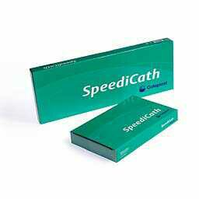

SpeediCath® Standard – The proven and reliable standard catheter for men
Easy opening with ring-pull feature for people with low hand dexterity
Adhesive dot ensures catheter stays in place during preparation
Available in different varieties
  Male – 40cm
  Male Tiemann tip – 40cm
  Boy – 30cm
  Paediatric – 20cm
  From Ch/Fr 6 to Ch/Fr 18
Tiemann tip designed to navigate the male prostatic curve
Notes:
[SPEAK]
SpeediCath comes in Green or White packaging depending on the country

Slide 13
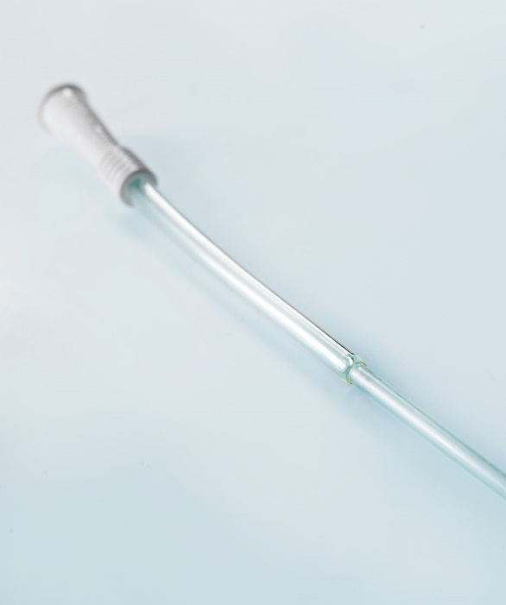
SpeediCath® Control – The proven and reliable standard catheter with extra control for men
Stiffer section at the connector enabling the user to achieve a greater control when inserting the catheter
Support non-touch catheterisation
Easy opening with ring-pull feature for people with low hand dexterity
Adhesive dot ensures catheter stays in place during preparation
Available Ch/Fr 12 – 40cm
Notes:
[SPEAK]
SpeediCath Control is a variant of SpeediCath. The device is a male catheter in size CH 12 and differs from the existing SpeediCath by having an 8 cm rigid outer catheter in CH 16, which is fastened just below the connector. The outer catheter is of the same type of material compared to SpeediCath. The transition between the two tubes is coated and designed, to avoid damage to the urethra.
Additional product characteristic you can mention about SpeediCath Control
Maximise speed at insertion (and show it with Boris)
Can be connected to any bag
SpeediCath Control comes in Green or White packaging depending on the country

Slide 14

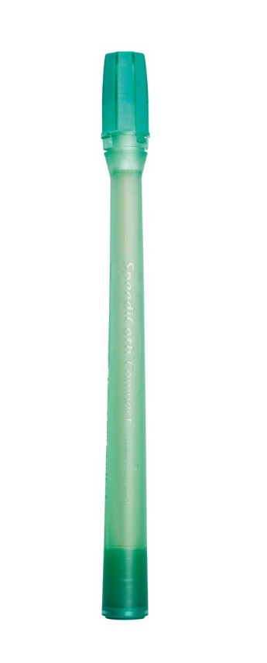
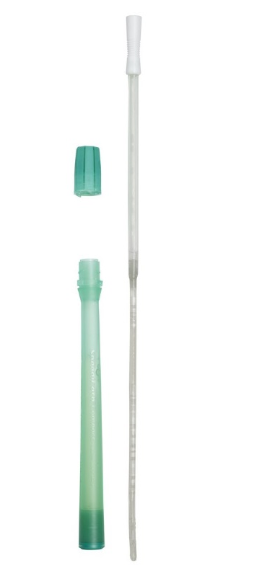
SpeediCath® Compact Male – The most compact catheter for men
A telescopic catheter tailor-made for men*
Discreet and compact design - practical both in and out of home for men who
  who catheterize directly into the toilet
  Who want a discreet catheter design
Improve quality of life related to intermittent catheterisation ⁽²⁾
Non-touch insertion ⁽¹⁾ ⁽³⁾ ⁽⁴⁾
Available in Ch/Fr 12/18 – 30cm
Domurath B et al. Spinal Cord 2011, 49(7), 817-821
Chartier-Kastler E et al. J Urol. 2013 Sep;190(3):942-7
Chartier-Kastler E. Spinal cord 2011, 49(7), 844-850
Bagi P et al. Urol Int 2011; 86:179-184
Notes:
[SPEAK]
The male urethra is found to be 22.3cm and Compact male is 30cm long. It is sufficient to empty the bladder.
Additional product characteristic you can mention about SpeediCath Control
Can be connected to any bag

Slide 15




SpeediCath ® Compact Male - What do our customers say?
”My patients were all impressed with the compactness and how easy it was to use”
“It’s extremely discreet both at home and out and about”
“It makes my job easier when it comes to training patients”
  Emma – Urology nurse specialist – UK
“This catheter changed my everyday”
“This catheter is better than others I have used so far”
Christophe – SCCM user - France
“The compact size gives you the confidence to live a normal life”
”It’s so easy to use – you don’t have to think twice”
Peter – SCCM user – UK
“If you have to use a catheter this is the one”
“It’s definitely much handier when travelling…You just screw the top on again and that’s it!”
Magne – SCCM user - Norway
Notes:
[READ THE TESTIMONIALS]

Slide 16
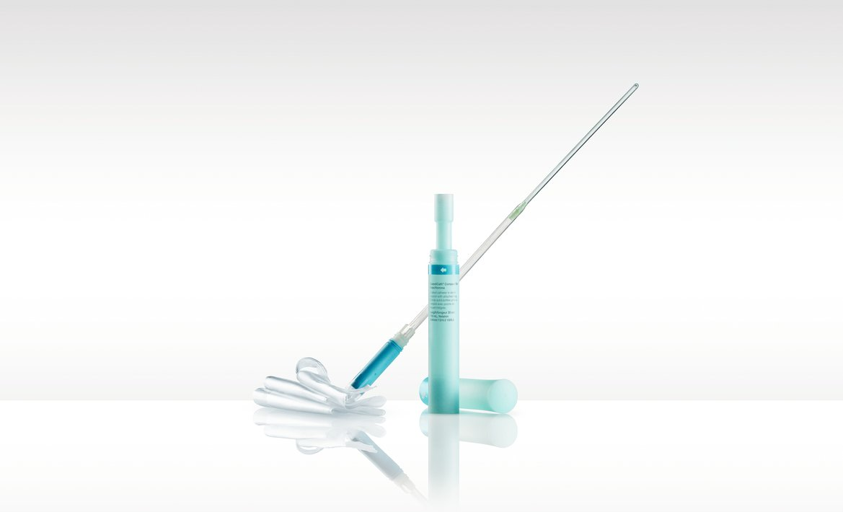
SpeediCath® Compact Set – The only compact all-in-one catheter and bag solution for men
Designed for men:
  who can’t catheterize directly into the toilet
  Who want a discreet all-in-one solution
Improve quality of life related to intermittent catheterisation ⁽²⁾
Non-touch insertion ⁽¹⁾ ⁽³⁾ ⁽⁴⁾
Less to store, bring and prepare
Available in Ch/Fr 12/18 – 30cm
Domurath B et al. Spinal Cord 2011, 49(7), 817-821
Chartier-Kastler E et al. J Urol. 2013 Sep;190(3):942-7
Chartier-Kastler E. Spinal cord 2011, 49(7), 844-850
Bagi P et al. Urol Int 2011; 86:179-184
Notes:
[SPEAK]
Additional product characteristic you can mention about SpeediCath Control
Urine bag holds 750 ml
Retail box contains 20 products

Slide 17


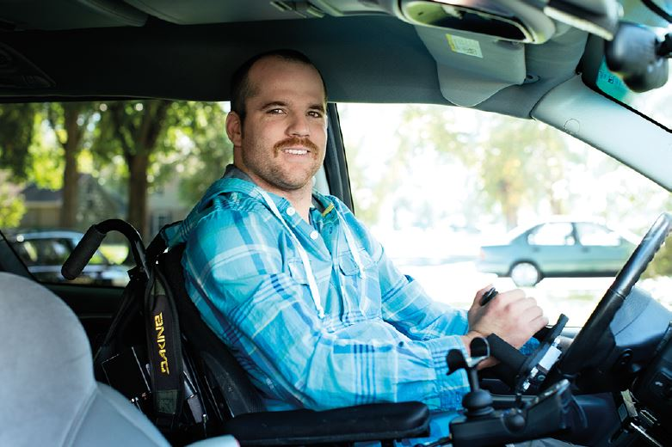
SpeediCath ® Compact Set Male – What do our customers say?
“They are so handy you can put them in your pocket, you don’t need to take a big bag with you, you don’t even need a dustbin”
“Small, Compact, fast and discreet”
  Björn – SCCS user – Germany
The advantage is that if I need to go the toilet I can do it anywhere. If I am in the car, I can do it there. It’s discreet.”
Nicolas - SCCS user - France
The reason it’s so much easier is there are so few steps involved – you don’t have to lubricate it, or push through the bag. The catheter’s already out so you just put it right in and you’re good to go”
It’s easier to keep more of them in a bag, and they’re easier to handle and use. It goes into the bladder easier and with less resistance, and the handles on the bag are useful.”
  Thomas – SCCS user - US
Notes:
[READ THE TESTIMONIALS]
Refer to Ian Cook Bladder solution A4 – real example of QoL
DJ – Brad- compact male set

Slide 18

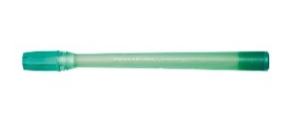

Overview of the SpeediCath portfolio for men
 | SpeediCath Compact Male | SpeediCath Compact Set | SpeediCath Standard | SpeediCath Control
Target group | Men who catheterise directly into the toilet and who want a discreet catheter design | Men who can’t catheterise directly into the toilet and who want a discreet all-in one solution | Men who want flexibility in their choice of catheter sizes and tips | Men who need extra control when inserting the catheter
Sizes | CH 12/16 | CH 12/18 | CH 6-18 | CH 12/16
Notes:
Localize based on your local strategy and portfolio
[SPEAK]

Slide 19

SpeediCath® for Women
SpeediCath Standard
SpeediCath Compact Female and SpeediCath Compact Female Plus
SpeediCath Compact Set
SpeediCath Compact Eve
Notes:
Make sure you have all the products with you to show the differences

Slide 20
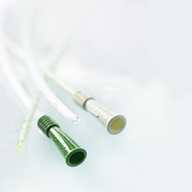

SpeediCath® Standard – The proven and reliable standard catheter for women
Easy opening with ring-pull feature for people with low hand dexterity
Adhesive dot ensures catheter stays in place during preparation
Available in different varieties
  Female – 20cm
  Paediatric – 20cm
  From Ch/Fr6 to Ch/Fr16
Notes:
[SPEAK]

Slide 21
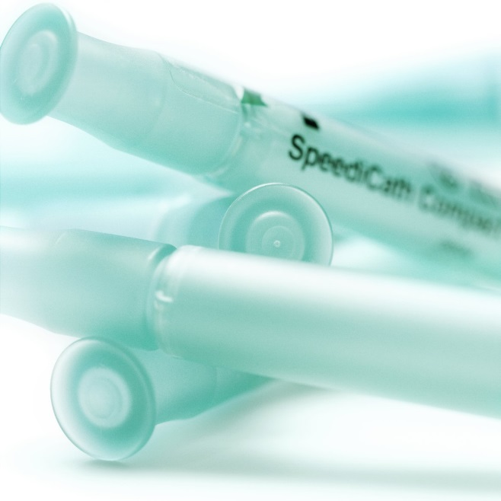
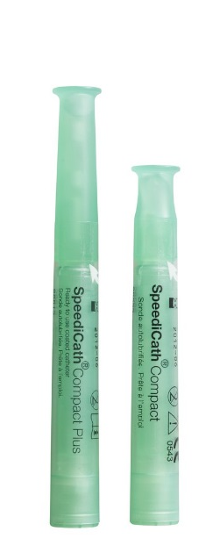
SpeediCath® Compact Female – The most compact catheter for women
Tailor made to suit the length of the female urethra ⁽¹⁾
Improve quality of life related to intermittent catheterisation ⁽²⁾
Discreet due to the small size
Easy handling during insertion ⁽¹⁾
Available in different varieties
  Female – 7cm
  Female Plus – 9cm
  From Ch/Fr6 to Ch/Fr14
Can be connected to Speedibag
(1) Biering-Sørensen F et al. Scand J Urol Nephrol 2007;41(4):341-345
(2) Chartier-Kastler E et al. J Urol. 2013 Sep;190(3):942-7
Notes:
[SPEAK]
The female urethra is at average 3-5cm, and there is no need for a standard 20cm female catheter

Slide 22
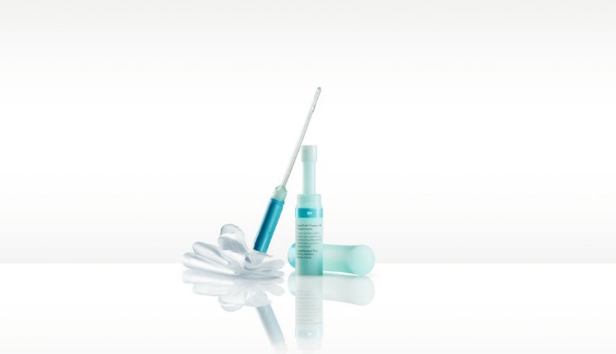
SpeediCath® Compact Set – The only compact all-in-one catheter and bag solution for women
Designed for women:
  who can’t catheterise directly into the toilet
  Who want a discreet all-in-one solution
Improve quality of life related to intermittent catheterisation*
Non-touch insertion
Less to store, bring and prepare
Available in Ch/Fr 10, 12, 14
*Chartier-Kastler E et al. J Urol. 2013 Sep;190(3):942-7
Notes:
[SPEAK]
Additional product characteristic you can mention about SpeediCath Control
Urine bag holds 750 ml
Retail box contains 20 products

Slide 23




SpeediCath ® Compact Set - What do our customers say?
  ”My dream catheter” - It fits in my handbag”
  Marcia – SCCS user - UK
  “The packaging is lovely, it’s nice, neutral color”
  “I like the fact you can actually reseal it and dispose it”
  “It’s really easy to use and totally intuitive to use. It’s easy to store”
  Liz - Nurse - UK
  “Great catheter, I would recommend”
  Daniela – HCP - Germany
  This compact set is a game changer. It is great for taking out - This has allowed me to do the things I love with confidence and ease – I feel more comfortable exercising and visiting friends and family, especially those who are a long journey away. All of this has led to improved self-esteem and a healthy sex life.”
  Shanna – SCCS user - UK
Notes:
[READ THE TESTIMONIALS]

Slide 24
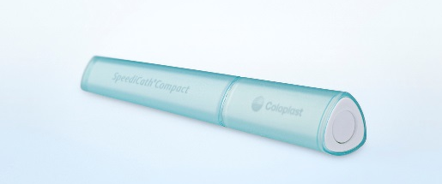
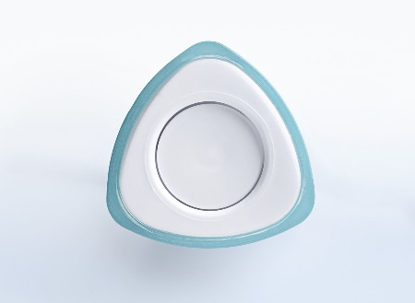
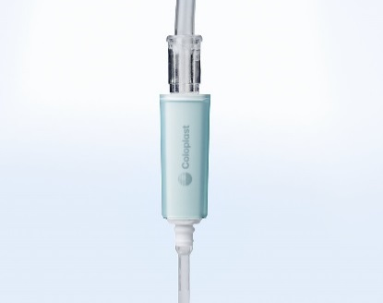
SpeediCath® Compact Eve
“Our most stylish and discreet catheter yet”
Designed for women:
  who can’t catheterize directly into the toilet
  Who want a discreet all-in-one solution
Improve quality of life related to intermittent catheterisation
Non-touch insertion
Less to store, bring and prepare
Available in Ch/Fr 10, 12, 14
*SpeediCath Standard is also available in boy, pediatric, and tiemann sizes
Notes:
SPEAK]
Additional product characteristic you can mention about SpeediCath Control
Lenght of the catheter is equivalent to SCCF Plus

Slide 25




SpeediCath ® Compact Eve - What do our customers say?
  “I like everything about SpeediCath Compact Eve. The color, the shape, everything.”
  “SpeediCath Compact Eve is better because of the triangular shape that makes it very easy to handle”
  “The box can be placed anywhere and looks like a neat little box, with nothing noticeable about it.”
  Melissa – SpeediCath Compact Eve user - Italy
  “It’s feminine, fast, easy, convenient – and stylish”
  Dorthe – MS Nurse in Denmark
  “SpeediCath Compact Eve has improved my self-confidence even more” - Monika – User in Germany
  “The design of the catheter is very important because it becomes part of your daily life” – Fabiola – User in Germany
Notes:
[READ THE TESTIMONIALS]

Slide 26

SpeediCath portfolio for women
 | SpeediCath Compact Female | SpeediCath Compact Plus | SpeediCath Compact Set | SpeediCath Standard
Target group | Women who catheterise directly into the toilet and who want a discreet catheter design | Women who want an extra lenght | Women who can’t catheterise directly into the toilet and who want a discreet all-in one solution | Women who want flexibility in their choice of catheter sizes
Sizes | CH 6-14 | CH 10-14 | CH 10-14 | CH 6-16
Notes:
Localize based on your local strategy and portfolio
[SPEAK]
The strategic focus for SCCE will be to gain NPDs and to convert competitor users in community. We will keep SpeediCath Compact Female and SpeediCath Compact Plus in the portfolio and the intention is not to actively convert these to SCCE. (Localize)
For the health care professionals, we want to ensure that the only catheter they introduce to their female patients (who will not have to use a bag daily), is SpeediCath Compact Eve. We are offering their patients a high performing product that does not have a medical look and feel, but looks like any other consumer product.
Furthermore, it is a product, which is hygienic and easy to use due to the one-step-opening, the triangular shape of the packaging and last but not least the easy connection to a bag.

Slide 27

Compact catheters improves quality of life (QoL) related to Intermittent catheterization
28%
Increase in quality of life related to Intermittent catheterization for Compact vs standard catheters
Chartier-Kastler E et al. J Urol. 2013 Sep; 190(3):942-7

Slide 28

Compact catheters significantly improve quality of life related to Intermittent catheterisation for both men and women
ISC- Q Score
The ISC-Q evaluates aspects of QoL related to ISC. It takes into consideration: Ease of use, discreetness, convenience, Psychosocial well being
!
0
100
Conventional catheters
Compact catheters
1
28% improvement in the Quality of life related to Intermittent catheterisation
63% users prefer Compact vs Conventional catheters
1
2
*Chartier-Kastler E et al. J Urol. 2013 Sep;190(3):942-7
Notes:
[SPEAK]

