Slide 1
Intermittant Self Catheterisation - Male

Slide 2
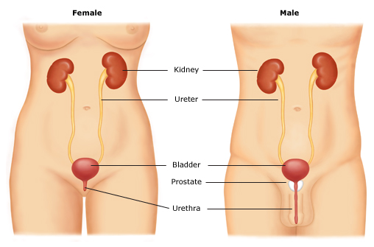
What are the components of the Male Urinary System?
2 Kidneys
2 Ureters
Urinary Bladder
Prostate
Urethra
Nerve Pathways

Slide 3
Function of the Lower Urinary Tract
  To collect urine produced by the kidneys
  To store it under safe conditions; low pressure
  To empty when it is appropriate

Slide 4
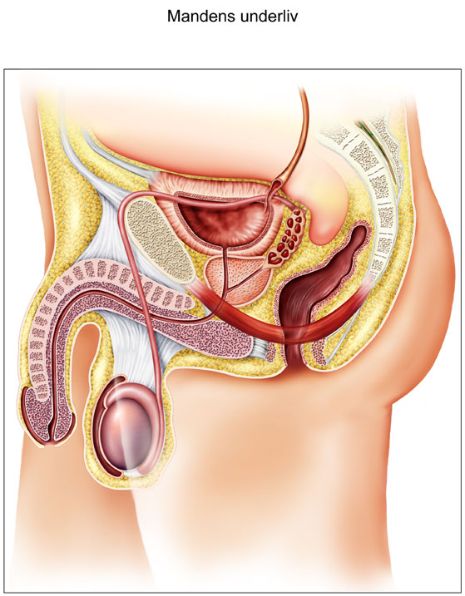
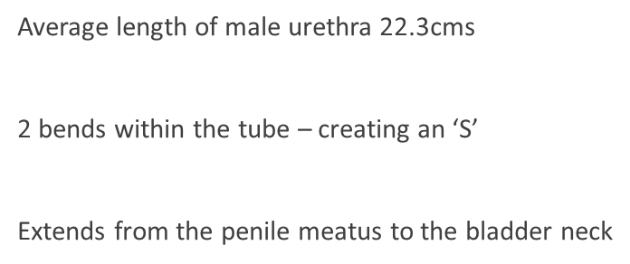
Male Urethra
Penile Urethra
Bulbar Urethra
Membranous Urethra
Prostatic Urethra

Slide 5
Male Urethra
Function of the Urethra
  to transport urine from the bladder
  muscular ‘tube’ that is in the closed position except when urinating
  closed position and natural lubrication acts as a defence against bacteria
  two sphincters within the male urethra
          Bladder neck: to prevent retrograde ejaculation
          Membranous urethra: helps maintain continence
Penile Urethra
  Approx 12 cms in length
  surrounded and protected by spongy tissue
  receives many para-urethral glands providing lubrication
  1st straight section of urethra

Slide 6
Male Urethra
Bulbar Urethra
  surrounded by muscle that helps with urethral emptying and ejaculation
  Starts at 1st bend in the urethra and finishes at 2nd bend
Membranous Urethra
  Starts at second bend of urethra
  pierces the pelvic floor
  thin walled and not directly supported by any muscle or ligament
Prostatic Urethra
  prostate is a walnut sized gland important in sexual function
  urethra runs through the anterior of the gland (front)
  ejaculatory ducts open into this section

Slide 7
Problem areas in the Male Urethra
Urethral meatus (tip of the penis) - narrowing
Bulbar urethra – 2 bends
Membranous urethra - thin walled
Prostate Gland – enlargement with age
Bladder Neck – getting through
False Passage – anywhere throughout length
Sensitivity throughout length

Slide 8
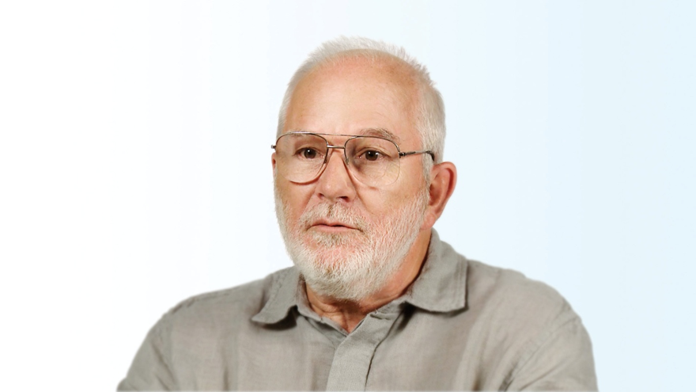
Causes of Bladder Dysfunction in Men
Neurogenic Bladder Dysfunction
            Spinal Injury
            Spina Bifida
            MS
            Botox used in some of these groups
Prostate Disease
        Pre-surgery due to obstruction
        Post surgery due to Atonic bladder
Urethral Obstruction
      Strictures
Surgery
        Bladder Augmentation

Slide 9
Indications for ISC in men
Storage problems:
Inability to hold significant volumes of urine in bladder
No real warning of time to void: urgency
Leakage between voids
Associated with men with MS, High level SCI and some Spina Bifida patients
  Management with drugs to reduce bladder activity
  Botox
  ISC
Emptying difficulties:
No feeling / sensation of when to void in some
Able to hold ever increasing volumes of urine if not managed effectively
Some patients still able to pass urine, but never empty to completion
Leakage between voids
Associated with men with lower SCI and Spina Bifida, Prostate disease, neuropathy (diabetes)
  Management with ISC
  Management with Indwelling catheter

