Slide 1
Introduction to Urinary Incontinence

Slide 2
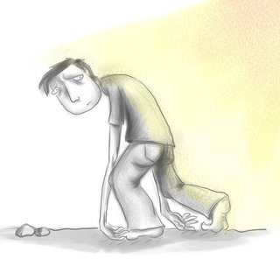
What is incontinence?
“The passing of urine in an undesirable place or at inappropriate times twice or more a month regardless of quantity lost.”
Thomas et al., 1980
“Urinary incontinence is a condition in which the involuntary loss of urine is a social and hygienic problem.”
International Continence Society., 2005

Slide 3
Causes of Urinary Problems
Incontinence/Retention
Neurogenic conditions causing urinary incontinence
Conditions causing damage to the nervous system include:
Spinal cord injury
Multiple sclerosis
Spina bifida
Diabetes mellitus
Stroke
Non-Neurogenic conditions causing urinary incontinence
Weakening of the pelvic floor due to age or childbirth
BPH (enlarged prostate)
Prostate or bladder surgery
Bladder cancer
Botox injections of the bladder to manage urinary incontinence
Ageing

Slide 4
Multiple Impact of Urinary Incontinence
Incontinence/Retention
Physiological
Psycological
Social
distress, embarresment, inconvenience, self esteem, loss of control, desire to be normal
withdrawal from everyday activity, loss of confidence, avoidance of social activities, strain on personal relationships
ruined clothing and bedding, need for surgery, moisture lesions
Notes:
People suffering from Urinary continence will obviously suffer from physiological outflow of urine, but the psychological and social elements are much stronger. Patients are afraid to be different – to have accidents – to smell. We should not underestimate the effects of incontinence on an individuals quality of life.

Slide 5
Incontinence has a big impact on people’s lives
“Urinary incontinence (UI) is a common disorder which has a substantial impact on quality of life (QoL). Perceived as truly debilitating from a physical, psychological and social point of view, it may cause both isolation and loss of independence [...].”
Chartier-Kastler et al., 2010
People are left feeling;-
Distressed
Embarrassed
Isolated
Helpless
Low self-esteem
Loss of personal control
Desire for a normal life

Slide 6
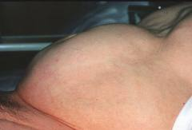
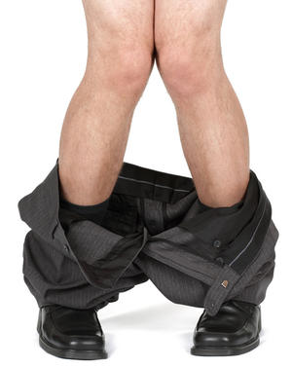
Urinary Incontinence can typically be split in two groups
Retention
Urinary retention (inability to empty the bladder)
Urinary incontinence (involuntary leakage of urine)
Incontinence
Notes:
Bladder problems typically take the form of urinary retention (inability to empty the bladder) or urinary leakage (incontinence) and arise from neurogenic disorders such as spinal cord injury, multiple sclerosis and spinal bifida. Urinary problems can be age related or result from an underlying physical disease, caused by a dysfunction in the bladder

Slide 7
Symptoms
Typical symptoms of urinary retention
Discomfort
Urgent sense to urinate but inability to start the urine flow
Frequent visits to toilet
Dribble due to overflow incontinence
Weak flow
Bloated lower abdomen
Typical symptoms of urinary incontinence
Urinary leakage
Small or large amounts of urine leaking without warning or without feeling the urge to go to the toilet
Involuntarily leakage when sneezing, coughing, laughing or exercising
A sudden urge to rush to the toilet to urinate
The need to get up to pass urine two or more times a night (nocturia)

Slide 8
There are many small hints and tips which people find useful to follow in order to reduce symptoms
Drink plenty of fluid – eg.3-4 pints a day, do not restrict intake
Water is best – alcohol, caffeinated and carbonated drinks can increase symptoms
which indicate bladder irritation
Concentrated urine is more irritable to the bladder than diluted
Avoid constipation by eating a healthy, balanced diet
(constipation can affect the urinary system as well)
Try and hold onto the urine in a little longer if you experience urgency
Pelvic-floor / Kegel exercises
If a patient continues to experience problems, they should speak to their healthcare professional and ask for further assistance

Slide 9
Male and female (>40 years) community prevalence of lower urinary tract symptoms (LUTS)
Boyle P et al. BJU 2003
Notes:
Prevalence of moderate and severe LUTS increases with age. This slide highlights that there is minimal difference in prevalence of incontinence between men and women over the age of 40

Slide 10
Retention
Urinary Retention
Urinary retention can be caused by an obstruction in the urinary tract, a bladder muscle weakness or by a neurogenic condition e.g. multiple sclerosis, spinal cord injury or spina bifida all of which interfere with signals between the brain and the bladder, resulting in a dysfunction in the urinary system.
Notes:
Urinary Retention
Urinary retention can be caused by an obstruction in the urinary tract, a bladder muscle weakness or by a neurogenic condition e.g. multiple sclerosis, spinal cord injury or spina bifida all of which interfere with signals between the brain and the bladder, resulting in a dysfunction in the urinary system.

Slide 11
Urinary Incontinence
Stress urinary incontinence (SUI) occurs when the muscles in the pelvic floor, under sudden, increased pressure (stress), are too weak to hold the urethral sphincters closed. The result is an involuntary leakage of urine during everyday activities such as sneezing, coughing, laughing or exercising. Women: Pregnancy, childbirth and menopause Men: Removal of prostate gland….
Urge urinary incontinence (unstable or overactive bladder) is caused by involuntary, uncontrolled contractions of the muscle in the bladder. This results in a sudden urge to go to the toilet, and involuntary urine leakage before reaching the toilet. UTI, neurological disorder
Mixed urinary incontinence is a combination of stress urinary incontinence and urge urinary incontinence.
Overflow incontinence (a frequent or constant dribble of urine) results from an inability to empty the bladder. With overflow incontinence you may feel as if you never completely empty your bladder. When you try to urinate, you may produce only a weak stream of urine damaged bladder, blocked urethra or neurological damage
Notes:
Urinary incontinence
There are different types of urinary incontinence, each with different symptoms and causes. The most common types of urinary incontinence are stress urinary incontinence (SUI), urge urinary incontinence and mixed urinary incontinence.
Stress urinary incontinence (SUI) occurs when the muscles in the pelvic floor, under sudden, increased pressure (stress), are too weak to hold the urethral sphincters closed. The result is an involuntary leakage of urine during everyday activities such as sneezing, coughing, laughing or exercising.
Urge urinary incontinence (unstable or overactive bladder) is caused by involuntary, uncontrolled contractions of the muscle in the bladder. This results in a sudden urge to go to the toilet, and involuntary urine leakage before reaching the toilet.
Mixed urinary incontinence is a combination of stress urinary incontinence and urge urinary incontinence.
Overflow incontinence (a frequent or constant dribble of urine) results from an inability to empty the bladder and occur in people with a damaged bladder, blocked urethra or neurological damage. With overflow incontinence you may feel as if you never completely empty your bladder. When you try to urinate, you may produce only a weak stream of urine.
It is also worth mentioning Functional Incontinence – particularly common in the elderly who are not nessevcarily incontinent but cannot reach a toilet in time due to mobility issues.

Slide 12

Common causes of non-neurogenic lower urinary tract symptoms
Enlarged prostate
  Urinary retention
Surgeries in urinary tract (bladder and prostate)
  Mainly stress incontinence
Aging
  All types of incontinence
  Incapability to fully empty the bladder
Child birth
  Stress incontinence
Notes:
Aging is one of the most typical non-neurogenic factors leading to urinary problem. It is expected that approximately 20% of the adult population suffers from moderate to servere urinary incontience. Other causes include surgery in the urinary tract and for the male population enlarged prostate. For the female population stress incontience related to child birth is very common.

