Slide 1
Long-Term Cost-Effectiveness of Transanal Irrigation In Patients With Neurogenic Bowel Dysfunction Who Have Failed Standard Bowel Care
Emmanuel et al, Value Health 2015 Nov;18(7):A360
Notes:
Raise your hand if someone have asked you to take care about cost, to safe money, to stay on a budget…
Also my manager tell me every time: do it, very well…but with less money…
I pay tax in UK, I agree with that… high level but with reasonable cost

Slide 2
Current situation of NBD patients
47%
of chronically constipated are not satisfied with their constipation medication¹
In the current NBD population
39% report that it causes some or big restrictions on social life and QoL
¹Chronic constipation: a survey of the patient perspective. Aliment Pharmacol Ther 2007
4 out of 10 have symptoms of constipation
7 out of 10 suffer from faecal incontinence
Notes:
1 – Almost half of the NBD patients do not have sufficient relief from their current bowel management program (mostly conservative bowel management with laxatives), as shown by Johanson J et al. Chronic constipation: a survey of the patient perspective. Aliment Pharmacol Ther 2007.

Slide 3

NBD has a large impact on resource utilization
50%
increased risk of hospitalisation due to constipation and impaction, compared to the general population¹
2.5
rate of UTIs per year in the SCI population²
Increasing health care costs
50%
Are dependent on others for emptying their bowels³
Notes:
NBD is not only a burden for the patients, but for the society and the healthcare systems due to the expenses related to its treatment and care
1- The neurogenic population has a 50% increased risk of hospitalisation due to complications arising from constipation and impactions (Sonnenberg A et al)
2- The risk of UTIs is more common in the neurogenic population – due to both bladder and bowel problems (Siroky MB et al)
3- Many patients require a caregiver. This can be a spouse or other family member, but in other situations a professional carer may be needed. (Glickman S et al)

Slide 4
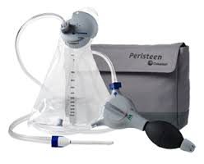
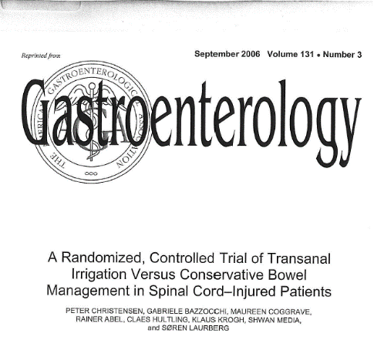
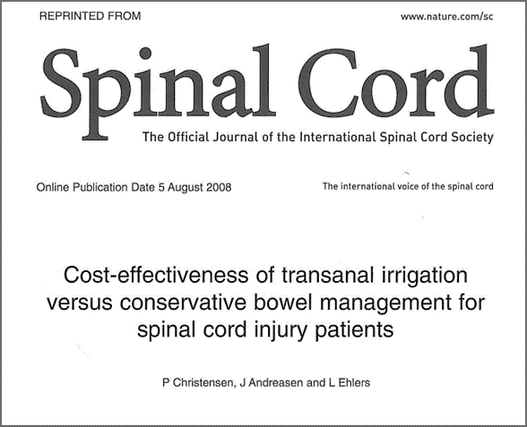
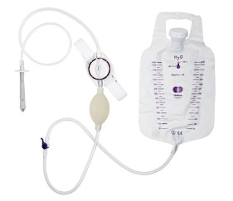
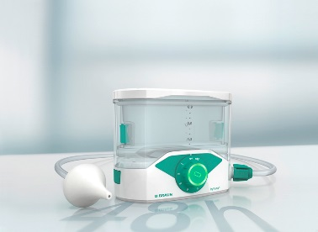
Peristeen is the only TAI device where efficacy has been demonstrated in a randomized controlled trial
Peristeen improves constipation, faecal incontinence and symptom-related quality of life, compared to conservative bowel management while being a cost-effective treatment strategy
NO EVIDENCE
Notes:
Peristeen is the only bowel irrigation device which has been documented, in a randomized controlled trial, to improve constipation, FI and symptom related QoL
In addition, Peristeen has also been demonstrated to be a cost-effective treatment compared to conservative bowel management programmes ( I will get back to this later.)
In contrast, our key competition, Qufora, has no evidence to support their evidence. Recently, BBraun’s Irypump S is positioning itself as a bowel irrigation device, also without data for it (and with claims of being cost-saving versus Peristeen)
In theory, our competitors cannot argue that they have the same effect as Peristeen, since no RCT comparing TAI devices has been conducted.

Slide 5
Anton Emmanuel’s data: background information
3 centres in the UK
227 patients since 2007
Neurogenic patients (most SCI, but also MS and SB)
Patients that had failed standard bowel care
Real-world evidence
Clinical outcomes and resource utilization
Yearly follow-up
Data for year 1 with 225 patients
Real world evidence means data collected from real practice, not in a controlled setting like a randomized clinical trial
Notes:
UCL London
National Hospital for Neurology and Neurosurgery
London Spinal cord injury center
75% trained in Hosp and 25% in Community
4,5 years (2007-2012)
High Compliance!!!
Real-world practice in 3 UK centres handling neurogenic bowel patients. Real-world data reflects more genuinely the experience and outcomes of patients and healthcare professionals, since it reflects the daily practice, instead of a controlled environment. Its limitation is that practice may vary from clinic to clinic and from country to country

Slide 6

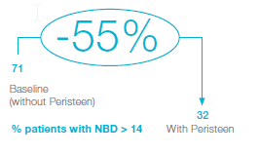
Clinical outcomes
The number of patients that had a NBD score >14 (severe) was reduced by 55% after 1 year of treatment with Peristeen
This real-life data confirms previous clinical trials (such as the Christiansen et from 2006) on Peristeen’s effectiveness in treating neurogenic bowel dysfunction
Notes:
Hosp £1,300 form 0,8 to 0,1
Visit £188 from 3,8 to 1,3
UTIs £1,500 from 1,4 to 0,6
Stoma £7,000 from 9% to 4%*
*after 2007 33 out 371; before 2007 19 out of 537
Not only the pts included in the study
Reduction of stoma surgeries was not a self-reported use of resources (unlike the occurrence of UTIs, visits to the doctor or hospitalizations). This figure was extracted from analysing the number of stoma surgeries performed on NBD patients in the years previous to 2007 (the year were Peristeen was first introduced in the 3 clinics) and the same number after 2007. Hence, it takes into consideration all patients, and not only those who were included in the study

Slide 7





Resource utilization after 1 years
57%
reduction UTIs
66%
reduction GP /
Specialist visits
88%
reduction admissions
61%
reduction stoma surgery
Notes:
Hold on the leavepiece

Slide 8
Long-Term Cost-Effectiveness of Transanal Irrigation In Patients With Neurogenic Bowel Dysfunction Who Have Failed Standard Bowel Care
Emmanuel A, Christensen P, Kumar G, Passananti V, Mealing S, Stoerling ZM, Andersen F, Soerensen J, Kirshblum S
Objectives: To investigate the long-term cost-effectiveness of initiating transanal irrigation* (TAI) as second-line management in patients with neurogenic bowel dysfunction (NBD) who have failed first-line standard bowel care (SBC). Methods:
A deterministic Markov decision model was developed to project the lifetime health economic outcomes, including quality-adjusted life expectancy (QALE), episodes of faecal incontinence (FI), urinary tract infections (UTIs), and stoma surgery when using TAI relative to continuing SBC. Patients could transition from TAI to (a) another round of first-line SBC, (b) third-line surgeries (sacral nerve stimulator, sacral anterior root stimulator, antegrade continence enema) or (c) stoma as the absorbing state. Transition probabilities and QALE estimates were based on real-world data collected at three clinics in UK from 2007-2014, in NBD patients due to spinal cord injury (SCI), multiple sclerosis, spina bifida, and cauda equina syndrome. Transition probabilities for failed SBC patients were collected from 2000-2007 prior to availability of TAI. Projected life-expectancy was based on published SCI population data. One-way sensitivity analyses were applied.
Results: The model predicts that a SCI patient diagnosed aged 30, with a life expectancy of 37 years using TAI, will experience a 36.1% reduction in FI, 28.7% reduction in UTIs, a 35.4% reduction in stoma surgery and improvement of 0.40 years of QALE, compared with patients continuing SBC. Lifetime cost-savings of £41,620 per patient was estimated for TAI versus SBC in a SCI patient, primarily due to avoided hospitalizations and stoma surgeries.
Incremental cost can differ due to altered life-expectancy (and age of diagnosis) in the patient cohort. One-way sensitivity analyses indicated that the model was most sensitive to variation in utilities on TAI and SBC treatment. Conclusions: TAI is a cost-saving treatment strategy reducing risk of stoma surgery and improving QALE for NBD patients who have failed SBC.

Slide 9


The model predicts that a SCI patient diagnosed aged 30, with a life expectancy of 37 years using TAI
28%
reduction UTIs
36%
reduction FI
£ 41,620
Lifetime cost saving per patient
35%
reduction Stoma Surgery

Slide 10
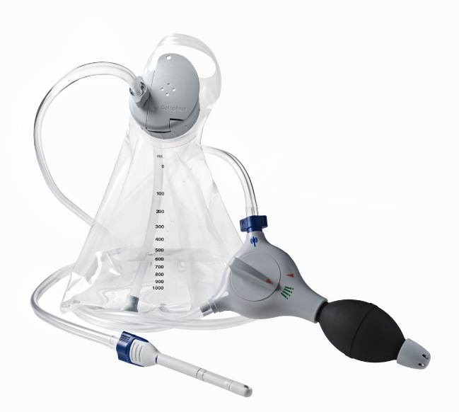
Peristeen is an effective, safe and cost-saving treatment
PROVEN
Clinical Effectiveness
PROVEN
Time & Cost Savings
PROVEN
Safety Profile

Slide 11
Key messages
“Increasing the use of Peristeen on those patients that have failed conventional bowel care generates direct savings for the healthcare centre.”
“Patients that have not or are not responding to conservative bowel care will benefit from adding Peristeen to their regime. To the clinical effectiveness of Peristeen in treating constipation, faecal incontinence and increasing quality of life, we can now add a benefit for the healthcare centre and the system in terms of direct savings every year.”

