Slide 1
Long-term outcome and safety of transanal irrigation for neurogenic bowel dysfunction
Faaborg PM, et al. Spinal Cord 2009;47:545–549

Slide 2
Long-term outcome and safety of TAI for NBD
Intervention
  TAI with rectal balloon catheter (48%); cone-shaped colostomy tip (32%); other system (20%)
Study design
  Long-term follow-up study (mean, 1.6 years; range, 0.1–19.5 years)
  Patients: n=211
      Predominantly SCI (n=173); including spina bifida, n=32); multiple sclerosis (n=25); other central nervous system aetiology (n=13)
      Using TAI after failure of conservative bowel management
Faaborg PM, et al. Spinal Cord 2009;47:545–549
Notes:
This was a long-term follow-up study in 211 patients with NBD, in whom previous conservative bowel management had failed. Patients were largely spinal cord-injured (n=173), of whom 32 had spina bifida. Twenty-five patients with multiple sclerosis and 13 with another central nervous system aetiology were also included in the study. TAI was performed using either a rectal balloon catheter (48%), cone-shaped colostomy tip (32%), or another system (20%)

Slide 3
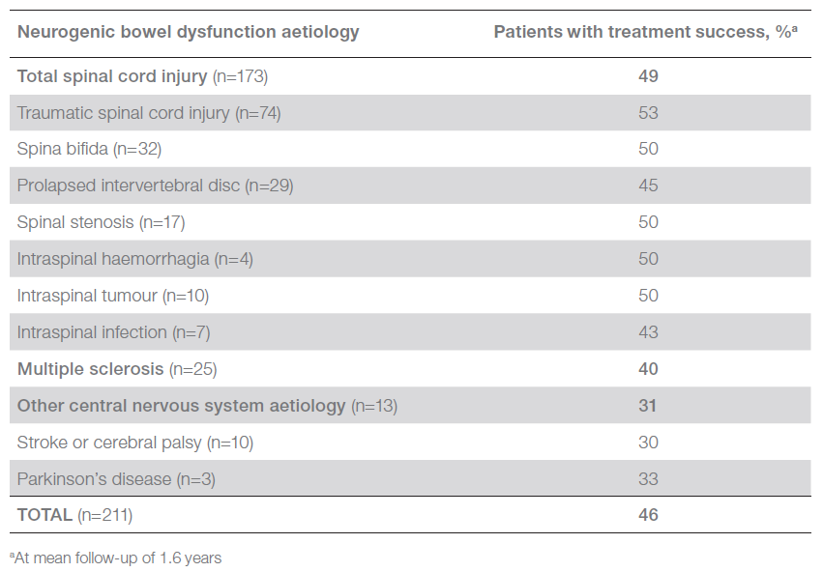
Treatment success in long-term users of TAI for whom conservative bowel management had failed
Treatment success defined as patients still using TAI at long-term follow up, or had continued using it until death or resolution of symptoms
Faaborg PM, et al. Spinal Cord 2009;47:545–549
Notes:
Key efficacy data:
Treatment success was recorded at long-term follow-up (defined as patient still using TAI at follow-up or had continued using it until they died or symptoms resolved)
Treatment discontinuations were most frequent during the first few months of treatment; however, at 3 years the success rate stabilised at 35% for the entire group

Slide 4
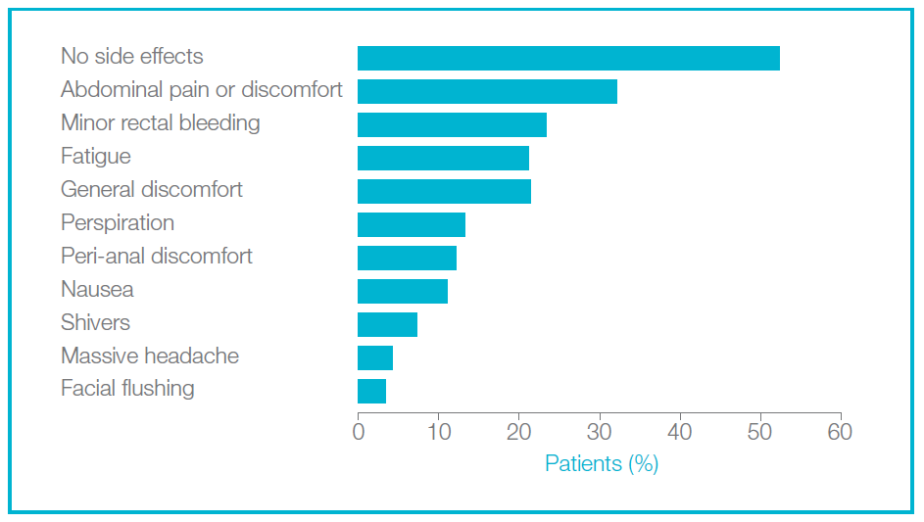
TAI was associated with a good long-term safety profile
Faaborg PM, et al. Spinal Cord 2009;47:545–549
Notes:
TAI was associated with a good long-term safety profile, with over half of patients (52%) experiencing no side effects
The risk of bowel perforation was low (estimated risk, 0.002% per irrigation); one non-lethal bowel perforation occurred in one patient in ~50,000 irrigations
Coloplast data shows that the risk of bowel perforations is less than 1 in 100,000, this data has been verified by the Coloplast Global Advisory Board for bowel management with 12 leading experts in the field of bowel management

Slide 5
Summary: Successful use of TAI in patients who had failed conservative bowel management
Data from this long-term follow-up study of a large number of individuals of mixed aetiology show TAI results in treatment success in those who have failed conservative bowel management, with no safety issues
Evidence from this study supports the long-term efficacy and safety of the TAI procedure
Return to index
Faaborg PM, et al. Spinal Cord 2009;47:545–549
Notes:
Study conclusions:
Overall, treatment success was achieved in 46% of long-term users of TAI, in whom conservative bowel management had failed
Among the subgroup of patients with SCI using TAI long term, treatment success was achieved in 49%
One in five treatment discontinuations occurred during the first few months of treatment, after which the rate of discontinuations slowed
TAI had a good safety profile when used long term
The risk of bowel perforation with TAI was low (estimated risk 0.002% per irrigation)

