Slide 1

Foundation Course in Stoma Care (FCISC)
An organisers guide
Updated 2019

Slide 2
Content
Overview
FCISC Part 1 – Preparation
FCISC Part 1 – Getting started
Supporting Nurse
What next
FCISC – Reports
FCISC Part 2 – Venue and Invitations
Invite email
FCISC Part 2 - Pathway
Three Prosthetic Abdomens
Consolidation day packs
FCISC Part 2 – Attendance and certificates
Monthly report
Help and support

Slide 3
Overview
The Foundation Course in Stoma Care (FCISC) is designed for nurses and other healthcare professionals who may come into contact with patients who have a stoma.
The course is designed to give them an understanding of anatomy, why a patient may have a stoma and how it is formed and how to care for it.
The course is in 2 parts:
Self study online course (part 1)
Clinical Workshop at which participants will review what they have learnt and experience how to cut and apply stoma appliances (part 2)

Slide 4
FCISC Part 1 – Preparation
Confirmation with SCN from account (supporting nurse)
A selection of editable posters advertising the FCISC are available via the events team
  Posters advertising course
  Flyers for SCN to give applicants with log on details

Slide 5
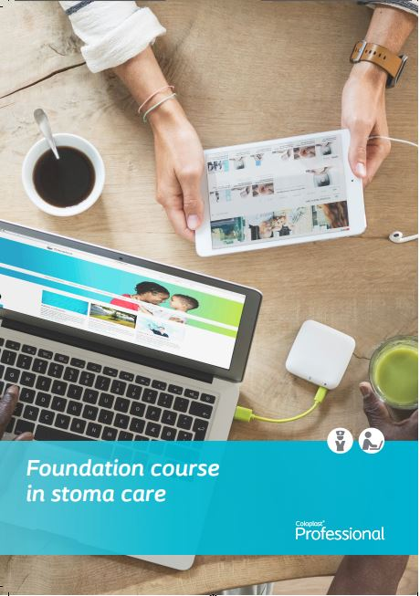
FCISC Part 1 – Getting started
Candidates that are interested in the Foundation Course
in Stoma Care will need to register online:
http://coloplast.e3learning.co.uk
Candidates will find it beneficial to have:
‘Guide to Coloplast Academy Online Training Portal: Stoma Care’
Siebel order code: CL757N

Slide 6
Supporting Nurse
A supporting nurse is mandatory to complete the course and should be listed on the drop down box when registering online. If no Supporting SCN from Trust (Nursing Home for instance) please contact the Coloplast Nurse covering that area
If the supporting Clinical Nurse Specialist is not listed – candidates can not complete registration and are advised to contact their Territory Manager or email events@coloplast.com so that we can register the supporting nurse on the system.
The TM will be notified via email upon a candidates registration.

Slide 7


What Next?
When the candidate has registered / undertaken FCISC part 1 and passed – they will be notified straight away.
Failed – they have the opportunity to re-take
Passed – they are ready to complete Part 2 – Clinical Skills Workshop

Slide 8
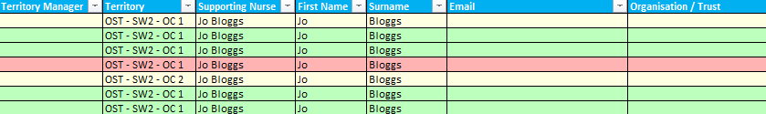
FCISC – Reports
A report can be run to see how many candidates have passed Part 1 in your area and are ready to attend Part 2 – Example below
You can run the report on either Supporting Nurse / Area / Hospital
Red - Not started course or been on the workshop / Yellow - Completed the course but not been on a workshop / Green – Completed course & workshop

Slide 9
FCISC Part 2 – Venue & Invitation
Now you have an idea of who to invite from the report
The maximum number of candidates per event is set at 12
Please agree date and venue with the Supporting Nurse & book accordingly
Invites to be sent out by yourself. Please use email template provided for uniformity

Slide 10
Invite email
Hi
A little while ago you signed up to do the Coloplast Foundation Course in Stoma care under the supervision of…
Our records show that you have now successfully completed Part 1, or in the process of completing part 1.
I would like to invite you to our Clinical Workshop day to complete Part 2.
(If you have yet to complete part 1 please can you complete as soon as possible in order to attend the day.)
At the Clinical Workshop day we will review what you have learnt and experience how to cut and apply stoma appliances.
We will be holding the Clinical Workshop day on :-… at…
Agenda attached.
If you could let me know if you are able to attend Part 2 on the above date, as soon as possible, I will then reserve a place for you.
PLACES ARE LIMITED SO PLEASE RESERVE ASAP.
I look forward to hearing from you.
Kindest

Slide 11
FCISC pathway
Part 2 confirmed with SCN
“Off the shelf”, supported by CP
“Individualised”*
*Supported by CP will be removed if presentation altered
Pre written presentation
Pre written agenda*
Presented by TM or SCN**
Presentation amended by SCN
Agenda amended by SCN*
Presented by SCN
*Timings to be entered by TM/SCN
**If the SCN wishes the TM to present, the TM must be confident and competent to do so. If this is the case only the “Off the shelf package” is to be used. All clinical questions will be directed to the SCN

Slide 12
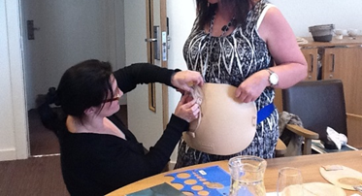
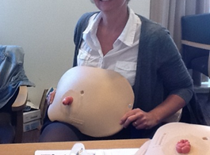
Three Prosthetic Abdomens
Please ensure you have the three prosthetic abdomens, each have a different stoma on them. There is a colostomy, Ileostomy and transverse loop stoma. The prosthetic abdomens are used by the nurses during the foundation course workshop to practice:
Templating
Correct cutting of a stoma appliance
Role play; changing of a bag
These can be worn by the nurses during these practical sessions, this gives them a ‘sense of reality’ and what it feels like to have a stoma on their abdomen themselves.

Slide 13
Consolidation day delegate packs
3 parts, each with their own order code, x1 paperwork and x1 equipment needed for each delegate
Paperwork (CL855N) – 1 pack per delegate
Equipment (CL856N) – 1 pack per delegate +1 for facilitator
Facilitator pack (CL857N)
These can be ordered as with any other stock request

Slide 14
Consolidation day delegate packs
Paperwork (each pack will contain)–
Welcome letter
A model framework for reflection
Selection tool
App leave piece
Body profile assessment
Feedback form
Agenda*
* An agenda is not included within the pack automatically. You will have a template agenda for you to amend to your timings. Please print your own agenda’s and place in the paperwork pack & facilitator pack ready for the day.

Slide 15
Consolidation day delegate packs
Equipment (each pack will contain)–
X2 drainable (10411, back up pouch 10421)
X2 closed (10671, back up pouch 10681)
X2 urostomy (10581, back up pouch 10582)
X2 post op pouches (18665, back up pouch 18666)
X3 measuring guides
X1 scissors
Foundation Course lanyard
Retractable badge/pass card holder

Slide 16
Consolidation day packs
Facilitator pack (each pack will contain) -
A model framework for reflection (RN) / Learning outcomes (HCA/Student), double sided
Selection tool
App leave piece
Body profile assessment
Register
Presentation
Feedback form
Agenda*
*An agenda is not included within the pack automatically. You will have a template agenda for you to amend to your timings. Please print your own agenda’s and place in the paperwork pack & facilitator pack ready for the day.

Slide 17
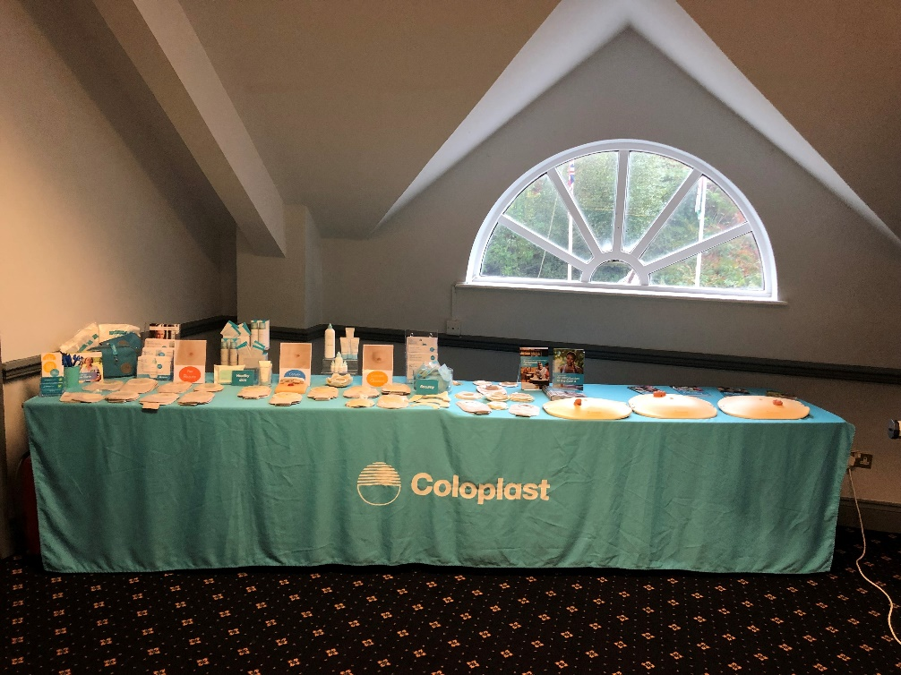
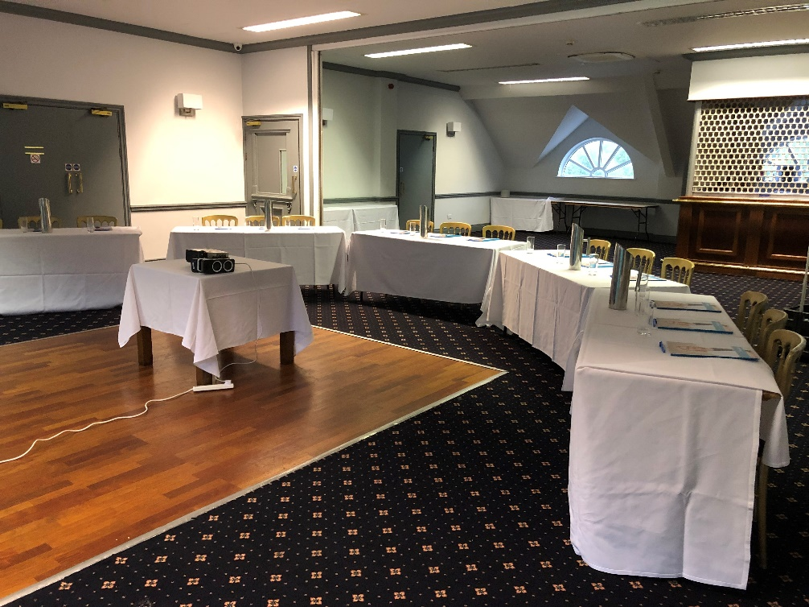
Display and room set up
Exhibition stock is to be used for display during Part 2 of the FCISC
Please ensure display screen/projector is available

Slide 18
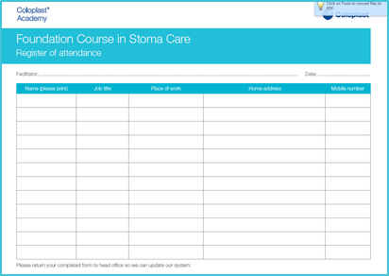
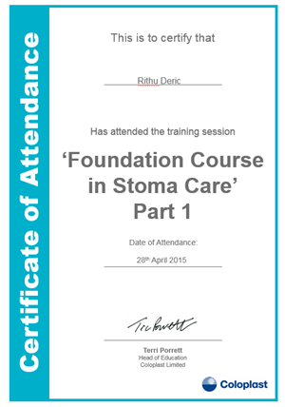
FCISC Part 2 – Attendance & Certificates
As normal please ensure all attendees on the day have registered. Please either send register to the Events team or email it to events@coloplast.com

Slide 19
Monthly Report
A monthly report will be sent to you from the events team so that you can check your accounts / nurses to ensure all up-to-date.
You can also determine which accounts are ready to hold a workshop.
This is sent out during the 1st week of every of month.

Slide 20
Help & Support
The Events Team
E: events@coloplast.com
T: 01733 392061 / 01733 392063

