Slide 1
Neurogenic Pathologies

Slide 2

Spinal Cord Injury
Spinal cord injury is a broad term for damage to the spinal cord. Most spinal cord injuries cause some degree of permanent disability or loss of sensation in parts of the body below the site of injury. The degree of disability depends on the extent of the injury and where along the spinal cord it occurs
The spinal cord is part of the central nervous system. Together with the brain it controls bodily functions including movement and behaviour. The spinal cord is protected by the bones of the spine and is cushioned by a clear fluid called cerebral spinal fluid. Nerves enter and exit the spinal cord at different points to control the various parts of the body. The spinal cord forms a vital link between the brain and the rest of the body – if damaged, sensation and movement may be impaired or completely lost

Slide 3
Spinal Cord Injury
Can be referred to as traumatic and non- traumatic injuries
  Traumatic injuries are typically falls, car accidents and similar
  Non-traumatic injuries can be caused by radiation, osteoporosis and similar
There is generally an increase in the non-traumatic injuries caused by an aging population whereas the traumatic is fairly constant
Incidence EU: 19.4 per million
Prevalence EU: 252 per million

Slide 4
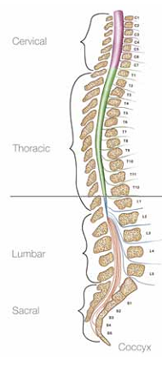
Impact of SCI on the bladder - neurogenic bladder
Reflex bladder – a failure to store urine. Usually occurs when the injury is above T12
Flaccid bladder – a failure to empty urine. Usually occurs when the injury is below T12
Benevento BT, Sipski ML. Phys Ther 2002;82(6):601-12.
Notes:
Although SCI does not influence how the kidneys produce urine, a major consequence of SCI is the loss of bladder function and the ability to store or empty urine. A bladder that has lost function due to damage to its nerve supply caused by SCI is termed ‘neurogenic bladder’. There are two main categories of dysfunction associated with neurogenic bladder – reflex bladder and flaccid bladder:
Reflex bladder (injury above T12) is a failure to store urine because the bladder muscles contract spontaneously as the bladder begins to fill with urine. This causes incontinence (accidental emptying) as the person is unaware of when the emptying will occur
Flaccid bladder (injury below T12) is a failure to empty urine because the bladder tends to lose muscle strength and cannot contract properly for emptying. The bladder will be at risk of overstretching and infection

Slide 5
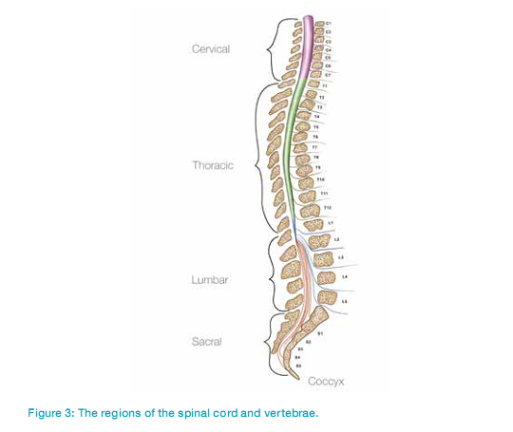
The impact of SCI depends on several factors
Cause of injury
  Traumatic vs non-traumatic
Level of injury
  Cervical, thoracic, lumbar or sacral
Extent of injury
  Complete vs incomplete
Notes:
The impact of an SCI will vary depending on the cause (traumatic vs non-traumatic), the level (location of the injury along the spinal cord) and the extent of the injury (complete vs incomplete). SCI is usually a long-term condition because of the limited capacity of the nervous system to recover following damage to the spinal cord.

Slide 6
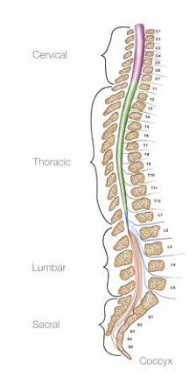
Physiological Impact of SCI
Higher level SCIs generally lead to more severe impairment, e.g:¹
SCI at C2
Possible paralysis from the neck down, difficulty breathing, difficulty with speech, no bladder or bowel control
SCI at L2
Possible paralysis of lower body and legs, some impairment to bladder and bowel control
Severity of impairment
Spinal Cord Injury Information Pages. 2009. http://www.sci-info-pages.com/function.html
Notes:
The specific type and amount of impairment caused by SCI varies from person to person and the way in which the spinal cord was damaged. Nevertheless, the extent of SCI largely depends on the level at which the injury occurs to the spinal cord. Higher level SCIs (i.e. those closer to the head) generally lead to more severe impairment to sensory and motor function than do SCIs that occur at a lower level. As the nerves supplying the bladder and parts of the bowel originate from the lumbar and sacral levels, problems with urination and defaecation can result from an SCI occurring at any point in the spinal cord from C1 to S4.

Slide 7
SCI – Level of Injury
  Injury in the cervical region often results in:
  Tetraplegia – loss of function in all four limbs
  Injury at or below T1 typically results in:
  Paraplegia – loss of function in lower body
Notes:
Bodily function below the level of the injury is usually either seriously impaired or completely lost after an SCI. The level of SCI generally corresponds to the vertebra that is closest to the site of injury. Depending on the level of injury, SCI results in tetraplegia/quadriplegia (if the injury occurs in the cervical region) or paraplegia (if the injury is at or below T1, i.e. in the thoracic, lumbar or sacral regions). Tetraplegia is the loss of movement and sensation in all four limbs; paraplegia is the loss of movement and sensation in the lower half of the body – typically both legs.

Slide 8
60% of SCI patients suffer from urinary incontinence
The distribution of end-users suffering from both retention and incontinence or one of the two is fairly similar across indications
Type of continence issue:
N=1.480
N=446
N=310
N=212
N=177
N=335
Notes:
Q2 (P) Do you experience…; a) difficulties in getting your urine out by normal means/urinating – or what is also know as “retention”? or b) that urine leaks out without you being able to stop it – or what is also known as “incontinence”…
Q3 (P): What is the cause of your continence issues?
N= 1.480

Slide 9
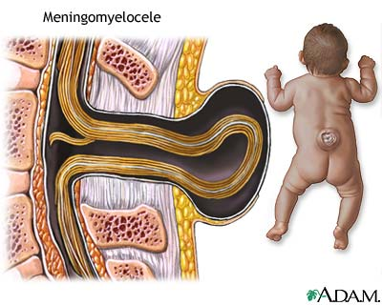
Spina Bifida
  People with spina bifida are born with a spine and central nervous system that have not developed properly causing revelation of the neural tube.
    Rates are falling in most developed countries due to a combination of pre-conceptional folic acid supplements and screening programmes
    Birth prevalence EU and North America: 3 per 10.000
    Birth prevalence South America: 9 per 10.000
Notes:
The number of children born with spina bifida is declining due to a combination of more women taking folic acid supplements before and after conception and screening programs to identify the condition early in pregnancy

Slide 10
Spina Bifida
Most common types of Spina Bifida
Myelomeningocele is where paralysis of the legs is likely and where bladder and/or bowel dysfunction is likely in 80% of cases. It occurs when the damaged spinal cord and nerves protrude through the opening in the spine, along with meninges (membranes that envelop the central nervous system) and cerebrospinal fluid.
Meningocele is when the meninges stick out through the opening in the spine in a sac that is also filled with cerebrospinal fluid. In general, meningocele is associated with a lesser degree of disability than myelomeningocele, but bladder and bowel problems are possible.
Spina Bifida Occulta is fairly common; one in 10 people may have it. Most people will not have any symptoms of disease. However, in about one in 1000 cases, the spinal cord might be trapped between the bones of the spine in the affected region. Some effects may be seen in childhood, such as bladder and bowel problems, or leg pain.
Meningocele
Spina bifida occulta
Notes:
The severity of the spina bifida depends on where along the spine the opening occurs, the size of the opening, whether skin covers the affected area and whether or not spinal nerves are involved. The specific features of spina bifida vary, but generally the small bones (vertebrae) that make up the spine are not fully formed and may have gaps between them. In severe cases, one or more vertebrae may be missing, exposing the spinal cord. The nerve damage means that the nerves controlling bladder and bowel function are affected.
Most common types of spina bifida
Ranging from most severe to less severe, the most common types of spina bifida are:
Myelomeningocele
Meningocele
Spina bifida occulta

Slide 11

Multiple Sclerosis
  Multiple sclerosis is an inflammatory disease in which the insulating covers of nerve cells in the brain and spinal cord are damaged. The term ‘sclerosis’ actually means scarring, and ‘multiple’ relates to the fact that the scarring can occur in many different places in the brain and spinal cordis a degenerative condition that affects the central nervous system (the brain and spinal cord communication). This can interfere with cognitive and bodily functions including control of the bladder and bowel.
The central nervous system
Consisting of many nerve fibres, the central nervous system carries messages to and from the brain and spinal cord to different parts of the body. Nerve fibres are surrounded by a protective sheath of myelin, which helps to insulate them and ensure that the messages they carry – the nerve impulses – travel quickly and correctly. In people with multiple sclerosis, the myelin sheath around nerve fibres becomes damaged or scarred. This interrupts the messages carried by the nerves and can interfere with a wide range of bodily functions.
Notes:
people with multiple sclerosis have neurogenic bladder dysfunction, which means they have a decreased ability to control their bladder. Some people may find that they need to urinate more frequently or urgently, whereas others may experience difficulty emptying the bladder or a feeling of incomplete emptying. Bladder problems, if left untreated, can be severely detrimental to the course of the disease and subsequently have a high impact on quality of life. The symptoms below may be one of the first indications of having multiple sclerosis but they may also develop during the course of the illness.

Slide 12
Multiple Sclerosis
In Europe and North America, multiple sclerosis affects one in 800 people, making this illness the most common cause of neurological disability in young adults. Symptoms are typically first seen between the ages of 20 and 40. Multiple sclerosis is approximately twice as common in women as in men. It is not known what causes multiple sclerosis, although it is thought to be a combination of genetic and environmental factors.
  Multiple sclerosis is a disease where persons own immune system attacks central nervous system and is a gradual decline of physical function over time
  Female and male ratio is 2:1
  50-70% will suffer from bladder problems the predominant symptom being urge incontinence however around 20% will at some point suffer from urinary retention
  Global prevalence: 30 per 100.000
  More common in northern parts of the world (80 per 100.000)

