Slide 1
Peristeen Troubleshooting

Slide 2

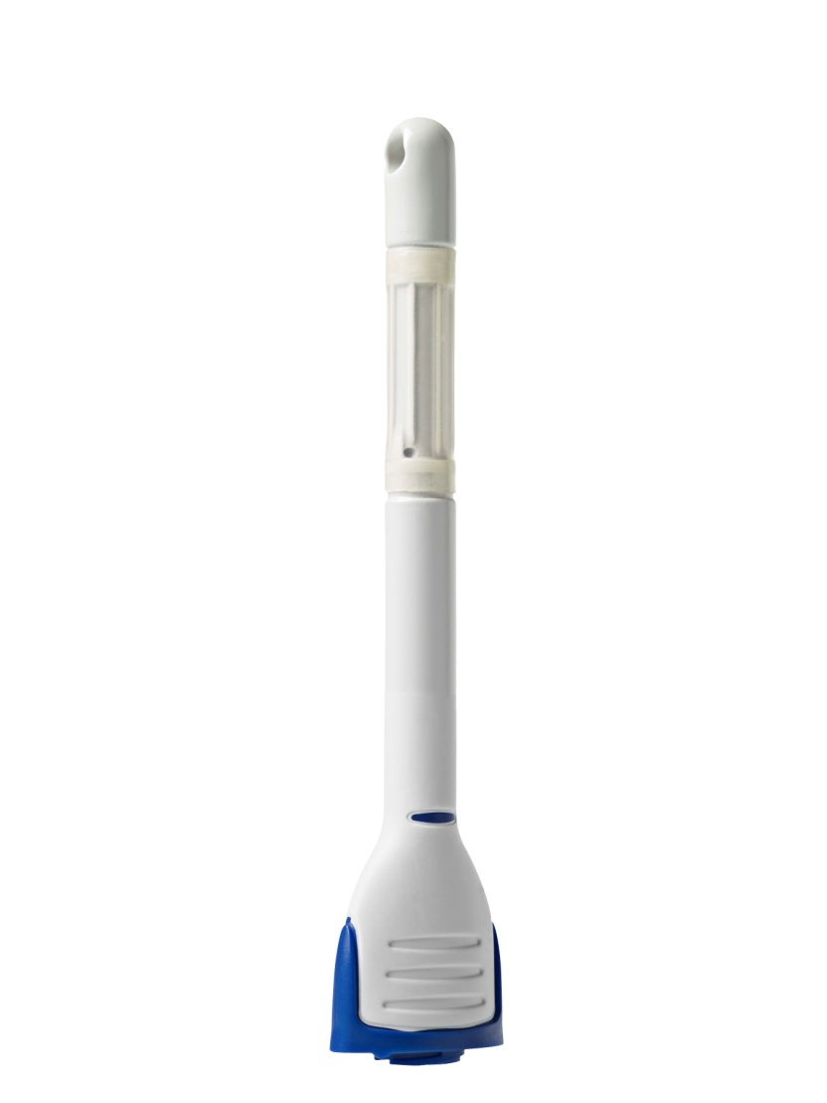
The catheter ‘falls out’.............
Try:
Is balloon inflated enough?
Adjust water volumes
Hydrate the balloon for less than 30 seconds
Hold the catheter insitu while water is being instilled

Slide 3

I am getting some rectal bleeding...................
Try KY jelly but not too much
? History of hemorrhoids
If still bleeding after 3 days – check up

Slide 4
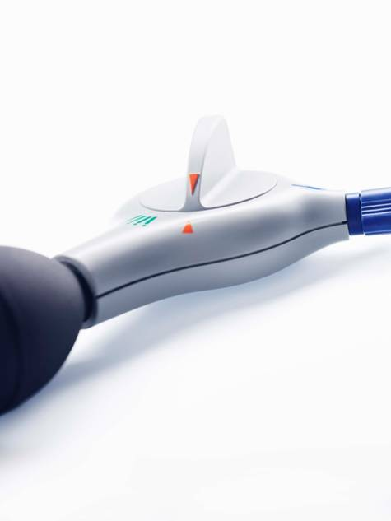
I am leaking after irrigation...............
Try:
Are they using too much water
After irrigating, stand; wriggle; sit down again and brace
30-60 mins after irrigating – return to toilet and brace
In neurogenic patients try digital stimulation after emptying

Slide 5
I don’t feel ‘empty’......................
Try:
2nd irrigation
Glycerin suppository before irrigating

Slide 6
Exploring the Evidence

Slide 7
Transanal irrigation (TAI) – putting patients in control
TAI is an alternative to conventional bowel management
It is a technique for emptying faeces from the bowel in a controlled manner
  Water is introduced into the rectum and colon via the anus, then evacuated into a toilet together with the contents of the descending colon, sigmoid and rectum
Clinical studies show fewer urinary tract infections (UTIs) associated with TAI vs. conventional bowel management^{1,2}
In patients with SCI, a lot of faeces can remain in the bowel after defaecation³, increasing the risk of a faecal incontinence episode
  Regular TAI can be used to help prevent these episodes and also reduce constipation
¹Christensen P, et al. Gastroenterology 2006;131:738–747;
²Ausili E, et al. Spinal Cord 2010;48:560–565;
³Christensen P, et al. Dis Colon Rectum 20003;46:68–76

Slide 8
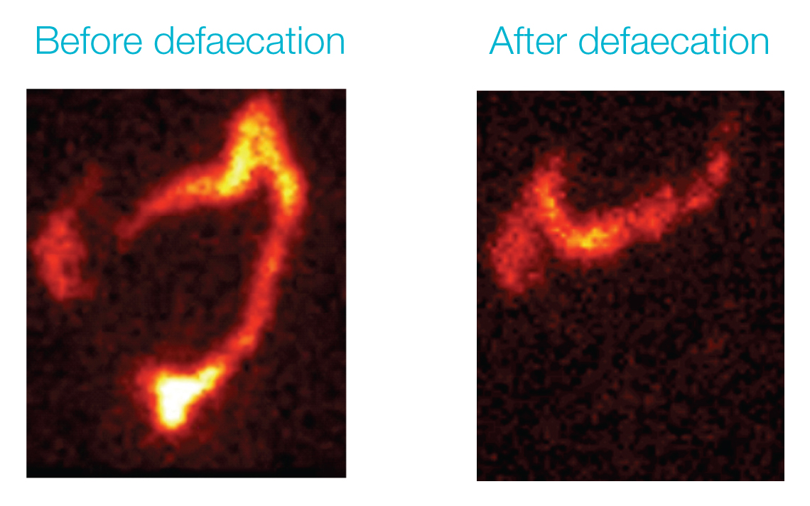
TAI effectively empties the contents of the rectum, sigmoid and descending colon
Scintigraphic images of the bowel in an SCI patient using TAI
Faeces present in
descending colon
and rectum before TAI
Descending colon
and rectum empty
after TAI
Notes:
These images show the bowel contents of an SCI patient − before and after defaecation using TAI
After TAI, the contents of the rectum, sigmoid and most of the descending colon have been efficiently emptied; the image resembles what would be seen after defaecation in a non-injured person
After TAI, new faeces take an average of two days to reach the rectum, helping users of TAI to remain continent between regular irrigations

Slide 9
Evidence summaries
The following slides summarise key data available on the use of TAI for the management of bowel dysfunction.
These data are primarily in individuals with SCI and spina bifida
Data exist on the efficacy, safety, well-being, QoL and overall cost to society of TAI for the management of NBD

