Slide 1
Practical overview of Peristeen

Slide 2

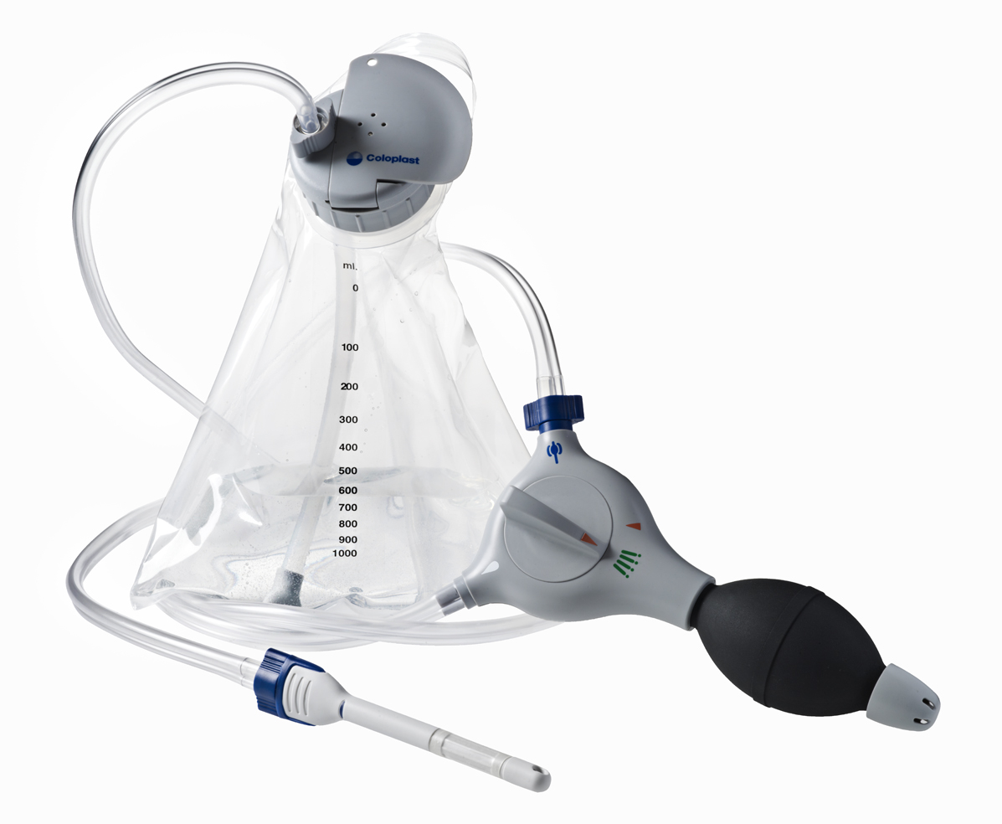
Peristeen Trans Anal Irrigation system

Slide 3
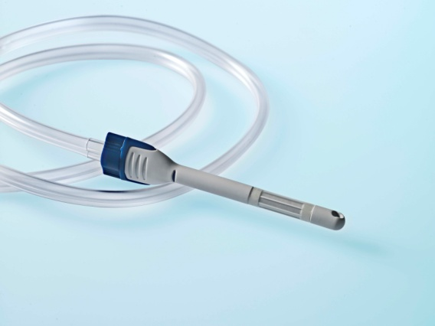
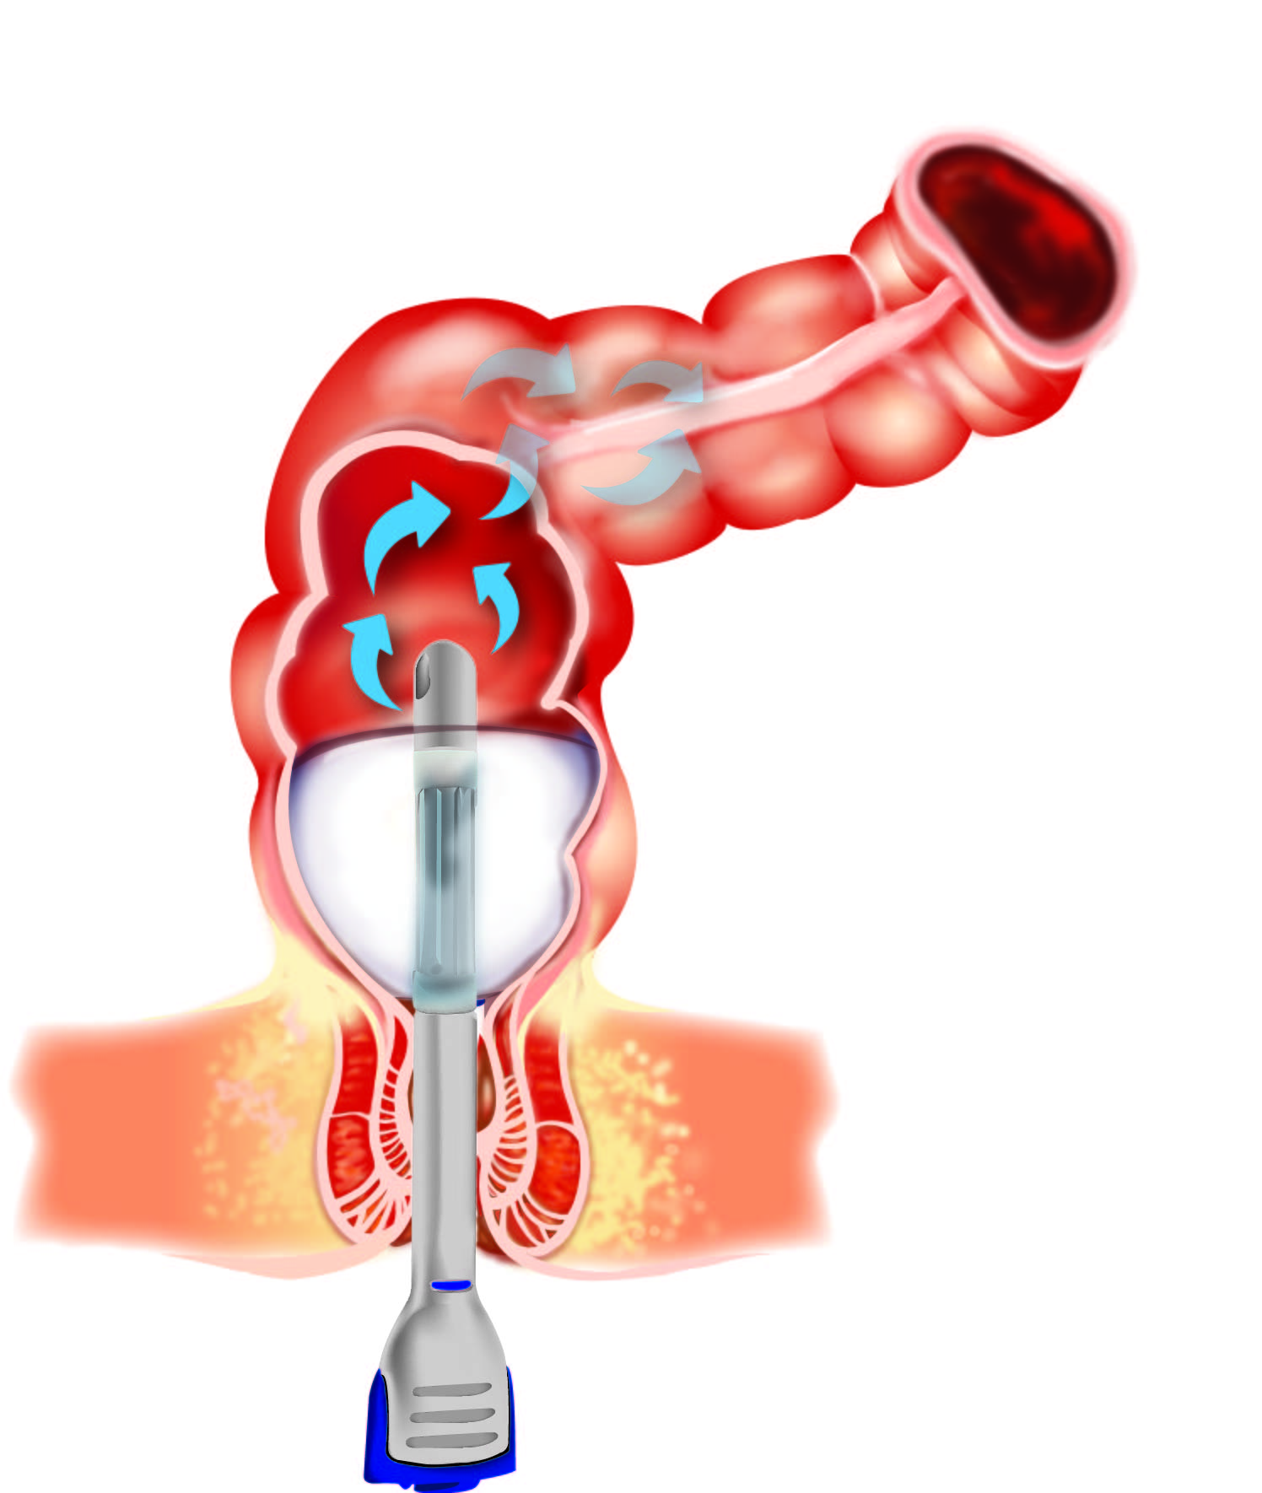
Catheter
Single use
2 sizes – regular and small
Self-supported inflatable rectal catheter
Easy to use pre-coated catheter

Slide 4
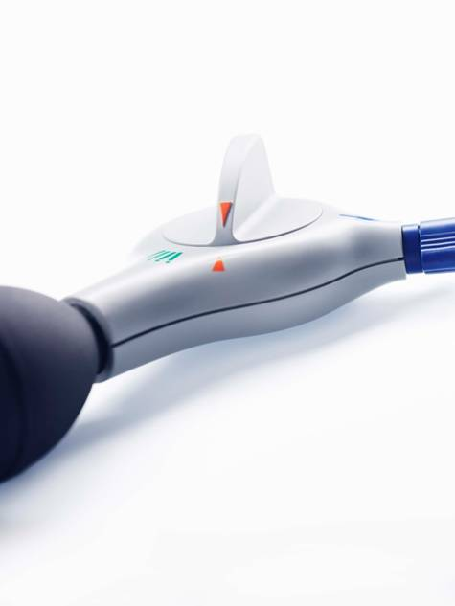
Control unit and pump
Sturdy construction
Easy to operate knob
Easy to understand pictograms/symbols
Works for 90 irrigations (change every 6 months if irrigating every other day)

Slide 5
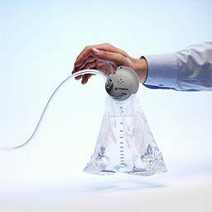
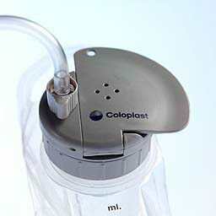
Water bag and pressure valve lid
Flexible placement
Easy to open and fill
Volume indicator
Water bag can be used for 15 irrigations (monthly if irrigating every other day)

