Slide 1
Trans Anal Irrigation - Starting your patient on Peristeen

Slide 2
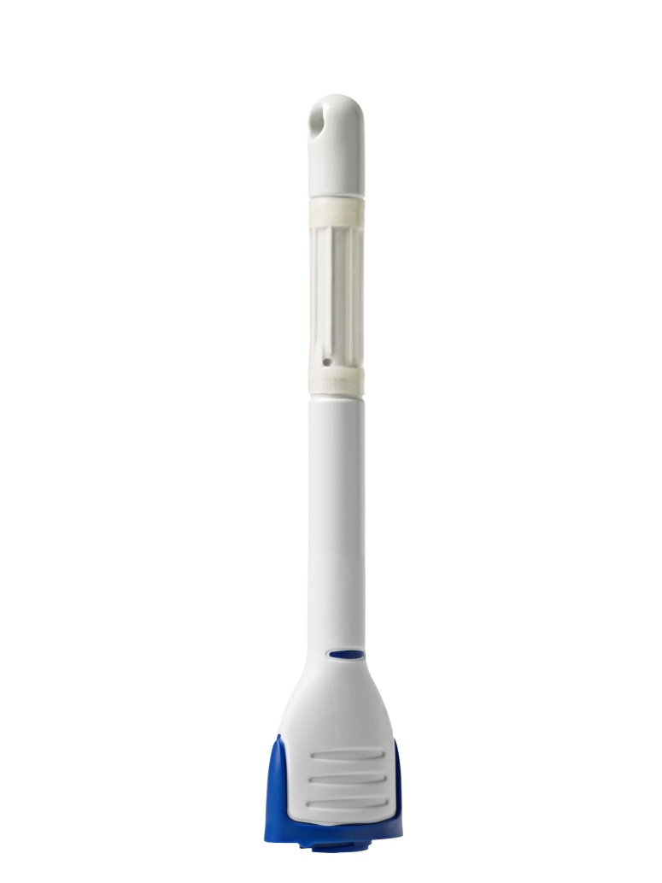
What do you need to get started?
Peristeen system code 29121
Accessory unit code 29122
Coloplast Care patient start pack
(Patient guide, step by step guide, DVD)

Slide 3
Getting Started – Teaching
Ensure you have all equipment to hand – register patient with Charter Healthcare
Ensure patient is not impacted
Patients can be taught in clinic or home setting
Ideally first irrigation will be done with health care professional present
500ml is an ideal amount to begin irrigating with for adults
Irrigate daily for first two weeks to ensure good technique and identify individual regime
Follow up in person or via telephone within 7 -14 days

Slide 4
Parameters to be adjusted individually:
Size of catheter Balloon
Volume of water
Frequency of irrigation
Medication
Any changes in the procedure must be done gradually
Only change one parameter at a time
Notes:
A number of parameters are adjusted on an individual basis…

Slide 5
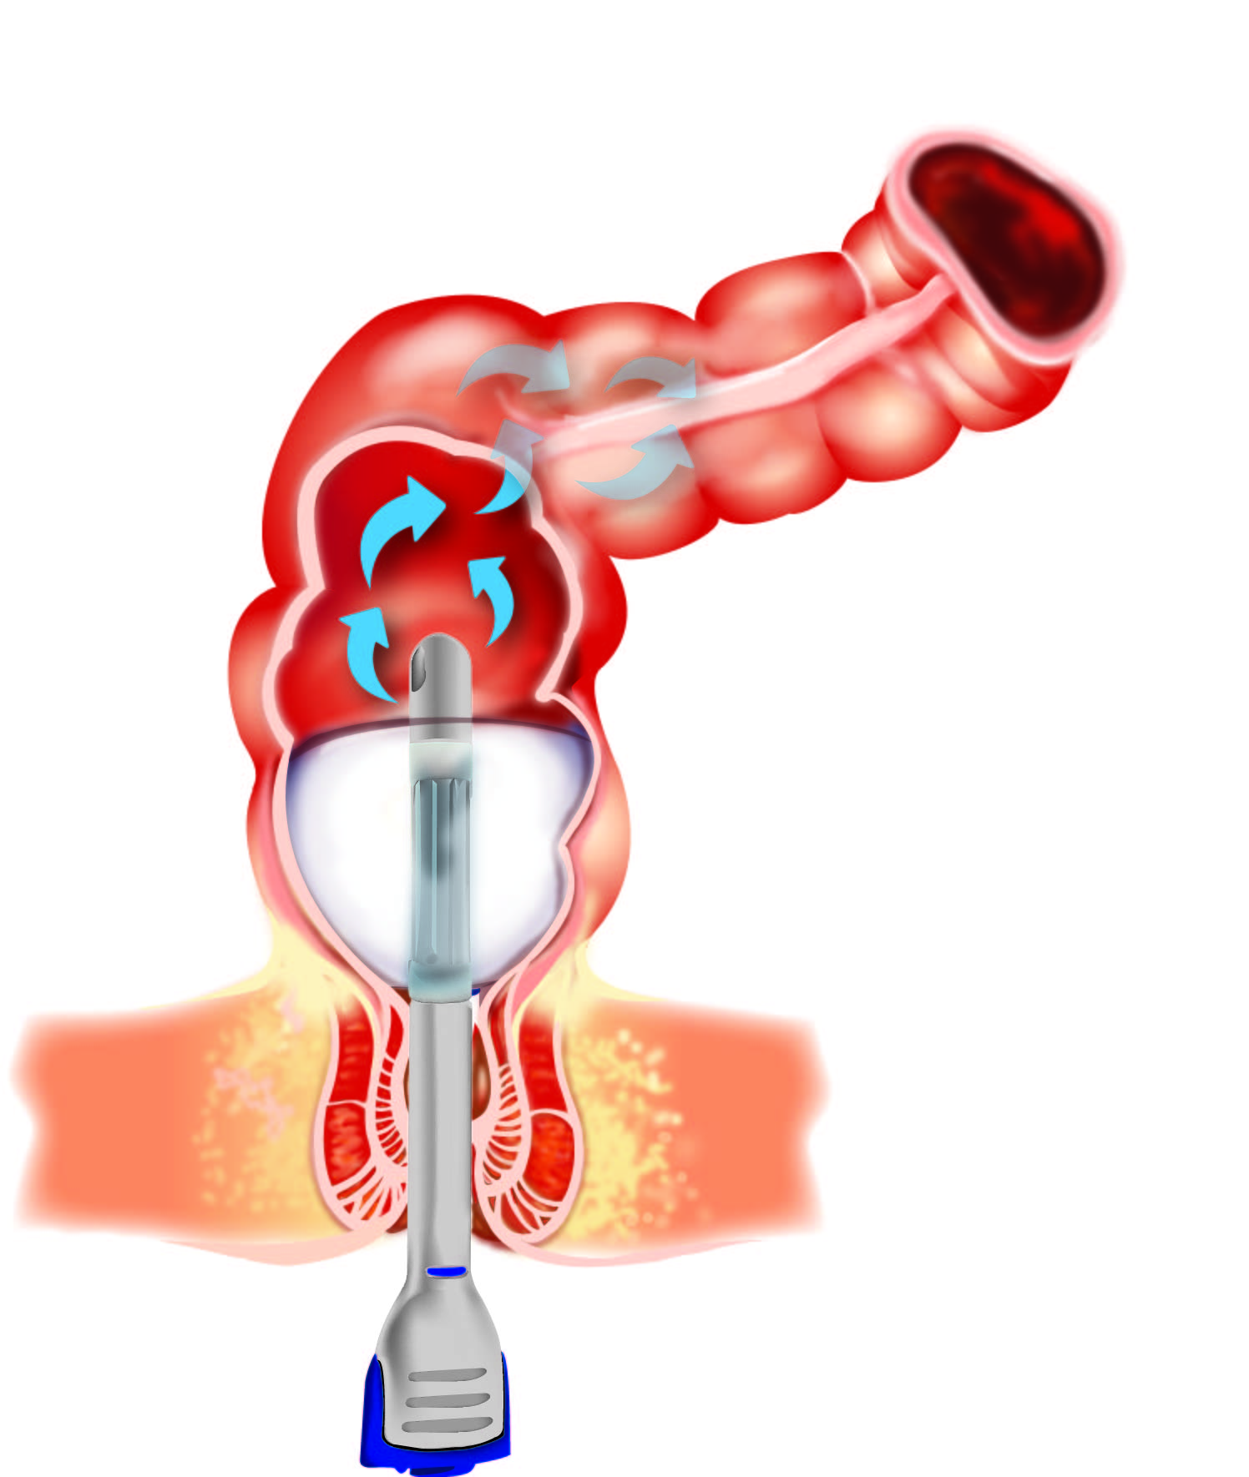
Parameters to adjust individually - catheter
Insert the catheter to the ”handle”
Start inflating the balloon with 1-2 pumps
Balloon must be inflated above sphincters
Adjust the number of pumps in case of leakage of water during the procedure
Patients with flaccid bowels may need 3-4 pumps
Minimum number of pumps should be tried out to avoid triggering of reflexes
Do not inflate with more than 5 pumps (2 pumps for small catheter)
Notes:
How to introduce the catheter…

Slide 6
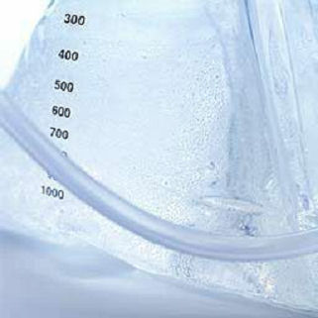
Parameters to adjust individually - volume of water
Water should be body temperature 36 - 38º C
Adults start with about 500 ml water
Children should start with 200-300 ml water
Notes:
How to adjust the volume of water…

Slide 7
Parameters to adjust individually - volume of water
Increase gradually the amount of water until the patient achieves a good and complete emptying
Effect achieved:
Faecal incontinence
When patient has no faecal incontinence episodes between irrigations
Constipation
When patient has regular bowel evacuations and emptying results after irrigation
When symptoms as bloating are reduced or disappear
Notes:
…continued…

Slide 8
Parameters to adjust individually - frequency and timing
Do the irrigation every day in the beginning
Do the procedure at regular intervals at the same time and fit it in to the daily routine.
Natural bowel movements are strongest in the morning after a meal.
    Some patients need to irrigate daily, others every other day – depending on thier transit times
It is important to irrigate regularly and not occasionally to achieve the optimal results
Notes:
How to define the individual routine - frequency and timing…

Slide 9

How do we ensure successful use of Peristeen?
New users of Peristeen should expect a period in which to adapt and optimise the irrigation regime to their individual needs
Parameters to adjust
Balloon size
Frequency
Water volume
Medication
Early difficulties are mainly attributed to practical problems
Follow up by the HCP is critical

