Slide 1
Transanal irrigation for the treatment of neuropathic bowel dysfunction
López Pereira P, et al. J Pediatr Urol 2009;6:134–138

Slide 2
TAI for the treatment of neuropathic bowel dysfunction
Intervention
  TAI with Peristeen
Study design
  Prospective study
  Mean follow-up, 12 months (range, 4–18 months)
  Patients: 40 children / youths with spina bifida and NBD
    With unsatisfactorily response to conventional bowel management
    Mean age, 12.5 years (range, 6–25 years)
López Pereira P, et al. J Pediatr Urol 2009;6:134–132
Notes:
In this prospective study, 40 children and youths with a mean age of 12.5 years with spina bifida and NBD who did not respond satisfactorily to conventional bowel management underwent TAI with Peristeen

Slide 3
Peristeen® significantly reduced symptoms of bowel dysfunction
Key efficacy data
  Peristeen significantly reduced:
      Difficulty and / or pain during defaecation (P<0.005)
      Feeling of incomplete evacuation (P<0.0001)
      Leakage of faeces (P<0.0001)
      Abdominal pain or discomfort before or after defaecation (P<0.0001)
      Occurrence of sweating or headache during or after defaecation (P<0.05)
  Peristeen significantly improved:
    Patients’ opinion of intestinal functionality (P<0.0001)
    Time spent on bowel management / Independence
  Key safety data
  No adverse events were reported
López Pereira P, et al. J Pediatr Urol 2009;6:134–132

Slide 4
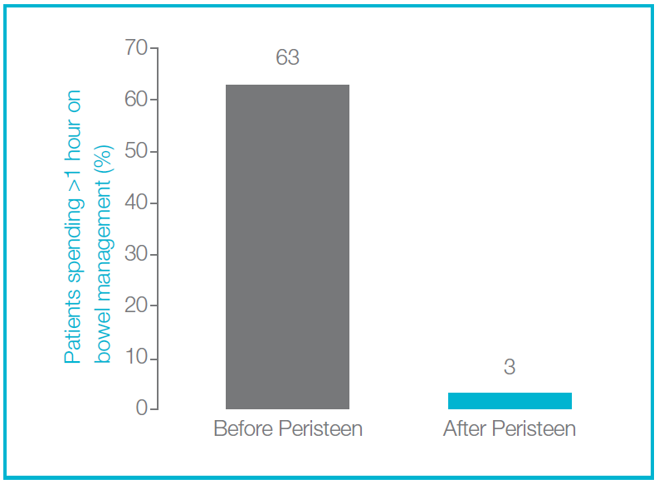
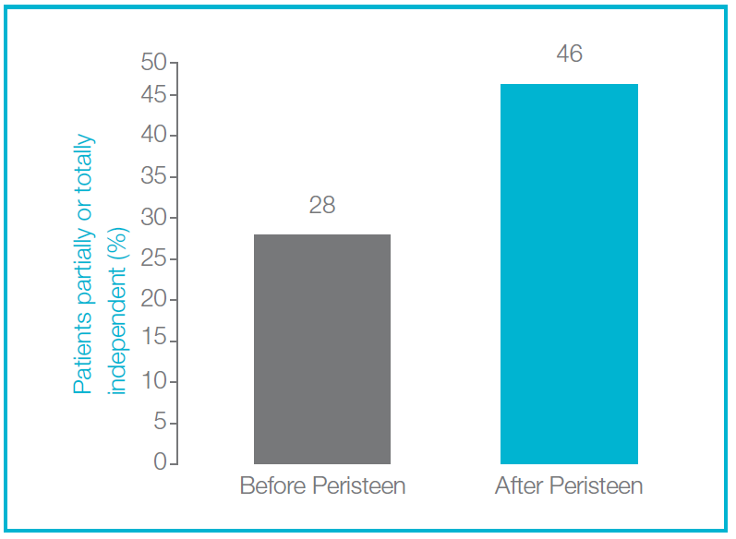
Peristeen® reduced time spent on bowel management and improved independence for bowel evacuation
Improvement
Improvement
López Pereira P, et al. J Pediatr Urol 2009;6:134–132
Notes:
Peristeen reduced the total time spent on bowel management; before Peristeen, 63% of children spent >1 hour; with Peristeen, this was reduced to 3%
Independence was improved with Peristeen; before Peristeen, 28% of patients were partially or totally independent in terms of bowel evacuation; with Peristeen, 46% were partially or totally independent

Slide 5
Summary: TAI for the treatment of NBD in children and youths
Data from this study show that Peristeen is effective in terms of reducing symptoms, reducing time spent on bowel management and increasing independence in children and youths who do not respond to conservative bowel management
Evidence from this study supports the positive benefits of Peristeen in children and youths
López Pereira P, et al. J Pediatr Urol 2009;6:134–132
Notes:
Study conclusions:
Peristeen is an effective therapeutic approach in children and youths with spina bifida and NBD
After changing from conservative bowel management to Peristeen, subjects experienced significantly reduced symptoms of bowel dysfunction, including faecal incontinence
Using Peristeen led to greater partial or total independence, reducing the need for assistance with bowel evacuation in children and youths with spina bifida
Peristeen significantly reduced the total time spent on bowel management, decreasing the proportion of children spending more than an hour on bowel management from 63% to 3%
Peristeen had a good safety profile in children and youths with spina bifida and NBD

