Slide 1
Urine Drainage Bags

Slide 2
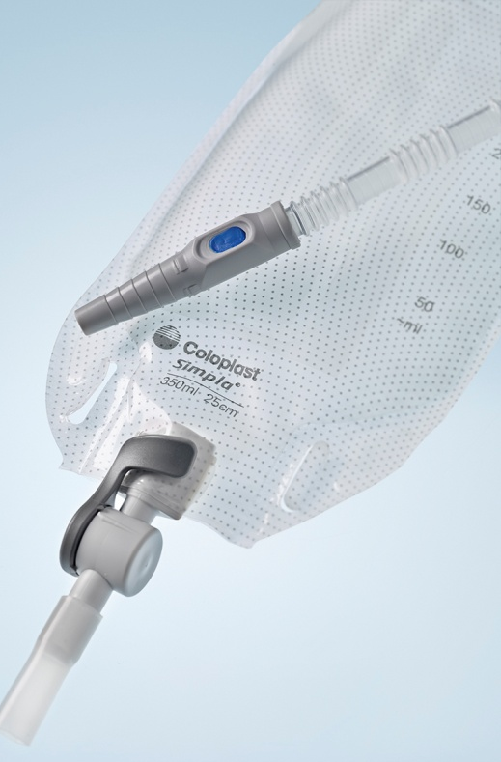
Who wears a urine drainage bag?
Anyone using an indwelling catheter
Any male wearing a sheath

Slide 3
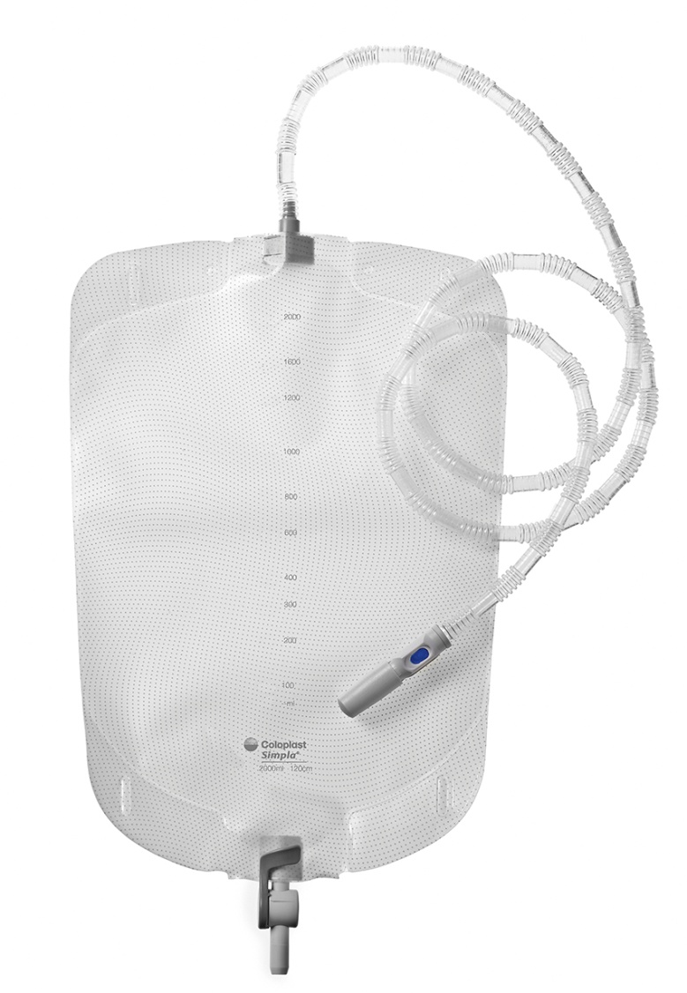
An overview of urine drainage bags
Two main types of urine drainage bags:
  Leg bags (day bags)
  Night bags
  (for additional overnight storage)
Leg bag
Night bag

Slide 4
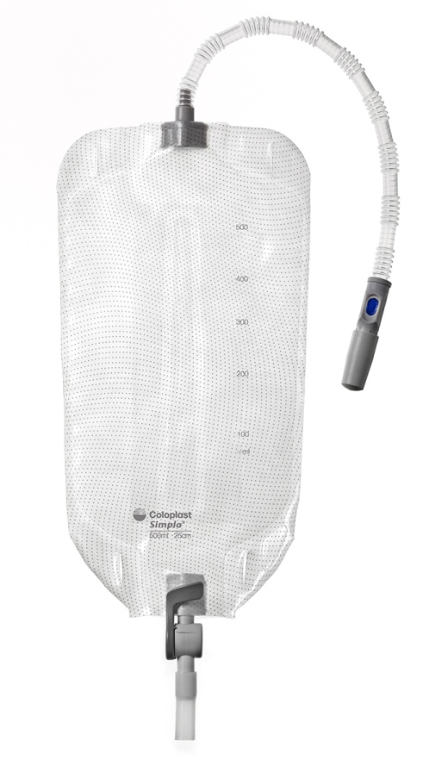
General specifications of a leg bag
Leg Bags normally come in 3 capacities or sizes
350ml
500ml
750ml
Leg bags usually come with a choice of 3 tube lengths
Long (for bag worn on calf - generally male length) – 25 cm
Short (for bag worn on thigh - generally female length) – 6 cm
Adjustable (long, adjustable tubing for use with a sheath) – 50cm

Slide 5
Leg bags provide daytime freedom and convenience
Various capacities and tube lengths available according to lifestyles
Sterile for indwelling catheter users
Sterile/non-sterile for sheath users
Variety of taps on offer
Variety of bag shapes and backings

Slide 6
A night bag enables additional overnight capacity to aid sleep
Connects to the end-users leg bag and provides an additional overnight capacity
Available in sterile and non sterile
Drainable and non-drainable
Sterile drainable night bags can be connected directly to an indwelling catheter, sheath (if bed bound) or the leg bag
Non-sterile, non-drainable leg bags cannot be connected directly to the end-users catheter as there is a potential infection risk. They can be connected directly to sheath

Slide 7
Specifications of a night drainage bag
Generally
2,000 ml
1,500 ml
The length of night bags tubing varies but is
generally between:
90 cm – 120 cm

Slide 8
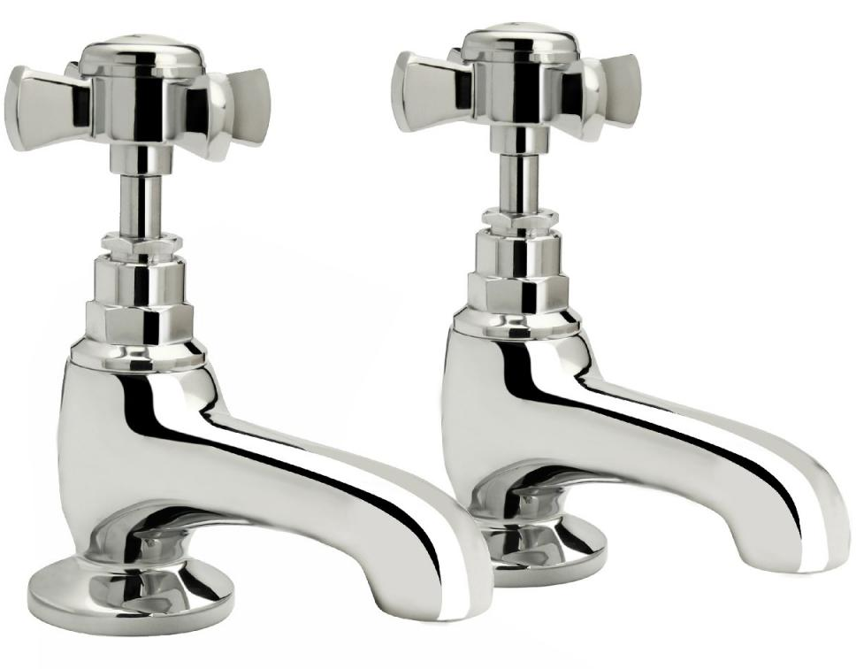
Urine drainage bag - taps
Taps have to be:
Safe and secure
Easy to use
Comfortable and discreet
Types of taps available:
Slide action tap (t-tap)
Lever action tap
Clamp action tap
Safety-Lock tap
Twist/Dial action tap

Slide 9
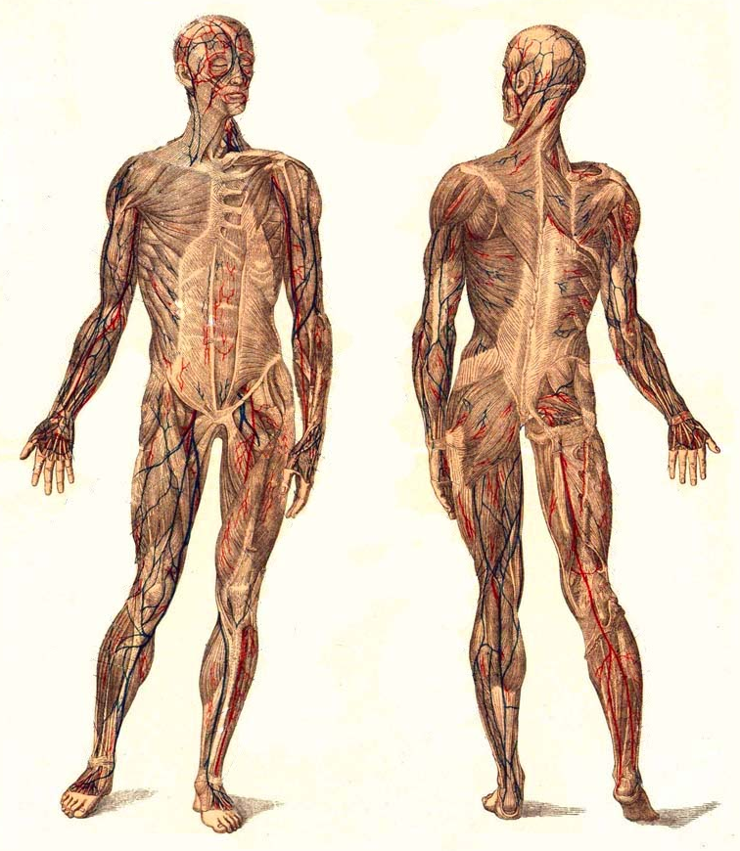
Anatomy of a urine drainage bag
Universal connector
Sample port
Tubing
Non-return valve
Body of bag (foil)
Fabric backing
Strap eyelets
Outlet tap
Night Bag Connector
PVC

Slide 10
PVC
The majority of urine bags are made of PVC for the following reasons:
PVC is soft and easy to weld
PVC is a quiet material
PVC weld strength susceptible to variations in temperature
PVC is a porous material and can sometimes allow odour to bleed through (although not proven)
PVC contains plastic softeners (Phthalates)
Does not burn well and does not degrade easily

Slide 11
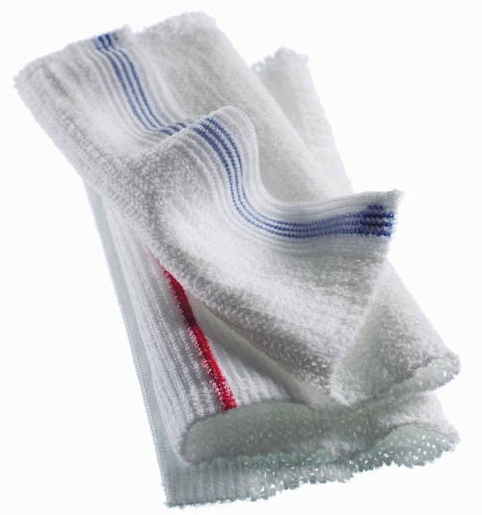
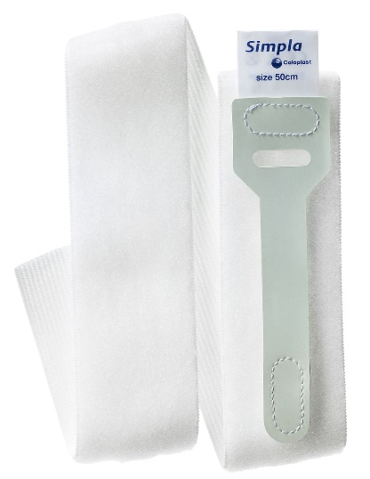
Accessories… remembering that the little things make all the difference
AquaSleeve
Coloplast Catheter Retaining Strap
also known as Simpla G-Strap

Slide 12
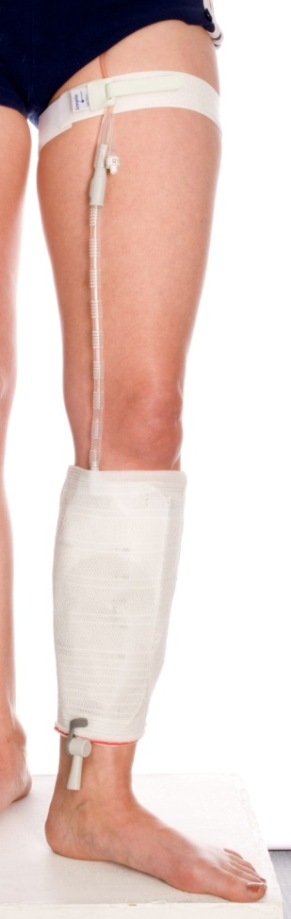
AquaSleeve…the alternative to leg bag straps
Popular alternative to straps
Evenly spreads the weight
Less likely to slip
No clammy plastic on skin
Suits all taps
Available in five sizes
(measuring tape available)
On prescription
Small (leg circum. 24-33 cm)
Standard (leg circum. 34-39 cm)
Medium (leg circum. 40-46 cm)
Large (leg circum. 47-64 cm)
Extra Large (leg circum. 65+ cm)

Slide 13
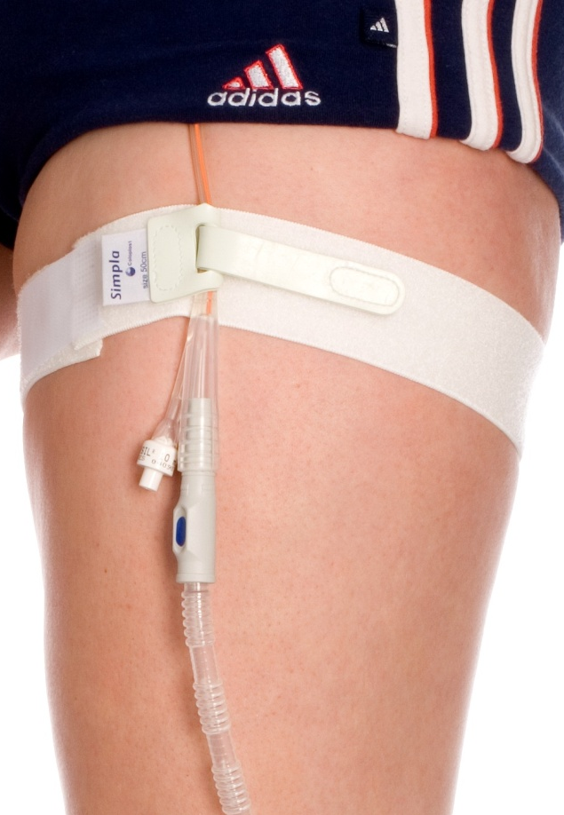
Coloplast Catheter Retaining Strap
(G-Strap)
Holds tubing comfortably in place
Prevents accidental urethral and
bladder neck trauma
Stops tubing from sliding, twisting and kinking
Available in 2 sizes:
  Adult
  Abdominal (suprapubic or can be cut to fit larger legs)
On prescription

Slide 14
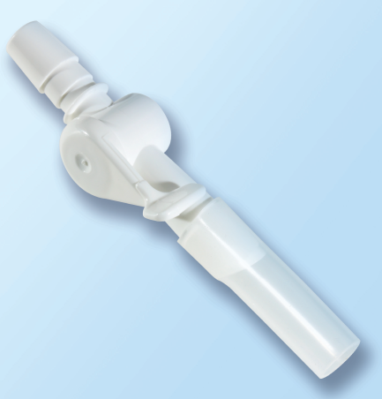
Catheter valve - Mobility for patients with indwelling catheters
Product code: CV3808
A convenient and discreet alternative to bags
Only suitable for patients with good bladder sensation, mobility and dexterity
Features smooth and discreet T2 lever tap

Slide 15
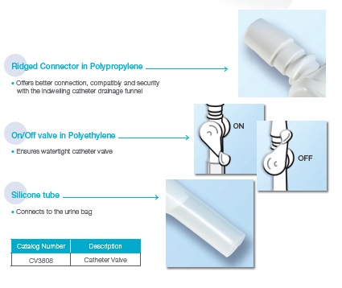
Simpla catheter valve
Ridged connector in polypropylene
Offers better connection, compatibility and security with the indwelling catheter drainage funnel
On/off valve in polyethylene
Ensures watertight catheter valve
Silicone tube
Connects to the urine drainage bags

