Slide 1
Catheter Care

Slide 2
What is a urinary catheter?
A catheter is a hollow tube that is used to remove fluid from or instil fluid into a body cavity or organ, a urinary catheter is designed for insertion into the urinary bladder to enable drainage of urine, removal of clots and instillation of medication.’
Pomfret (1996)

Slide 3
Reasons for Catheterisation
To relieve acute urinary retention – whilst awaiting assessment by urologist.
To relieve chronic retention with renal impairment.
Nerve damage – where bladder sensation is reduced (diabetics, neurological, spinal injury)
To protect wounds from urine; sacral pressure sores
Palliative Care (only if absolutely necessary)

Slide 4
Complications
Infection
Non-drainage of urine
Encrustation
Bypassing
Haematuria
Tissue damage

Slide 5
Infection
Research shows that an indwelling catheter is the main factor which predisposes a patient to a Urinary Tract Infection (UTI) . Burke et al (1981), Crow et al (1998)
80% of healthcare associated infections are related to catheter insertion.
The extra cost of looking after a patient with a urinary tract infection is estimated at £1,122 per patient.
Ref: Department of Health ‘Winning ways’ 2004

Slide 6
Signs and symptoms of a UTI
Fever
Frequency / Urgency to pass urine
Discomfort on passing urine
Suprapubic or back pain
Offensive smelling or discoloured urine
Haematuria
Confusion
Notes:
Urgency, frequency and dysuria will be absent in catheterised patients.
Will need dipstick or CSU sending to confirm diagnosis.

Slide 7
CAUTI - How is infection introduced?
There are 3 main routes:
On insertion of the catheter
Via the drainage system
Via the space between the walls of the catheter and the urethra
Hart (1985)
Notes:
Poor aseptic technique when catheterising.
Bacteria enters at the following points, catheter/drainage tube junction, via the sampling port, outlet of the drainage bag, via any punctures of the drainage bag system, on the outside of the catheter due to handling or movement of the catheter, on the inside of the catheter due to bio film formation, on the connection points of the link system. Wilson (1998).
Caused by gram negative bacteria from the gut colonising the perineum, women are more vulnerable than men as the urethra is shorter and nearer the perineum. This is thought to be the most common route of infection in women. Men are at less risk from this route as the urethra is longer and further away from the rectum. The most common route for men is thought to be from the drainage system. Wilson (1997).

Slide 8
CAUTI - Encrustation.
Infected urine results in a higher incidence of encrustation than non-infected urine
Encourage an increase in fluid intake
Encourage mobilisation
Review frequency of catheter change
Consider the use of an open-ended catheter

Slide 9
CAUTI - Formation of encrustation.
The bacteria Klebsiella, Pseudomonas or Proteus when present in urine produce urease
Ammonia is released when the urease mixes with Urea ( which is also present) resulting in an increase in urine alkalinity (above PH7)
An increase in urine alkalinity results in encrustation.

Slide 10
Non-drainage of urine
Check that the bag is below the level of the bladder to allow drainage by gravity. Use night stand or secure bag to leg.
Check that the tubing is not blocked or kinked
Catheter may be encrusted discuss with GP or continence advisor the use of bladder maintenance solutions.
Avoid constipation, treat if present.

Slide 11
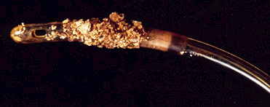
Biofilms
Biofilms obstruct the lumen and block urinary catheters.
Therefore
Catheter choice is important.

Slide 12

Folysil Catheters
100% Silicone
X ray line
Licensed for suprapubic and urethral use
Use up to 12 weeks
Open ended version

Slide 13
Catheter Maintenance - Troubleshooting
40 – 50% of catheterised patients will block.
Blocked catheters cause the patient pain, anxiety and incontinence.
Little research in this area.

Slide 14
Bypassing of urine.
Bypassing of urine has been found to occur in 89% of patients with long term catheters
Due to:
Encrustation and blockage
Bladder spasm
Kinked tubing
Constipation
(Roe and Brocklehurst.1987).
Notes:
Change the catheter by trained staff.
Catheter may be too large causing irritability, use the smallest size possible, size 12ch catheter can drain 100l in 24 hrs. Patient may require anticholinergenics.

Slide 15
Haematuria
May indicate an infection – always take a sample for urinalysis from the sample port
Small amount of bleeding is usual following initial catheterisation – increase fluids
May indicate a more serious problem - if it remains present after 24hrs seek medical advice
Trauma – always use the smallest catheter that allows drainage
Always use Cathejel in all female and male catheterisations.
Notes:
Blood in Urine = Haematuria May be visible in the form of clots or traces on dip stick test

Slide 16
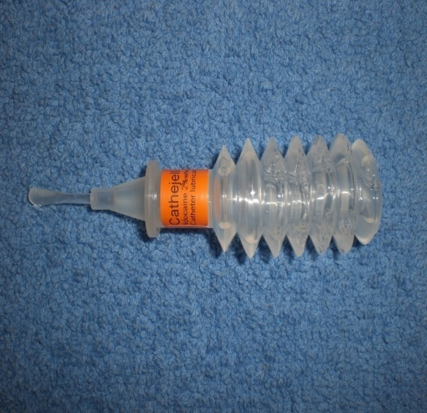
Cathejel
Cathejel is a water based gel
Contains 2% lidocaine for
anaesthetic action and chlorhexidine for antiseptic cover.
Pain free within 3-5 mins
Reduced infection rate, up to 90-99% of bacteria and yeasts
within 10 minutes.
Urethral trauma is reduced to a minimum

Slide 17
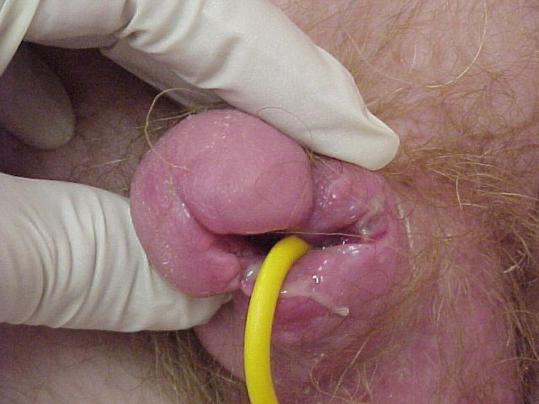
Tissue damage
Caused by:
Wrong size/type of catheter
Excessive pressure or traction of the catheter on the urethra due to poor securing of catheter and or drainage bags.
Trauma on insertion/removal of the catheter.

Slide 18
Preventing Infection
Adequate hand washing before and after handling of the catheter – using soap, water and an alcohol sanitizer
Wearing of a fresh pair of gloves and apron for each individual patient you attend.
Good practice when emptying the bag. Disposable night bags only in communal environment.
Good patient hygiene, at least daily washing or bathing, cleaning around a suprapubic catheter site with soap and water. No dressing around Suprapubic site.
Notes:
Use of sterile saline or water not chlorhexadine as this may result in resistant micro-organisms (Roe, 1993 in Penfold, 1999) and urethral trauma (Gould, 1994 in Penfold, 1999).
Keep the catheter bag below the level of the bladder to allow drainage by gravity(
Keep drainage bag closed except to empty twice daily (Roe, 1985 in Penfold 1999), prevent bags from getting overfull.
Changing of bag or catheter valve every 5-7 days according to DOH guidelines.
Showering is preferable to bathing, however if bathing then the bag should be emptied prior to bathing and the tap should remain closed. The bath should be washed out before and after use.
Encourage good fluid intake, aids flushing action and helps to prevent constipation.

Slide 19
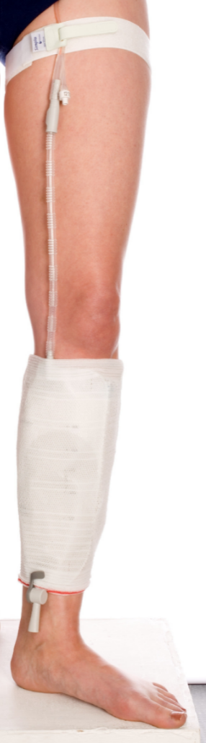
Preventing Infection
Aseptic technique when catheterising
Maintaining a closed drainage system
Correct positioning of the drainage bag as illustrated in the
picture
Notes:
19
Use of sterile saline or water not chlorhexadine as this may result in resistant micro-organisms (Roe, 1993 in Penfold, 1999) and urethral trauma (Gould, 1994 in Penfold, 1999).
Keep the catheter bag below the level of the bladder to allow drainage by gravity(
Keep drainage bag closed except to empty twice daily (Roe, 1985 in Penfold 1999), prevent bags from getting overfull.
Changing of bag or catheter valve every 5-7 days according to DOH guidelines.
Showering is preferable to bathing, however if bathing then the bag should be emptied prior to bathing and the tap should remain closed. The bath should be washed out before and after use.
Encourage good fluid intake, aids flushing action and helps to prevent constipation.

Slide 20
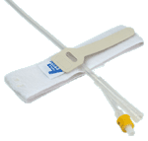
Securing Catheters / Drainage Bags
Secure catheter to patient well at all times
Use G-Strap / Catheter Retaining Strap

