Slide 1
Trans Anal Irrigation

Slide 2
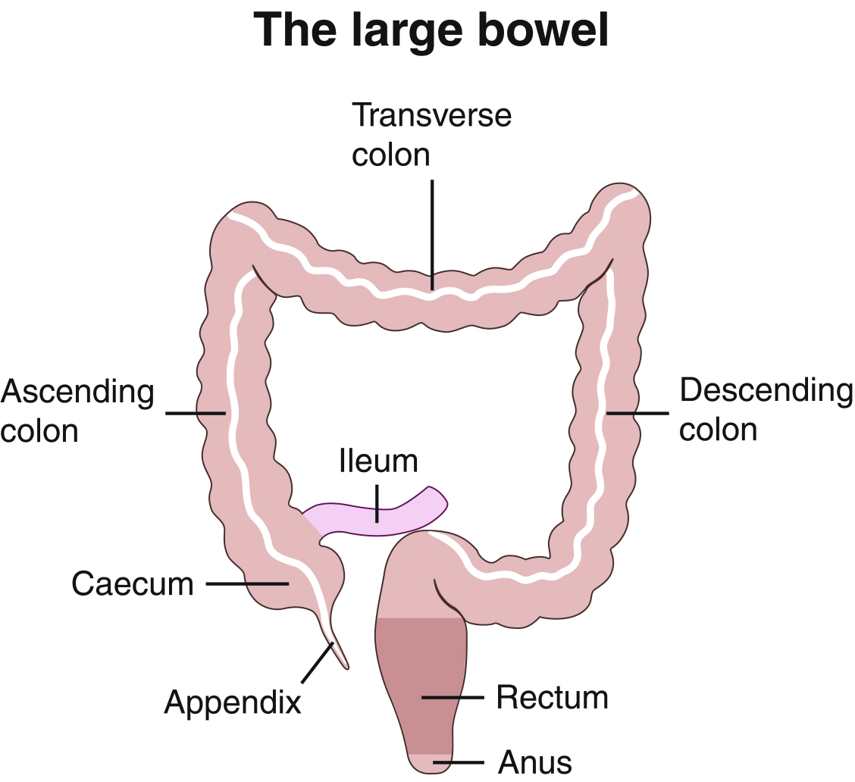
Notes:
The large bowel or colon acts as a “waste processor”, receiving semi-liquid stool from the small intestine and gradually re-absorbing fluid, resulting in formed stool.

Slide 3
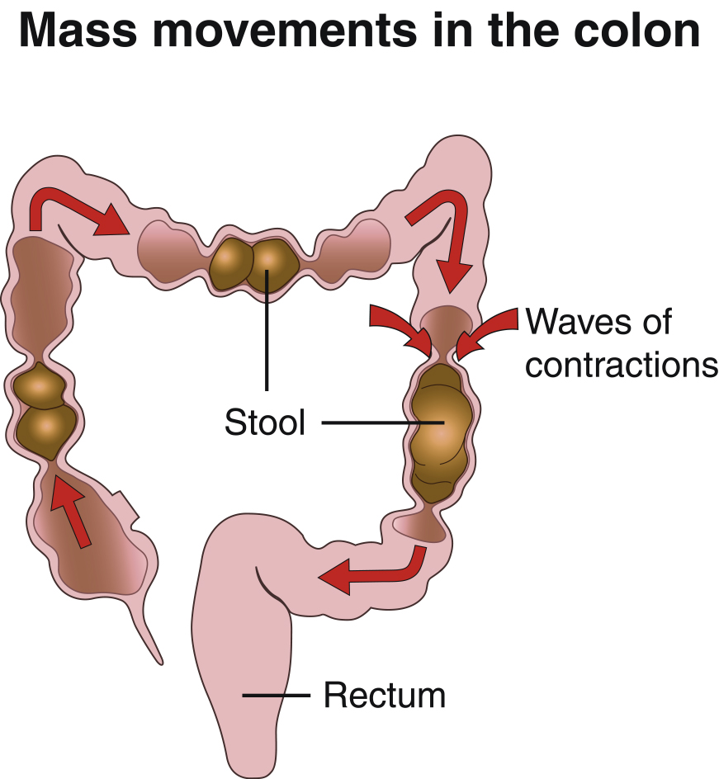
Notes:
There is continuous mixing and churning of matter in the colon, with occasional “mass movements” when waves of peristalsis propel stool large distances along the colon. Typically these mass movements are triggered by eating or drinking (the “gastro-colic response”) and the large bowel tends to be most active in the morning. This is why 15-30 minutes after breakfast is the most common time for defaecation. Normal adults taking a Westernised diet pass 150-200 grams of faeces per day, the amount depending largely upon dietary fibre intake. Normal bowel frequency varies considerably and is probably between three times per day and three times per week in Western societies (Connell et al, 1965), with only 40% of the population of Western countries experiencing the accepted “normal” bowel habit of once per day (Heaton et al. 1992). Once the phase of toilet training is passed, the urge to defaecate is felt once rectal filling passes a threshold volume, but this urge should not be desperately urgent and can easily be resisted until a toilet is found to empty the bowel.
References
Connell,A.M., Hilton,C., Irvine,G., Lennard-Jones,J.E. and Misiewicz,J.J. (1965) Variation in bowel habit in two population samples. British Medical Journal ii, 1095-1099.
Heaton,K.W., Radvan,J., Cripps,H., Mountford,R.A., Braddon,F.E.M. and Hughes,A.O. (1992) Defaecation frequency and timing, and stool form in the general population: a prospective study. Gut 33, 818-824.

Slide 4
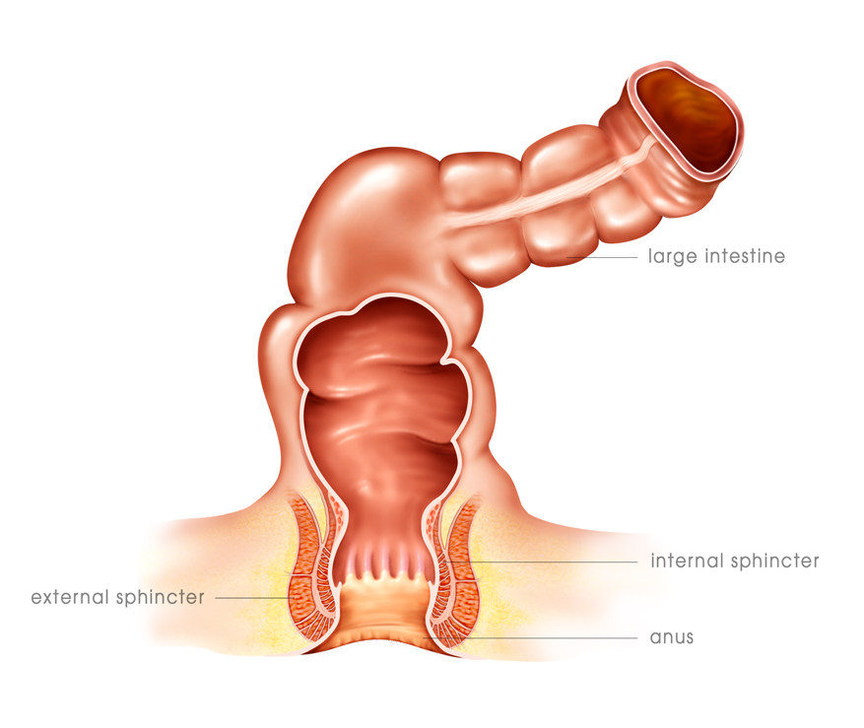
The Anus
“Man has evolved to be the greatest of all the species. And the organ that has ensured this is the hand.
Yet, were I to put in your hand a mixture containing matter solid, liquid and gaseous and then ask you to selectively release the gas, you could not. And yet, the lowly anus can do so, with ease, and I might add, several times a day…”

Slide 5
Lower part of colon - rectum
Notes:
Looking more closely at the lower part of the colon - the rectum - we see the two sphincters: the internal sphincter and the external sphincter.
These two sphincters control the defecation process. The internal sphincter is an extension of the colon musculature and is exclusively controlled by reflex (we cannot consciously control it). The external sphincter, however, is ”self controlled” meaning that it can be controlled consciously by the brain.
The emptying of the bowel is called the defecation process. This process is controlled via the defecation center, which is situated in the sacral center low on the spinal cord.
When the colon is empty it is folded up. When faeces fill up the rectum, the pressure changes and the rectum wall is distended. This pressure change will initiate impulses sent from the bowel wall to the defecation center, saying that the bowel is full -> the internal sphincter relaxes -> the person will then get a message to the brain that the bowel is full and it is time to go to the toilet -> the brain sends a message back to the bowel in order for the person to consciously contract the external sphincter until a suitable time and place has been found.
When the stool arrives in the rectum, the internal sphincter will relax but the external sphincter will remain contracted until we find an adequate time for evacuation.
This is how it works for a normal functioning person. Now we move on to have a look at a the bowel function of a spinal cord injured patient. In a spinal cord injury, the defecation centre and the lower part of the colon are almost always influenced by the injury as the defecation centre is situated very low on the spinal cord. Sphincter muscles, bowel and the bowel nervesystem are all intact but the nerves located in the bowel system are no longer able to communicate with brain the way they used to. This means that the person has no urge to defecate and may also experience difficulties in controlling the external sphincter. The small intestine and the stomach is controlled by the Brain nerve located very high on the spinal cord. Even in a very high injury these functions remain intact and the SCI patient is able to absorb the nutritious substances needed by the body.

Slide 6

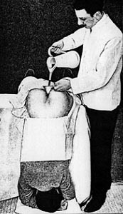
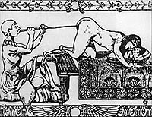
Trans Anal Irrigation - Is it new?
One of the earliest records is the Ebers Manuscript – 1550 BC
To prevent intoxication – mid 1800-1900’s

Slide 7
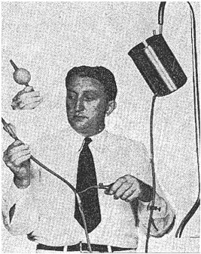
Trans Anal Irrigation
Krogh et al. 1999
Incontinence, n=9, success 44%
Constipation, n=16, success 19%
Children, n=12, success 91%
Shandling 1987
Re-introduction of method
Children with spina bifida and faecal incontinence
Result: 100% continence
Christensen et al. 2001
Incontinence, n=8, success 79%
Constipation, n=11, success 40%
Shandling B, J Pediatr Surg 1987; 22: 271-3
Krogh K et al. Ugeskrift for laeger 1999; Vol. 161 (3) p. 253-256
Christensen P et al. Dis Colon Rectum 2003; 46: 68-76
Notes:
Transanal irrigation is an ancient method, but in 1948 it was re-introduced by Baird (on the picture) as a treatment method for children with spina bifida. He made some initial studies on anal irrigation and achieved some very positive results. He proved that the method resulted in an improved hygiene and a better quality of life for the children.
Later in 1987, Schandling re-introduced the method, but this time as a chronic treatment instead of a method only for acute use/a method only used in hospitals. His aim was that the patients could use the method themselves and in their homes for the rest of their lives. He made an extensive study with two years follow up on SB children and children with faecal incontinence and he achieved a result of 100% continence within his target group. Today the method is still very well penetrated within this patient group. It is clear that children react really well to the anal irrigation method, probably because they have their parents to help them with the procedure and to make sure it is done on a regular basis but it may also because of their younger bodies.
In 1999, Dr. Klaus Krogh carried out a new study on transanal irrigation, which was followed up later in 2001 by yet another study by Dr. Peter Christensen. The two studies were carried out in the same hospital in Aarhus, Denmark with the same nurses, thus the two studies have a lot in common. The study by Dr. Peter Christensen was a Coloplast sponsored Ph.D. study.
Looking at the results from the two studies, you may notice that the success rates increase. The main reason for this was that the nurses who trained the patients in anal irrigation were more trained and more familiar with the anal irrigation method in 2001 than in 1999 and thus, the patients participating in the study were better informed and better trained. The conclusion was that the training of both the nurses and the patients is paramount to achieving a high success rate for the patient.
The hospital ward in Aarhus (an anal physiological clinic) now has more than 500 patients in total who irrigate regularly. This makes the method a well accepted and well penetrated method to solve the problems of the SCI patients.

Slide 8
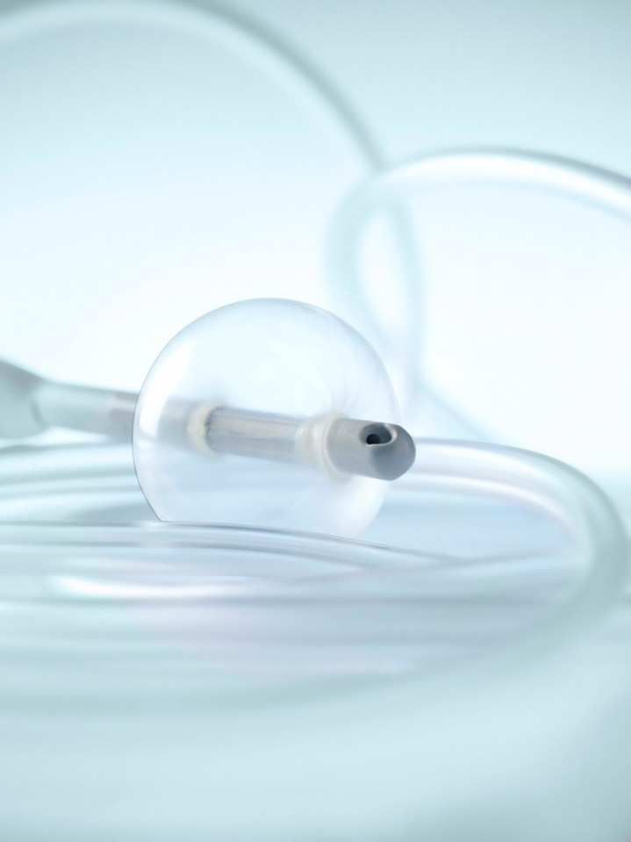
Indications for Trans Anal Irrigation
Neurogenic bowel –
      Spinal Cord Injury
Multiple Sclerosis
Spina Bifida
Parkinson's disease
Chronic faecal incontinence
Chronic constipation

Slide 9

Neurogenic bowel dysfunction score
For all patients with neurogenic diagnosis
Validated Score
Easy to fill in for the patient or HCP
Consider Peristeen if score 10 or over

Slide 10
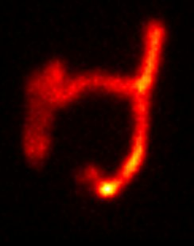
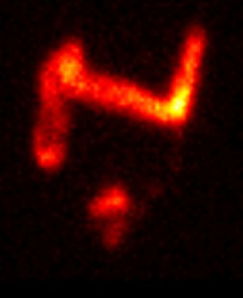
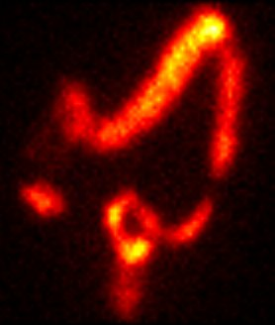
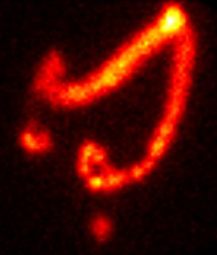
How effective is irrigation?
Before defecation
After ”normal” defecation
Non injured person
SCI patient
Christensen P et al. Dis Colon Rectum 2003; 46: 68-76. Figures 2 & 3 pages 70-71: Reproduced with kind permission of Springer Science and Business Media.
Notes:
In the PhD study in 2001, Peter Christensen looked at the efficiency of transanal irrigation method. He measured how well the colon was emptied as well as the transit time in the colon. In order to that he used radioactived markets to show the effects of irrigation - this is also referred to as the scintigraphic method.
Briefly the scintigraphic method consists of the following steps:
1.Small radioactivated plastic markers which the patient swallows.
2. With time the markers will travel through the digestive system when food and water is digested and absorbed.
3. This means that the markers can be tracked through the large intestine.
4. So what you see on the pictures are the radioactivated markers left in the stool.
The top pictures show the bowel of a person with normal reflexes - before and after defecation - and the lower line show the defecation of an SCI patient. Can you remember the shape of the colon from before - the ascendens, transversum, descendens, sigmoid colon, rectum and anus. The colon of a SCI patient is not placed any differently to the colon of a normal person - it is just the angel of the picture which is different and thus, it makes the colon look like it has a different shape.
The conclusion is that a normal person with normal reflexes empties most of the colon descendens. This is clearly a much more efficient emptying than the SCI patient. After spending ½-1 hour on the toilet, the SCI patient has not been able to have an efficient emptying and this patient still has a high risk of a faecal incontinence episode.
The SCI patient in the scintigraphic pictures is a man, 35 year old and paraplegic. As ”normal defecation” he has used his normal bowel management routine ie. Laxatives and digital stimulation.

Slide 11
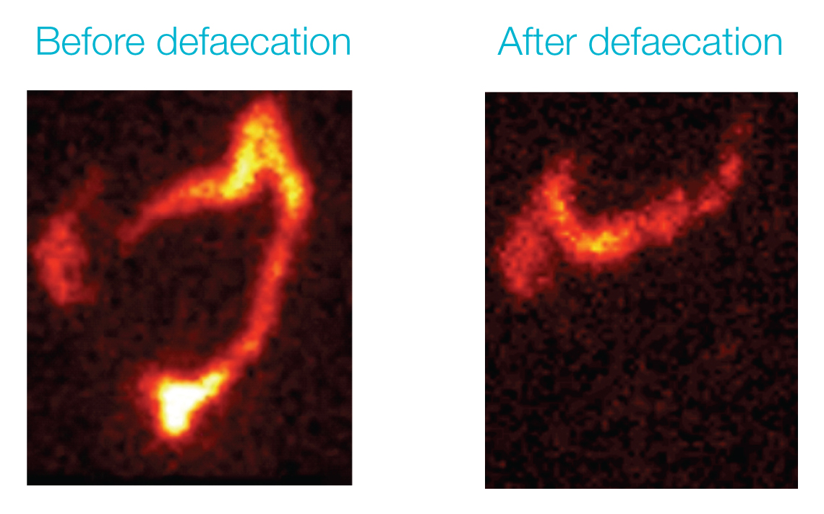
Irrigation effectively empties the contents of the rectum, sigmoid and descending colon
Descending colon
and rectum empty
after TAI
Faeces present in
descending colon
and rectum before TAI
Notes:
These images show the bowel contents of an SCI patient − before and after defaecation using TAI
After TAI, the contents of the rectum, sigmoid and most of the descending colon have been efficiently emptied; the image resembles what would be seen after defaecation in a non-injured person
After TAI, new faeces take an average of two days to reach the rectum, helping users of TAI to remain continent between regular irrigations

Slide 12
Advantages of Peristeen
Relieves symptoms of chronic constipation ie bloating / abdominal pain
Prevents faecal incontinence and accidents
Gives the patient more control over when, where and how
Increases independence confidence, dignity and quality of life
Majority of patients irrigate every other day/third day
Simple and easy to use
Evidenced based

