Slide 1
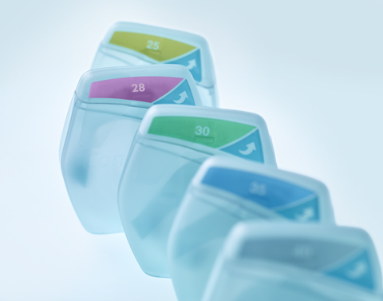
Promoting Dignity and Maximising Independence
Urinary Sheaths

Slide 2

The Facts
Urinary incontinence impacts people’s quality of life…..
Urinary incontinence is a condition in which the involuntary loss of urine is a social and hygienic problem International Continence Society., 2005
Over 14 million people in the UK suffer from bladder control issues
Buckley and Lapitan, 2009
People are left feeling…….
Notes:
Bring this to life, rather than presenting the slide, use it to stimulate conversation.
Encourage discussion around how urinary incontinence can affect the way a person feels. Has anyone got an example of a patient they’ve treated for example?
Typical answers are:
Distressed
Embarrassed
Isolated
Helpless
Low self-esteem
Loss of personal control
Desire for a normal life
Encourage discussion around impact at a personal level.

Slide 3
Impacts of Urinary Incontinence
Incontinence/Retention
Physiological
Psychological
Social
Distress
Withdrawal from everyday activity
Ruined clothing and bedding
Need for surgery
Moisture lesions.
Embarrassment
Inconvenience
Low self esteem
Desire to be normal.
Loss of confidence
Avoidance of social activities
Strain on personal relationships.
Notes:
People suffering from Urinary continence will obviously suffer from physiological outflow of urine, but the psychological and social elements are much stronger. Patients are afraid to be different – to have accidents – to smell. We should not underestimate the effects of incontinence on an individuals quality of life.

Slide 4
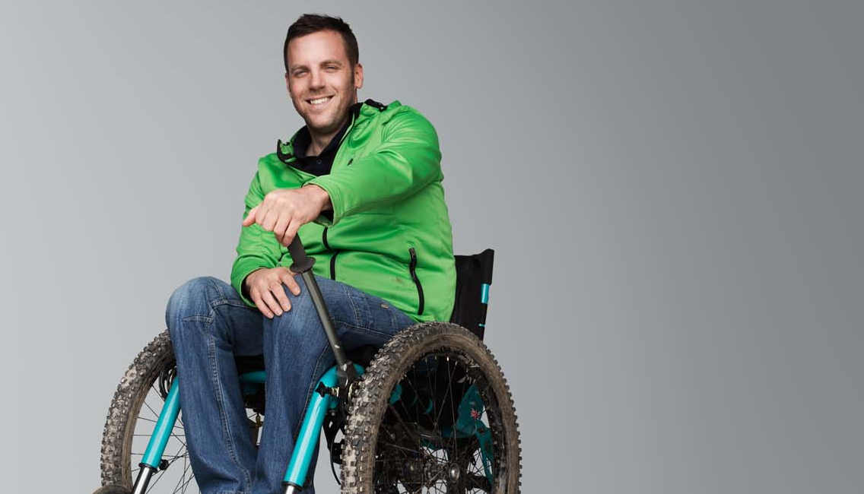
How can we promote dignity and maximise independence?

Slide 5

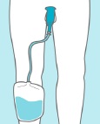
Sheaths are an option for men….
A sheath is a device fitted over the penis with an outlet port, allowing it to be connected to a urine drainage bag.
Available in various, shapes, sizes and materials.

Slide 6

When they work what’s the impact?
What are your experiences of sheaths?
Let’s look at maximising their success and impact
Who’s suitable for sheaths?
Notes:
Slide to drive conversations – get the nurse to think specifically about their department:
Typical answers:
Who’s suitable:
Spinal Cord Injury
Multiple Sclerosis
Spina Bifida
Parkinson’s disease
Prostate Patients
Pad users
Male patient with dribble
Useful for dribble incontinence through to larger volumes
Sheaths can also be used at night time to manage nocturia and functional incontinence.
Compile the list in the room to refer back to
What are your experiences of sheaths?
They fall off
When they work they work well
When they work, what’s the impact?
Good solution
Provide dignity
Non invasive
Flexible option
Reinforce these positives
If no experience skip on

Slide 7

How do we move forwards?

Slide 8
Picking the Right Patient – What assessment should be done prior to using a sheath?
If suffering from frequency and urgency incontinence, a UTI must be excluded and/or treated appropriately prior to sheath use.
Ideally, there should be a minimum penis shaft length of approximately 4cm (when sitting upright) for a sheath to be successful.
The patient should have good skin integrity.

Slide 9
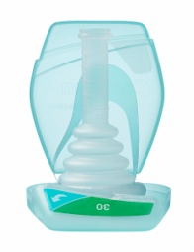
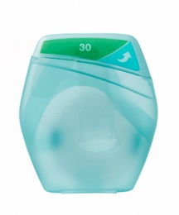
Conveen Optima
Picking the right option
69% of patients preferred sheaths over pads to manage their urinary incontinence.
Notes:
Need link to research

Slide 10
Conveen Optima
Picking the right option
97% of Healthcare Professionals agreed that Conveen Optima was easy to apply using gloves.
67% of patients indicated Conveen Optima as their overall product preference.
Notes:
Need link to research

Slide 11
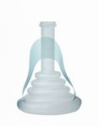
Conveen Optima Features and Benefits
Conveen Optima
Feature
Smart Pack
Feature
Double strip-grip
Features
100% Silicone
PH balanced adhesive
Features
Push ring connector
Sure grip-ribs
Anti-kink bellows
Benefits
Discreet packaging and non-medical in appearance.
Designed to look like a consumer product (mints/ dental floss)
Easily carried by the end-user
Sheath is kept in premium condition
Colour coded for easy identification of sizes.
Benefits
Easy to apply whilst wearing gloves (clinically proven)
Facilitates smooth application
Ensures sheath is fitted securely
Reduces product wastage – right first time
Benefits
Inert material – has allergenic properties
Silicone retains its memory so allows it to be packed discreetly
Comfortable as its soft and flexible
Reliable and skin friendly
No residue left on skin after removal
Benefits
Aids connection and disconnection
Helps to prevent leakage
Prevents the occlusion of urine to prevent backflow
Minimal risk of kinking and disconnection from a UDB
Ensures consistent drainage
Notes:
Get the product out, pass one to each nurse and talk through this slide with the product
Specifically highlight:
Push-ring connector – Aids connection/disconnection to UDB
Sure grip ribs – Provides additional grip
Turquoise double-strip grip – Allows ease of application when wearing gloves
Anti-kink bellows – Prevents blow back of urine.
pH-balanced adhesive – Reliable and skin friendly leaving no residue

Slide 12
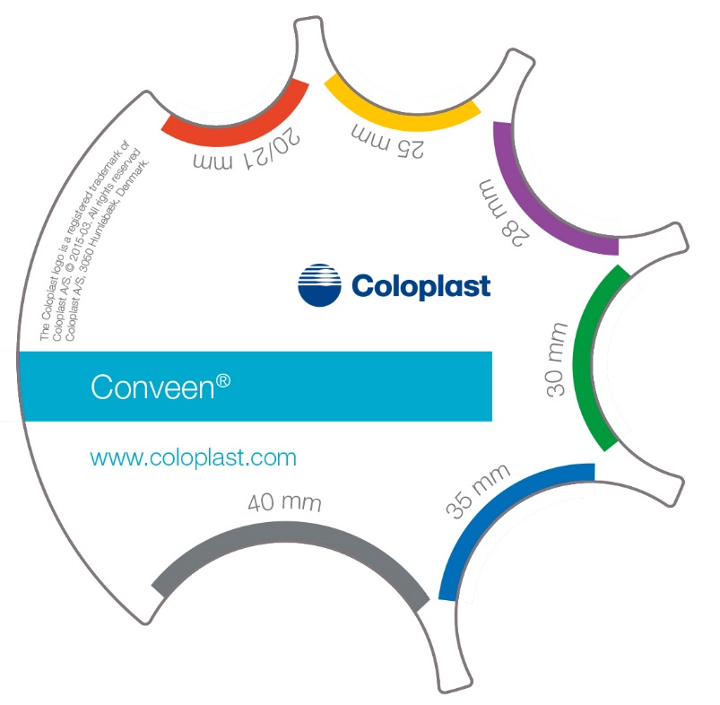
Getting the right size….
Use the Conveen Measuring guide to select the correct size of sheath for ALL patients.
Do not guess!
Measure the penis mid shaft or at the widest point.
This is the MOST important part of fitting a sheath.

Slide 13
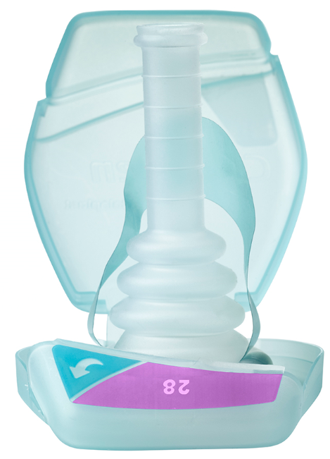
Conveen Optima is available in various sizes and now includes a new size - 28 mm
Conveen Optima – Short |  | Conveen Optima - Standard
Diameter | Product Code | Diameter | Product Code
21mm | 22121 | 25mm | 22025
25mm | 22125 | 28mm | 22028
30mm | 22130 | 30mm | 22030
35mm | 22135 | 35mm | 22035
Shorter length suitable for the majority of patients |  | 40mm | 22040

Slide 14
Top tips for fitting Conveen Optima
Remember the penis size may change according to temperature, time of day, position and any weight change of the patient.
If the penis is in between 2 sizes of Conveen Optima, select the smaller size.
Ensure skin is clean and completely dry and don’t use any talcs, creams, moisturisers or shower gels.
Ensure a smooth application with no ridges or wrinkles.
Notes:
Demonstrate this on Boris, once everyone is agreed on size, fit sheath.

Slide 15
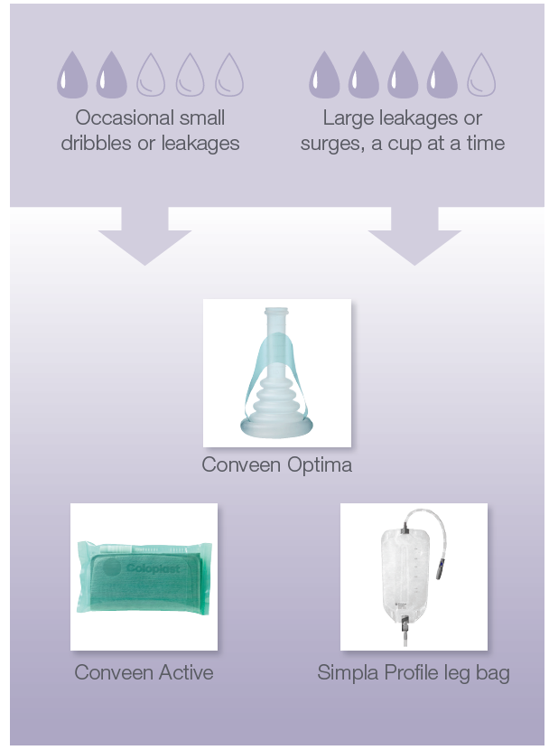
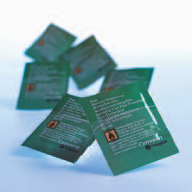
Getting the right UDB and Accessories
Prep wipes
    Fully prepares the surface of the penis removing any residues
    Double function of film left on surface – aids adhesion as well as preventing irritation and trauma upon removal.
    Conveen Prep Wipes are alcohol based and should only be used on unbroken skin.

Slide 16
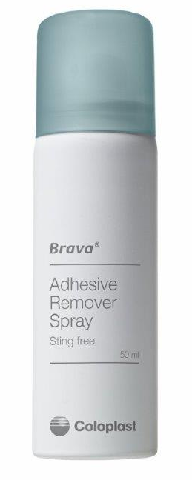
Removal of Conveen Optima
Conveen Optima
Conveen wear time is a maximum of 24 hours.
Detach the sheath from urine bag connector.
Carefully roll it off the penis.
Warm, soapy water can be used to help remove the sheath if necessary.
Brava adhesive remover spray is now
licenced for continence care and can be used for removal - code: 12010.
Dispose of the sheath in a bin.
The Smart pack can be recycled.

Slide 17
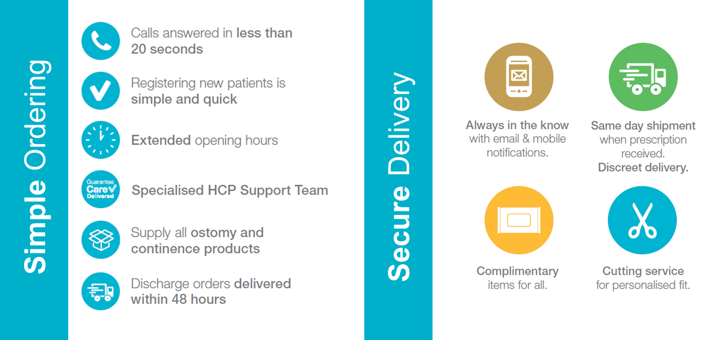

Notes:
Adapt to your audience:
Hospital – Give supplies of correct size from stock and UDB homepack and register on Charter for ongoing supplies.
Community – Use Starter pack at patient’s house / clinic and then call Charter to register for ongoing supplies.

Slide 18
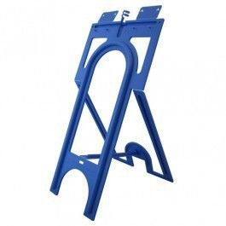
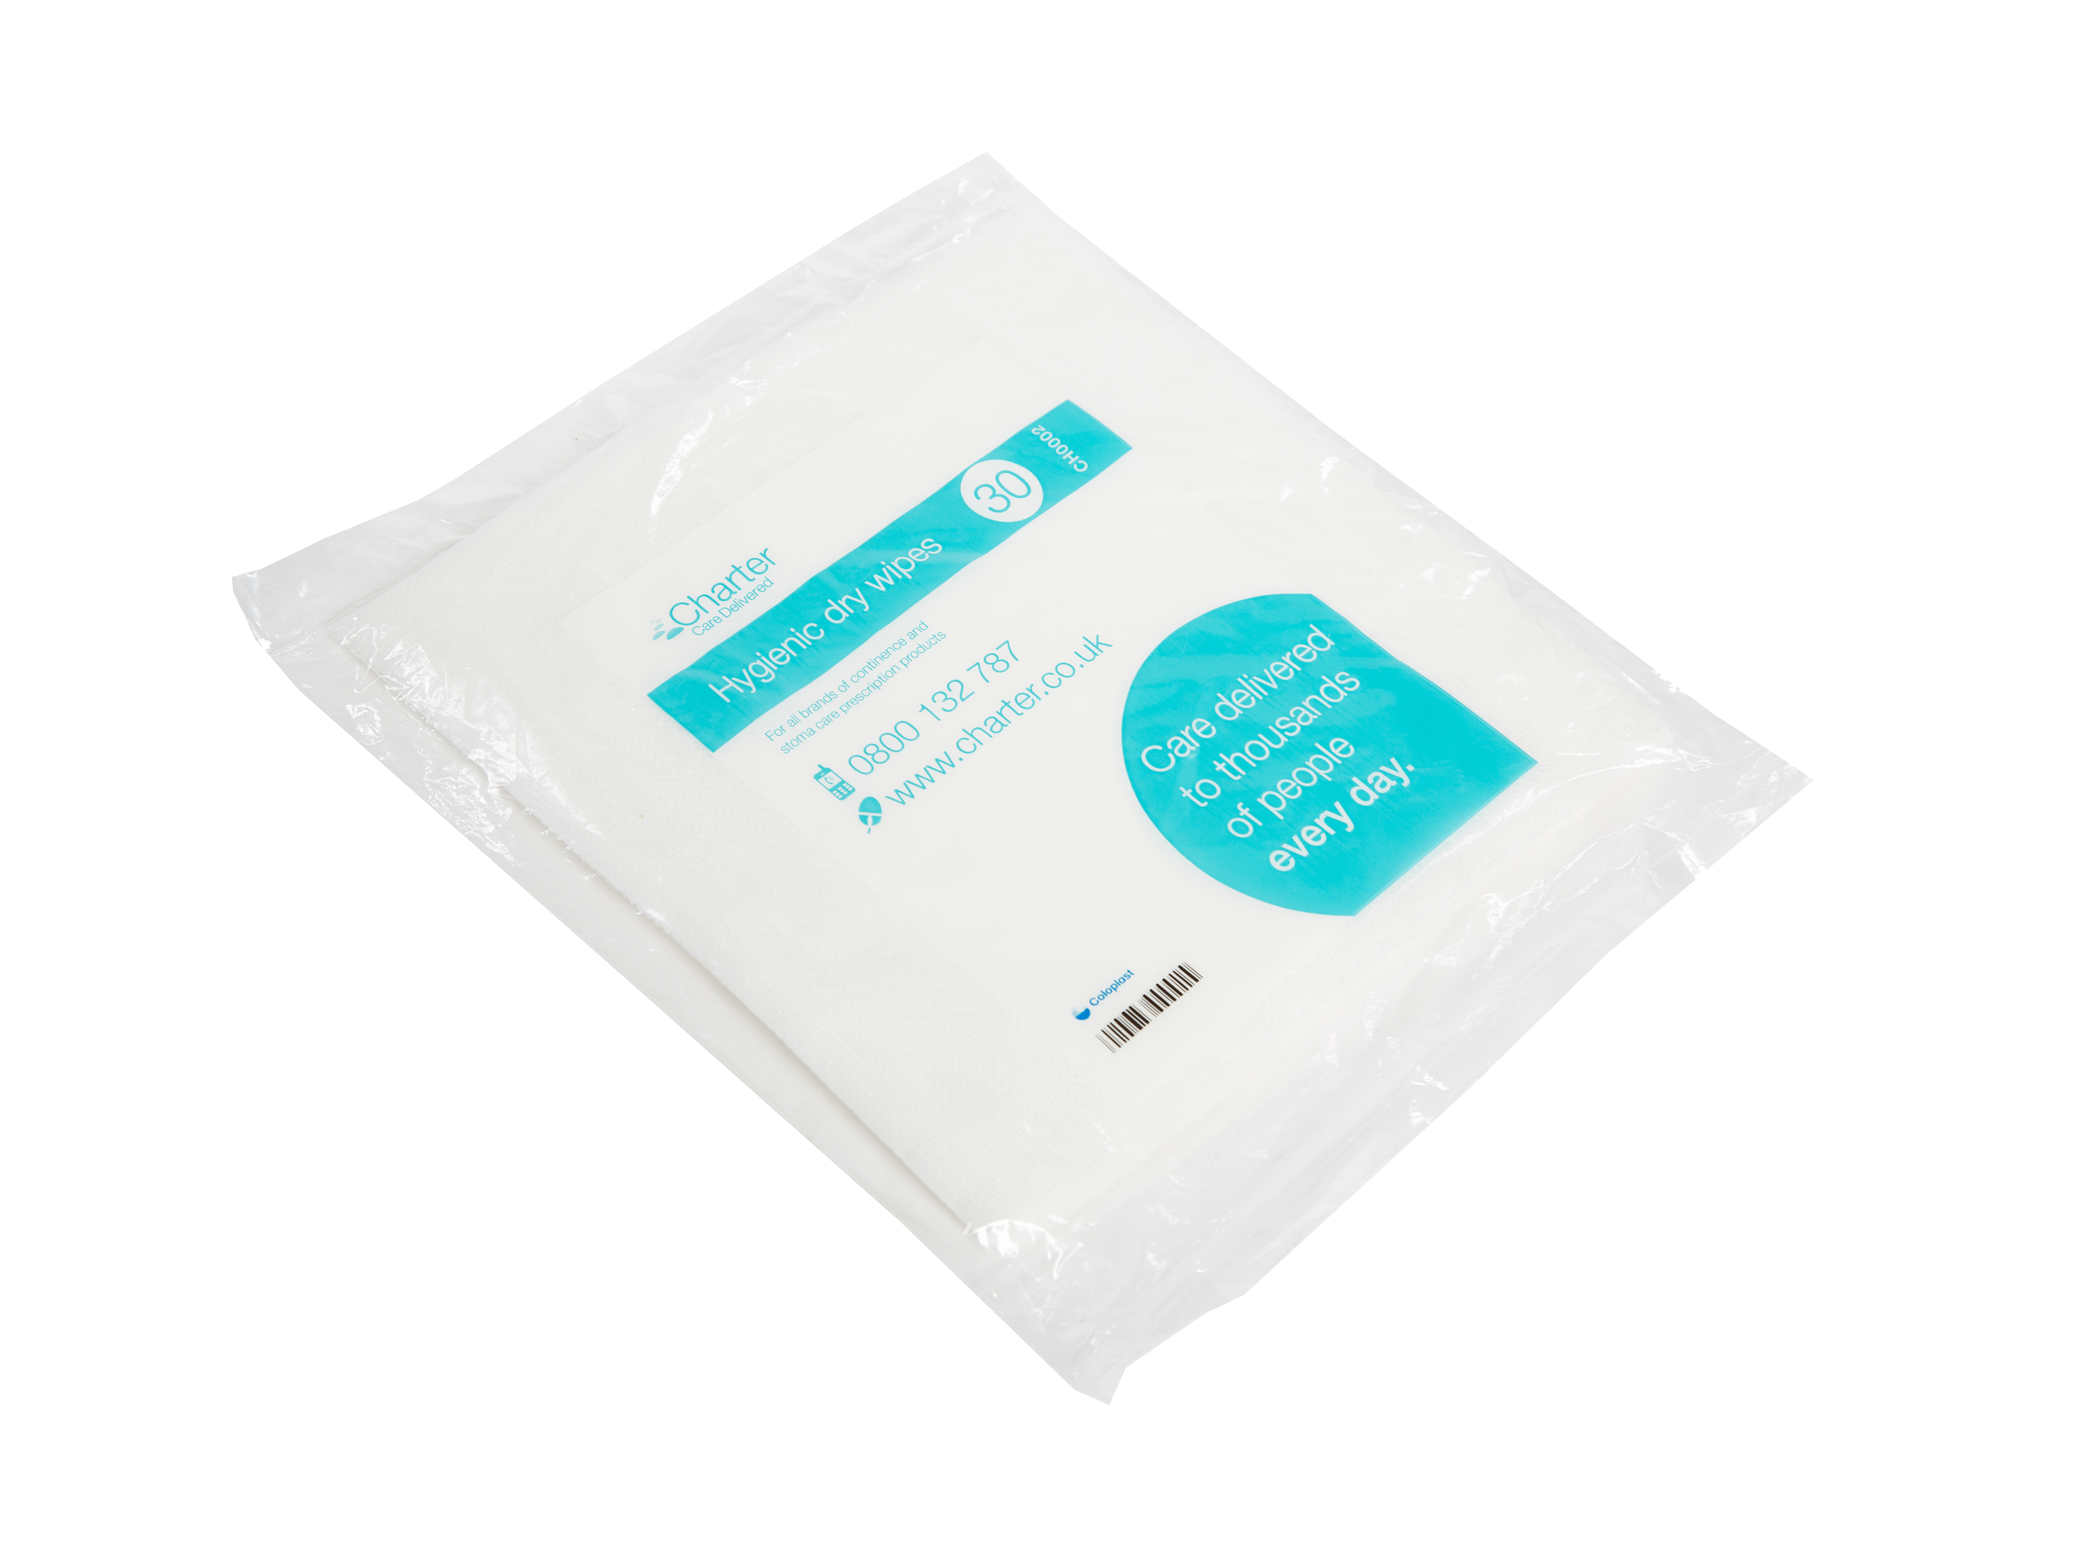
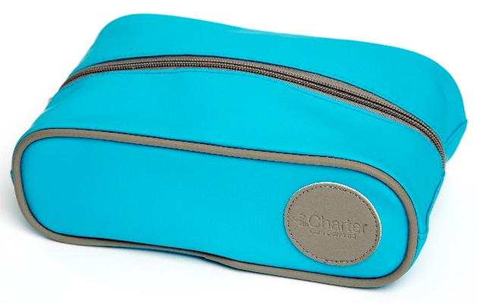
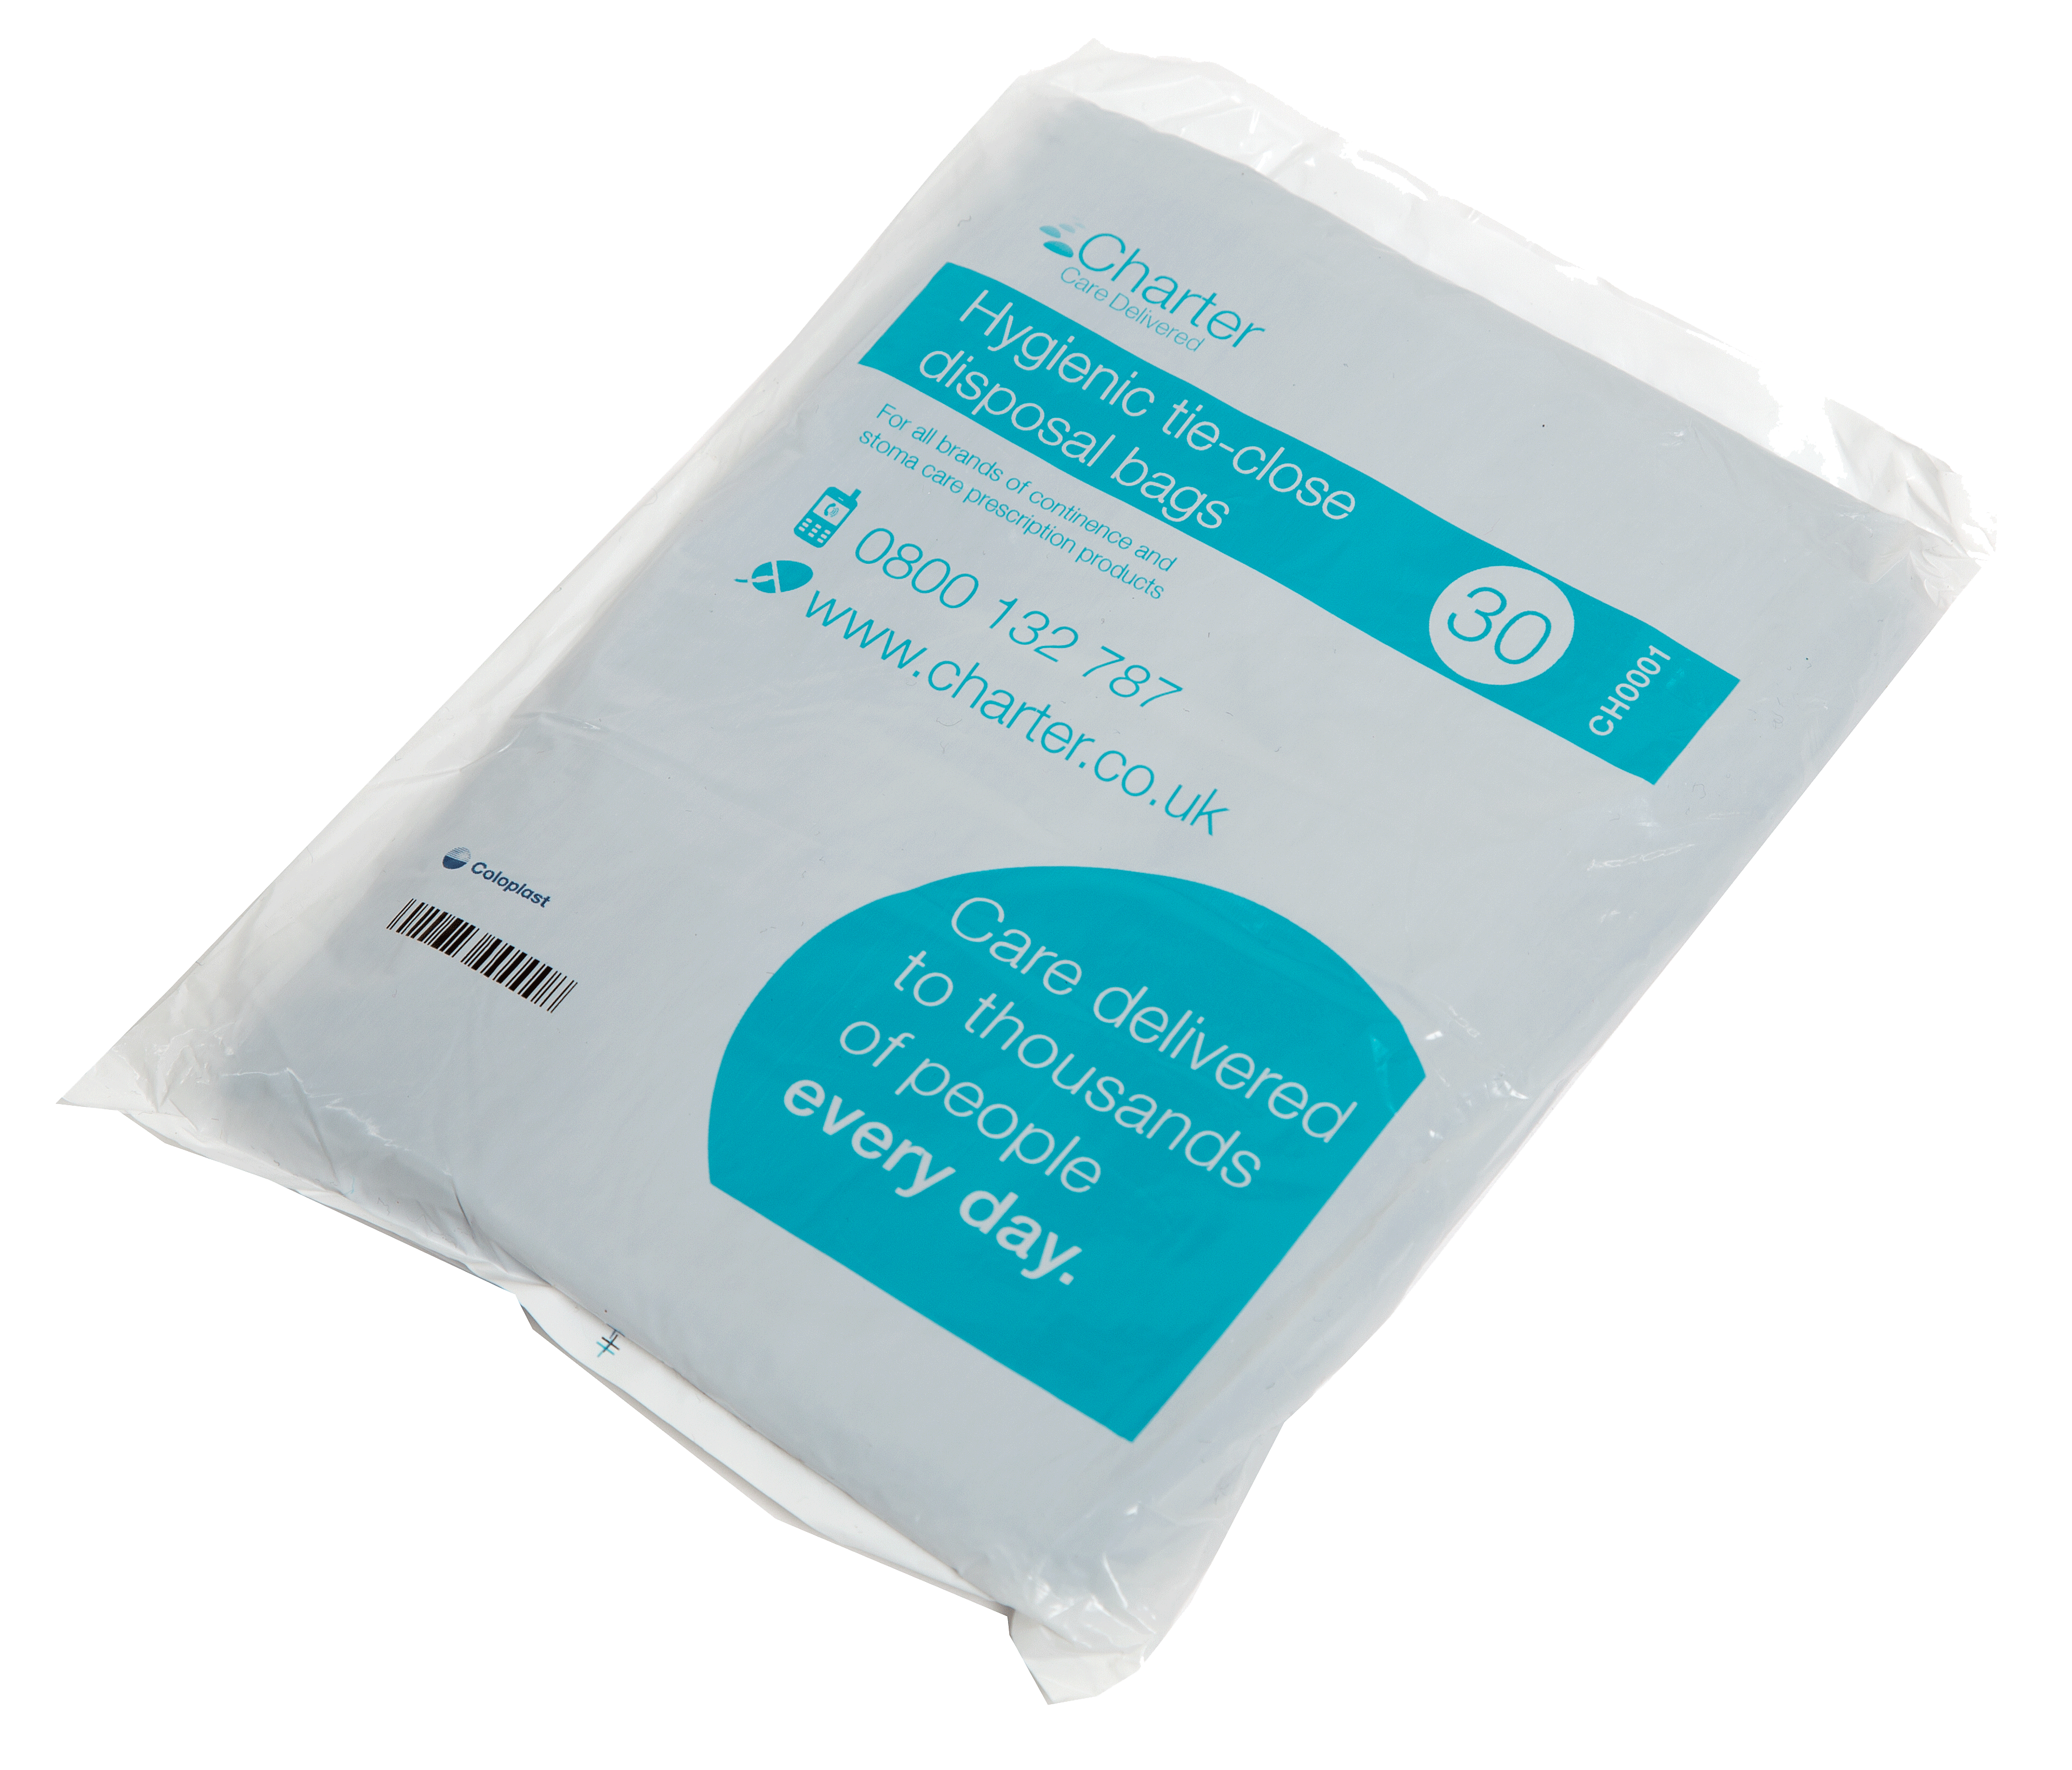
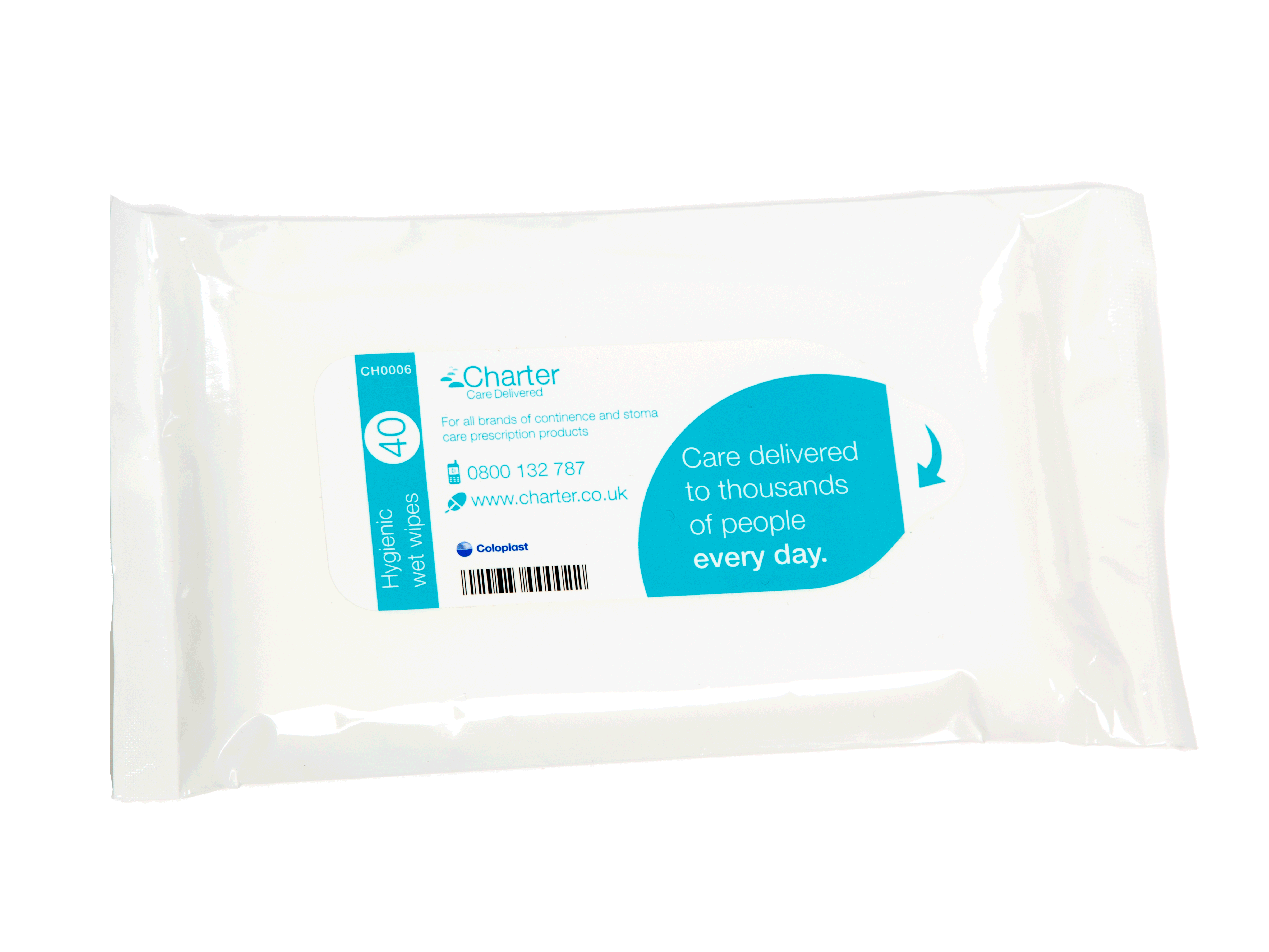
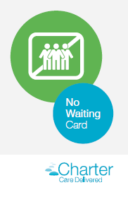

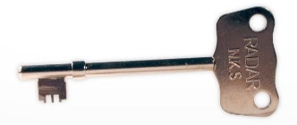
Charter – 0800 374654

Slide 19

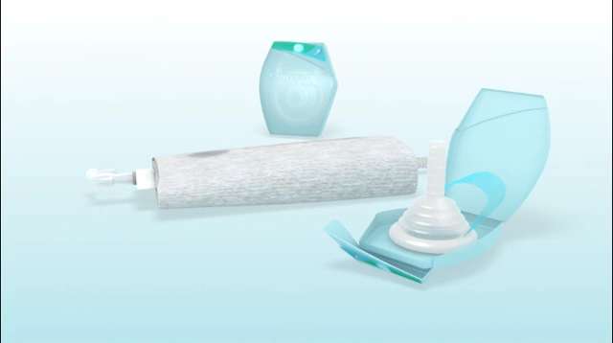
Consumer video
Animation video

Slide 20
Let’s practise.....
Notes:
Get Boris out and get nurses to a have a go…..

